Slide 1
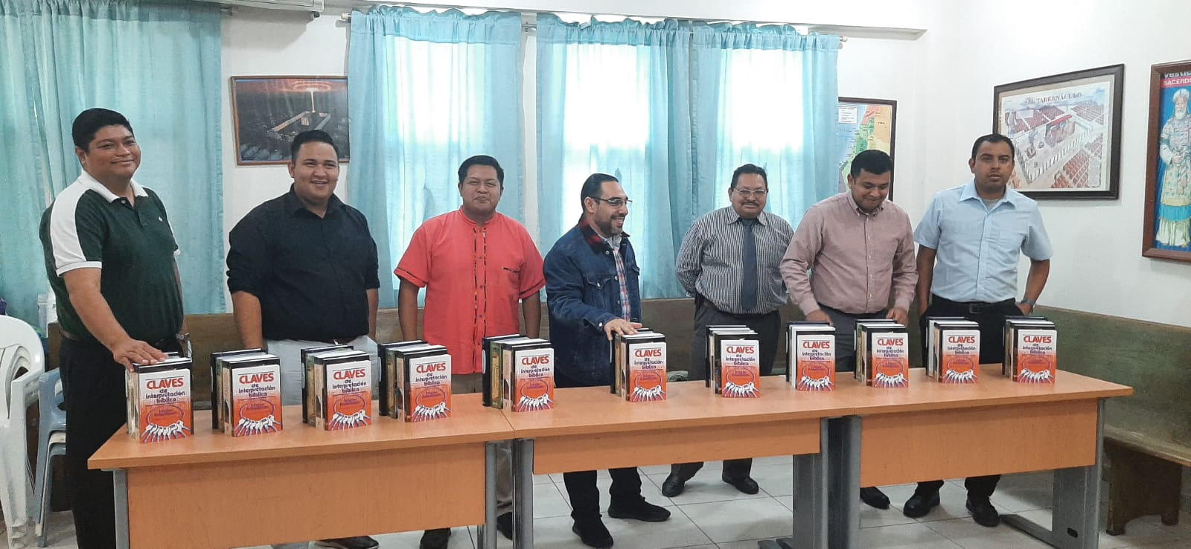
Quarterly report April – June 2023 Monterrey school of preaching A Life Preparing Workers For The Lord
www.monterreyescueladepredicacion.com

Slide 2
MONTERREY DAY AT Brownwood Tx
We started the second quarter of the year with our traditional “Monterrey Day”. This time, Austin Avenue church of Christ in Brownwood Tx was the host. We really appreciate all kindness and love in Christ Jesus showed us by the brotherhood.
Also, we are so thankful with the Mission Committee of Austin Avenue church of Christ at Brownwood, Tx, which was in charge of our lodging.
From Monterrey came Jesus Conrado (Director) and his wife; Luis Rodriguez and Salvador Gonzalez (Sierra Ventana COFC Elders).
Likewise were among us David Cardenas and his wife Rosalinda our mentors which encouraging us to continue serving the Lord Jesus Christ.

Slide 3
MONTERREY DAY AT Brownwood Tx
We presented a brief report about the main activities of the school during 2022.
Also we presented a short video where every student presented their spiritual background, presented their families, talked about their plans after graduation, etc. Especially each one of them expressed their thankfulness for the support they have received to dedicate two years of preparation on God´s Word.
Bill Pursch gave us a special report about the work that have done for more than twenty years as chair man of Mission Committee for Monterrey School of Preaching, and announced the new one: Brother Mario Luna. Also he speaks about how the future of the Scchool looks like
Roland Bowen gave us a financial report.
Thank you all for your fellowship. We enjoyed it.

Slide 4
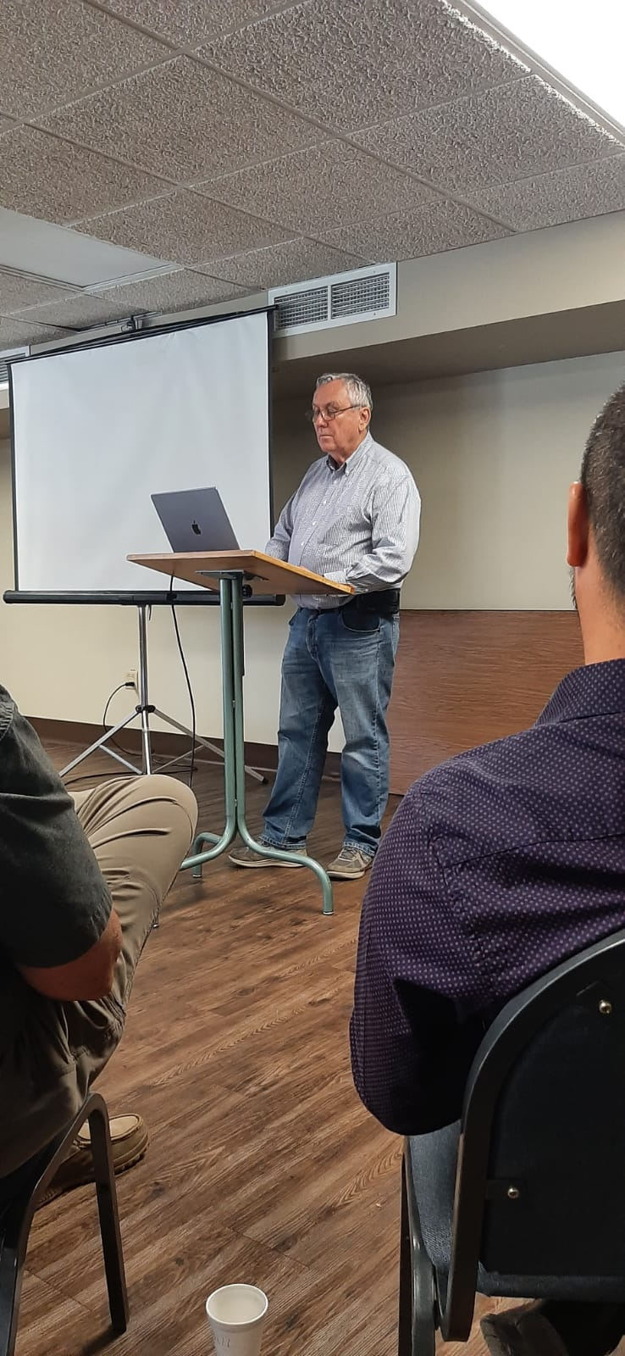
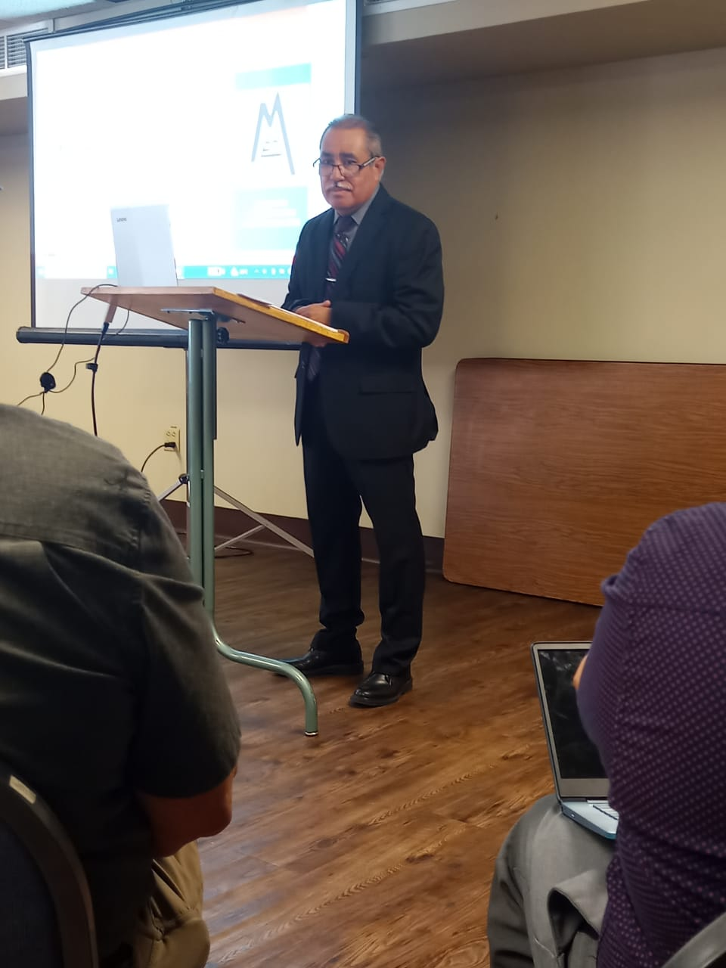
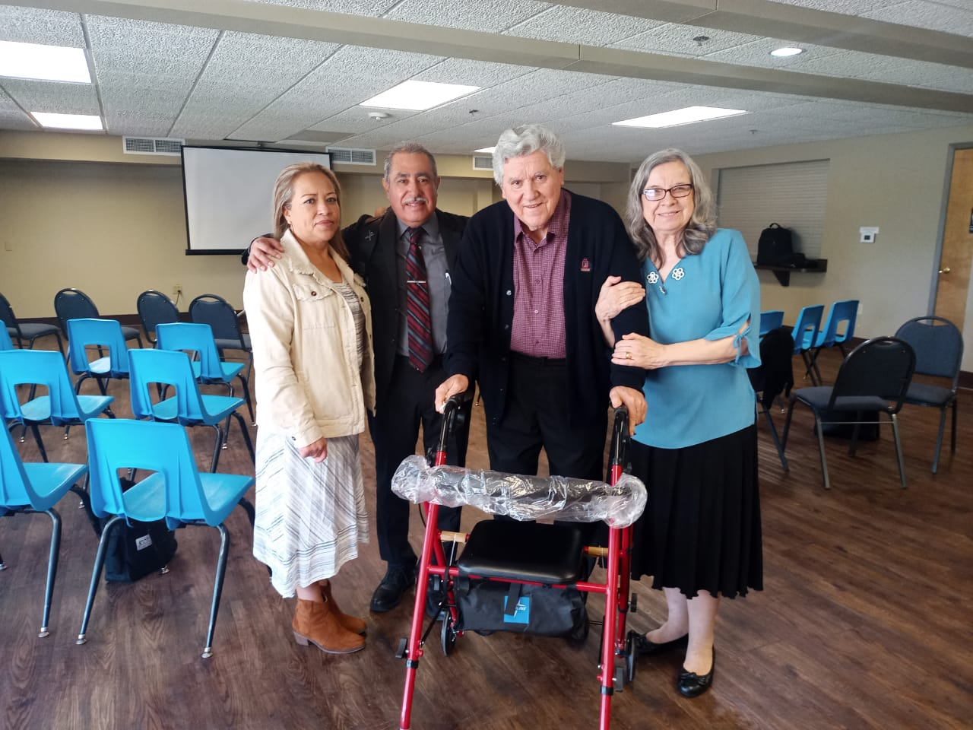
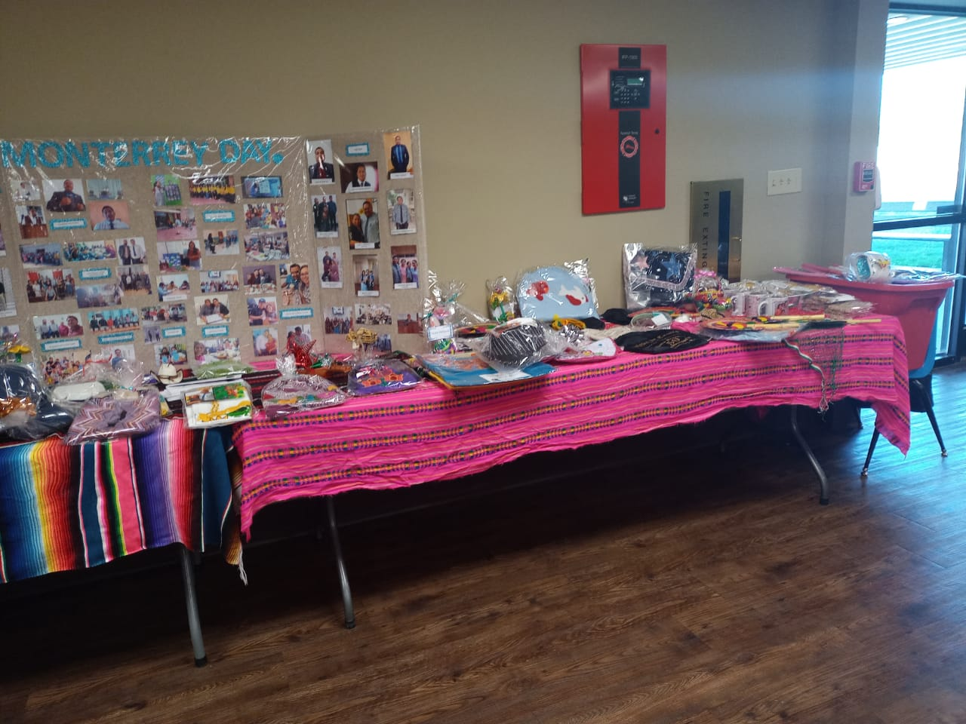
Some pictures of MONTERREY DAY 2023

Slide 5
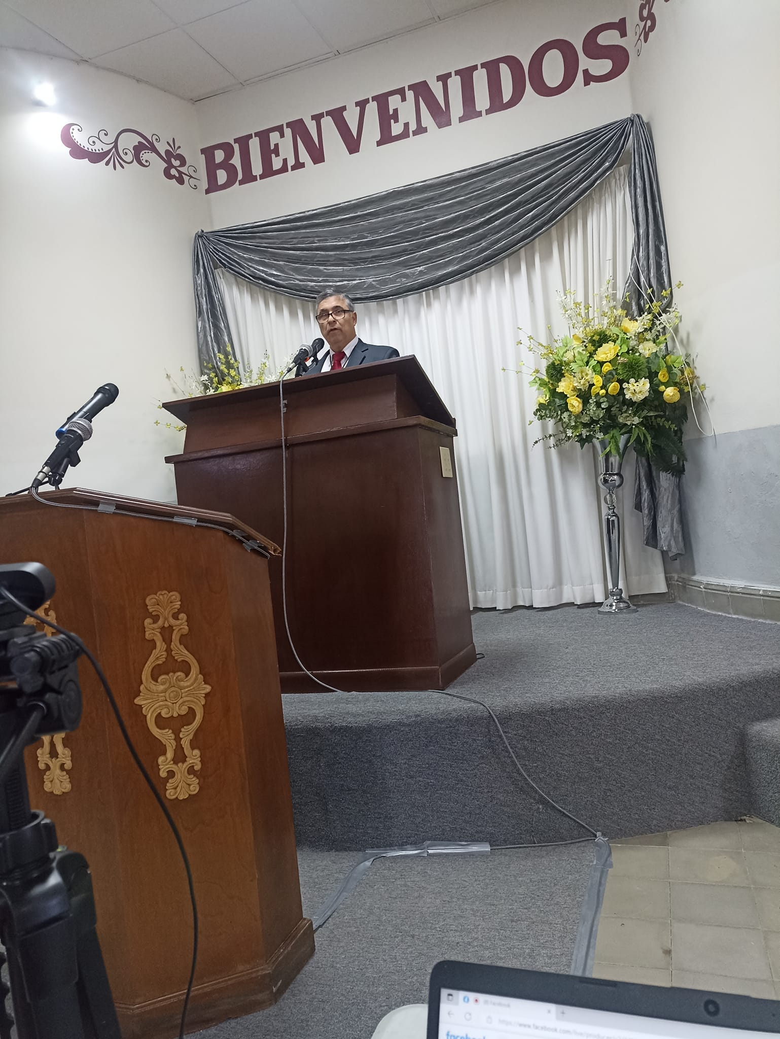
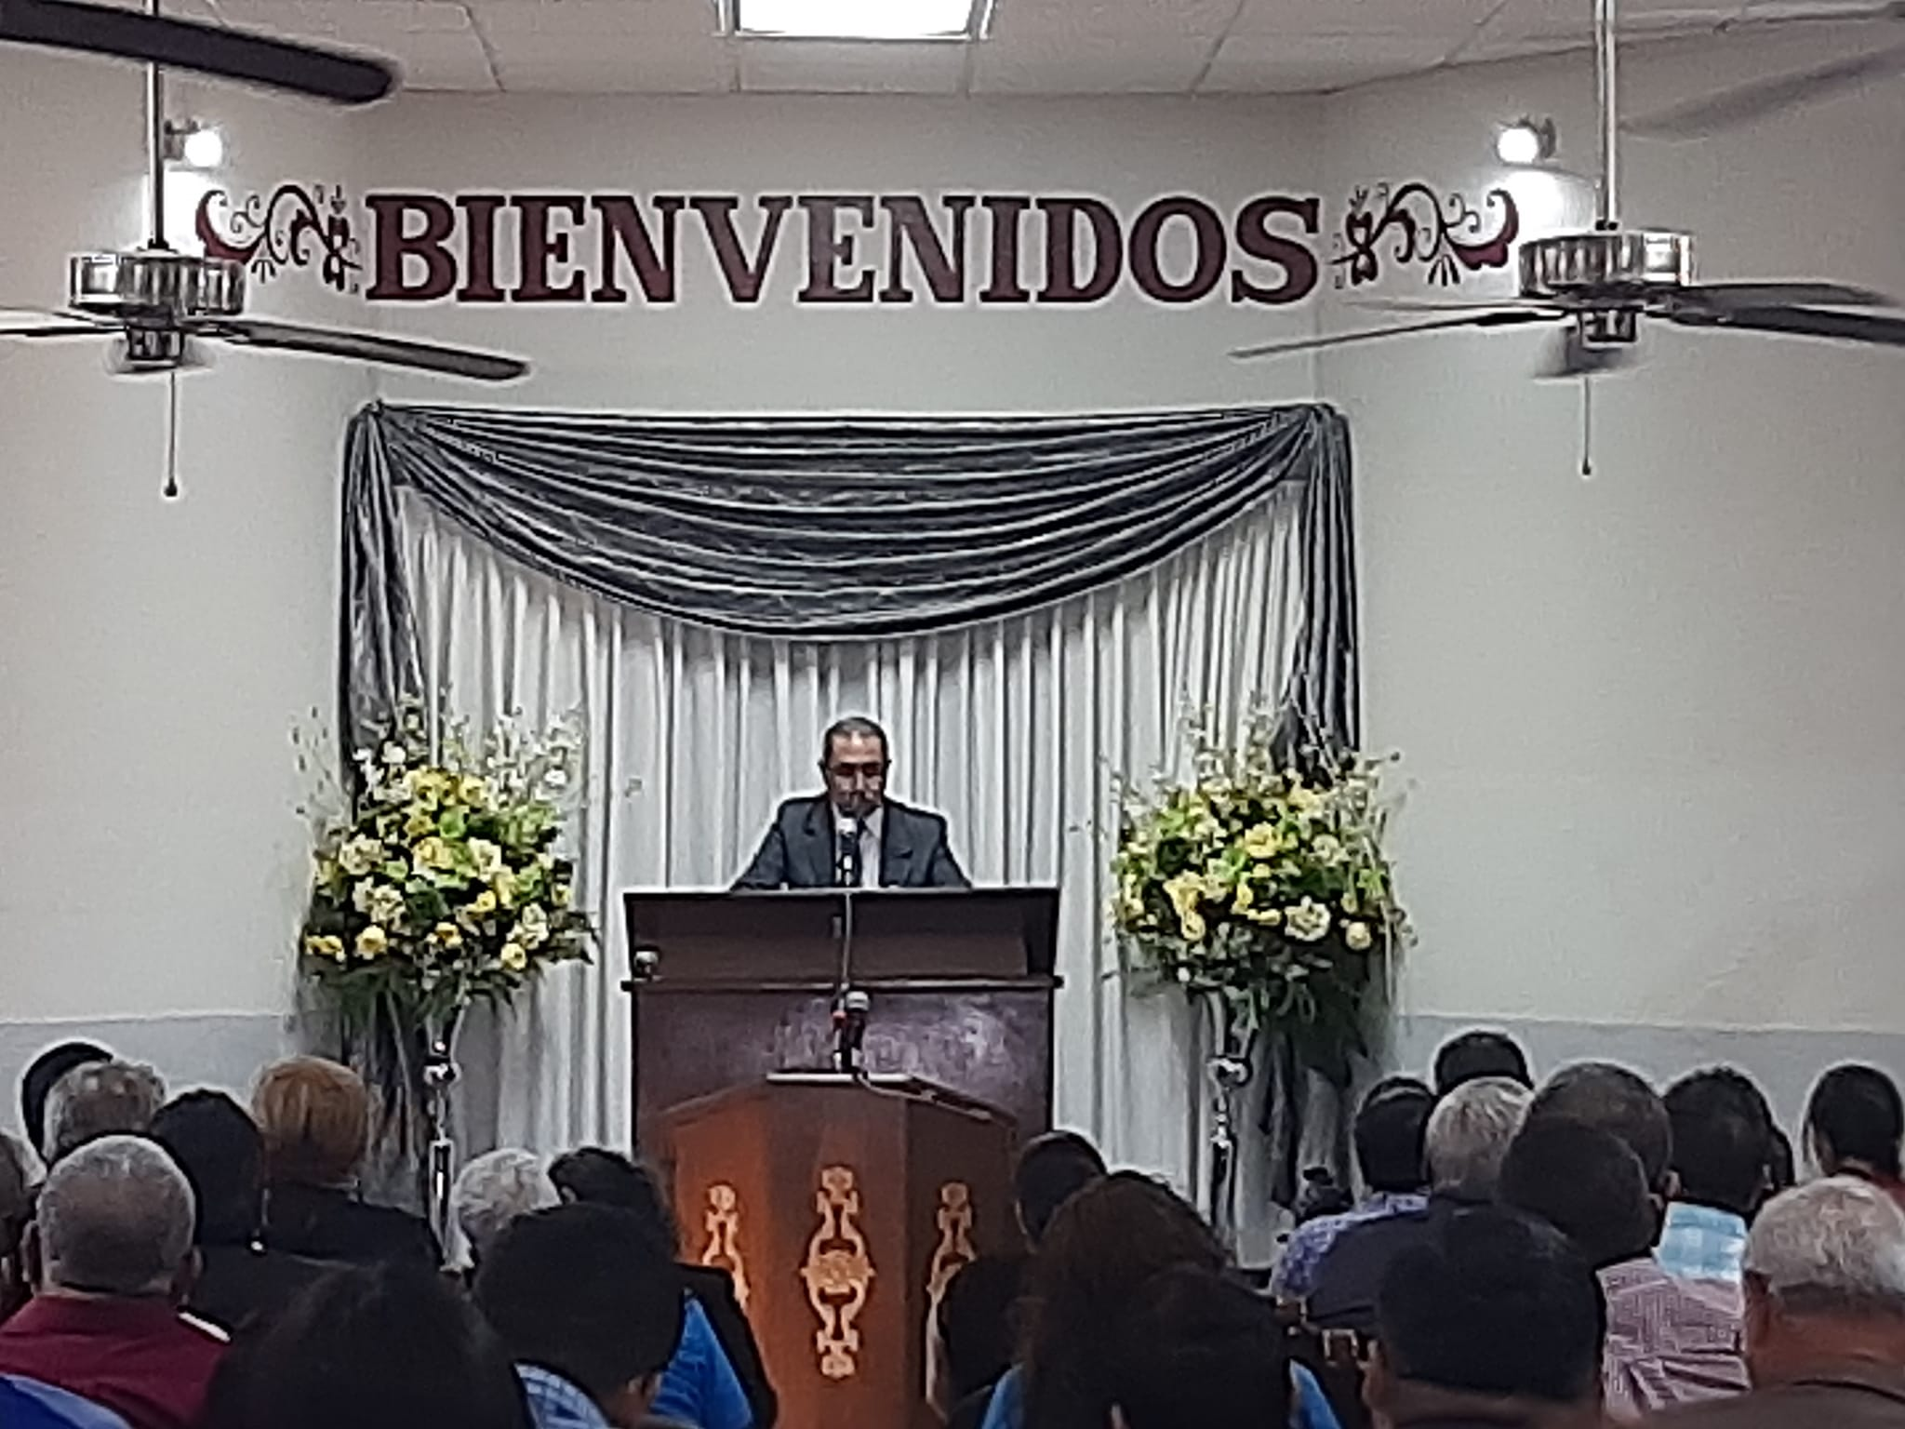
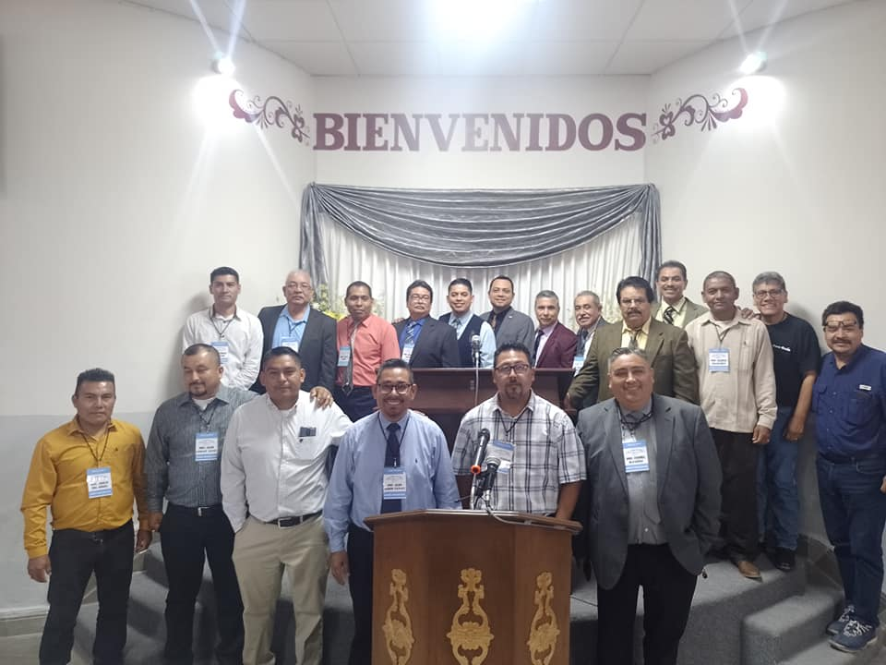
Lectureships and campaiGns
Throughout the year, usually there are Lectireships and Gospel Meetings where as instructors we are invited as speakers. These events are opportunities to promote the school.
North East Lectureships – Matamoros, Tam. México
On April 11 to 13, we had the opportunity to preach the Word at Matamoros Tamaulipas. Salvador González and I, within others speakers, were so blessed by the topics presented and the Christian fellowship.

Slide 6
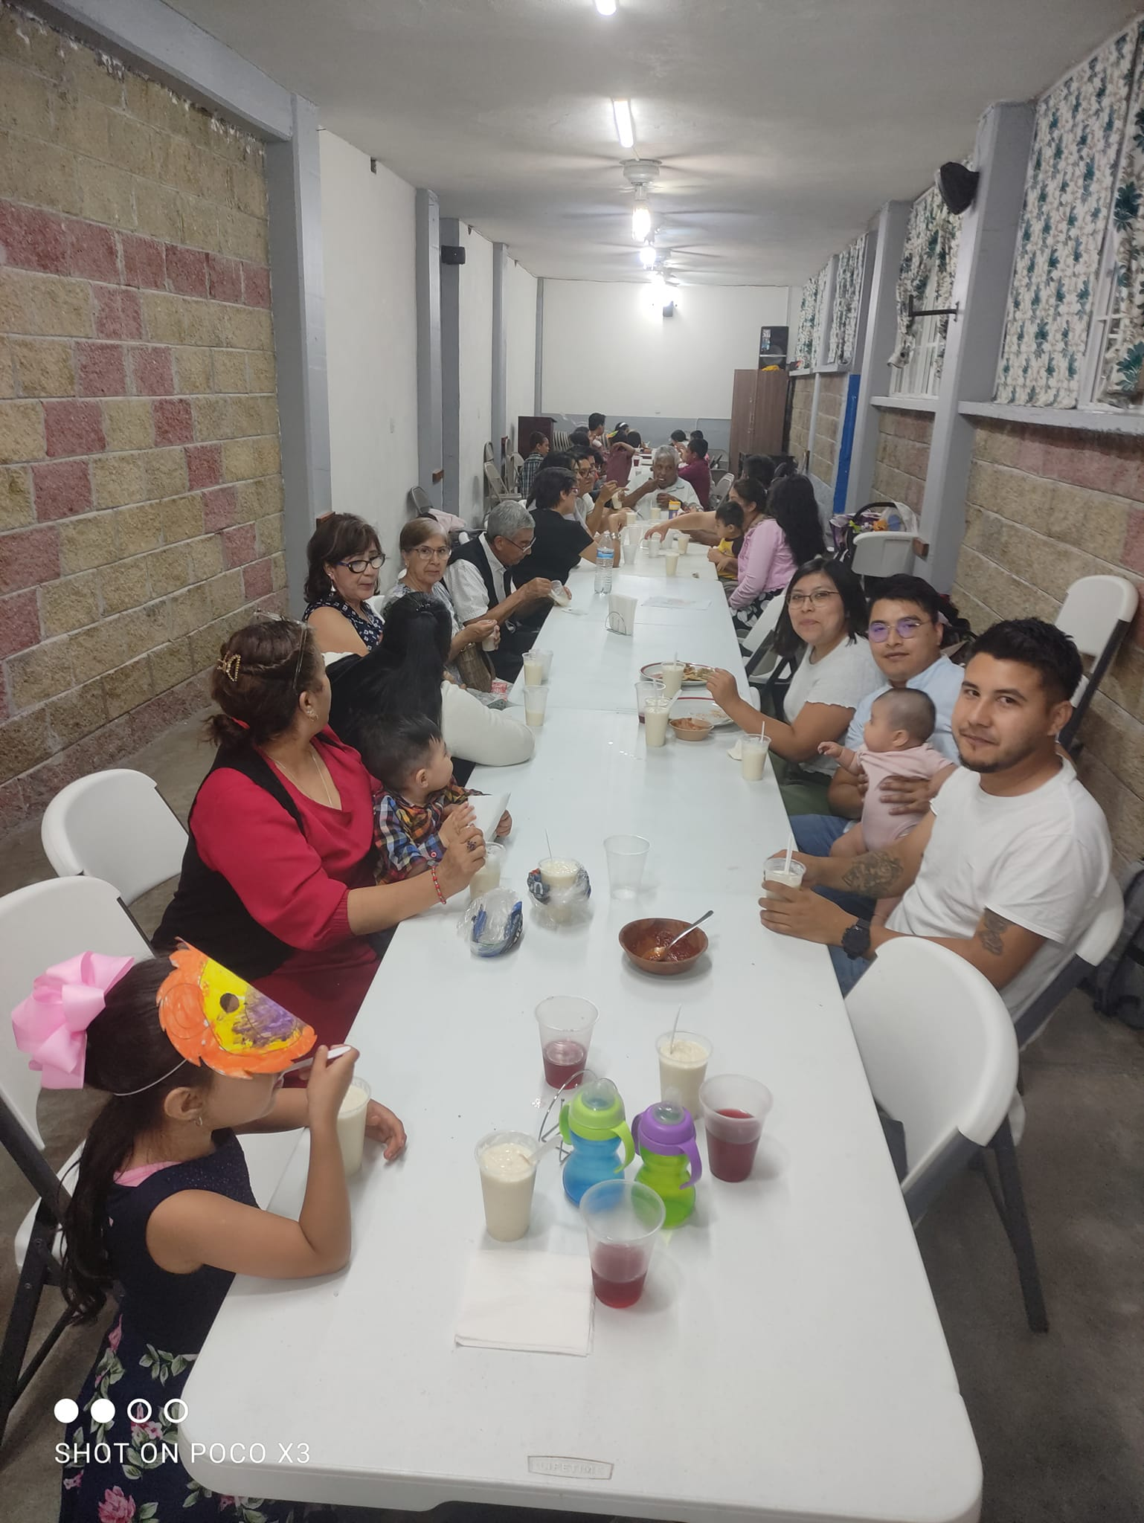
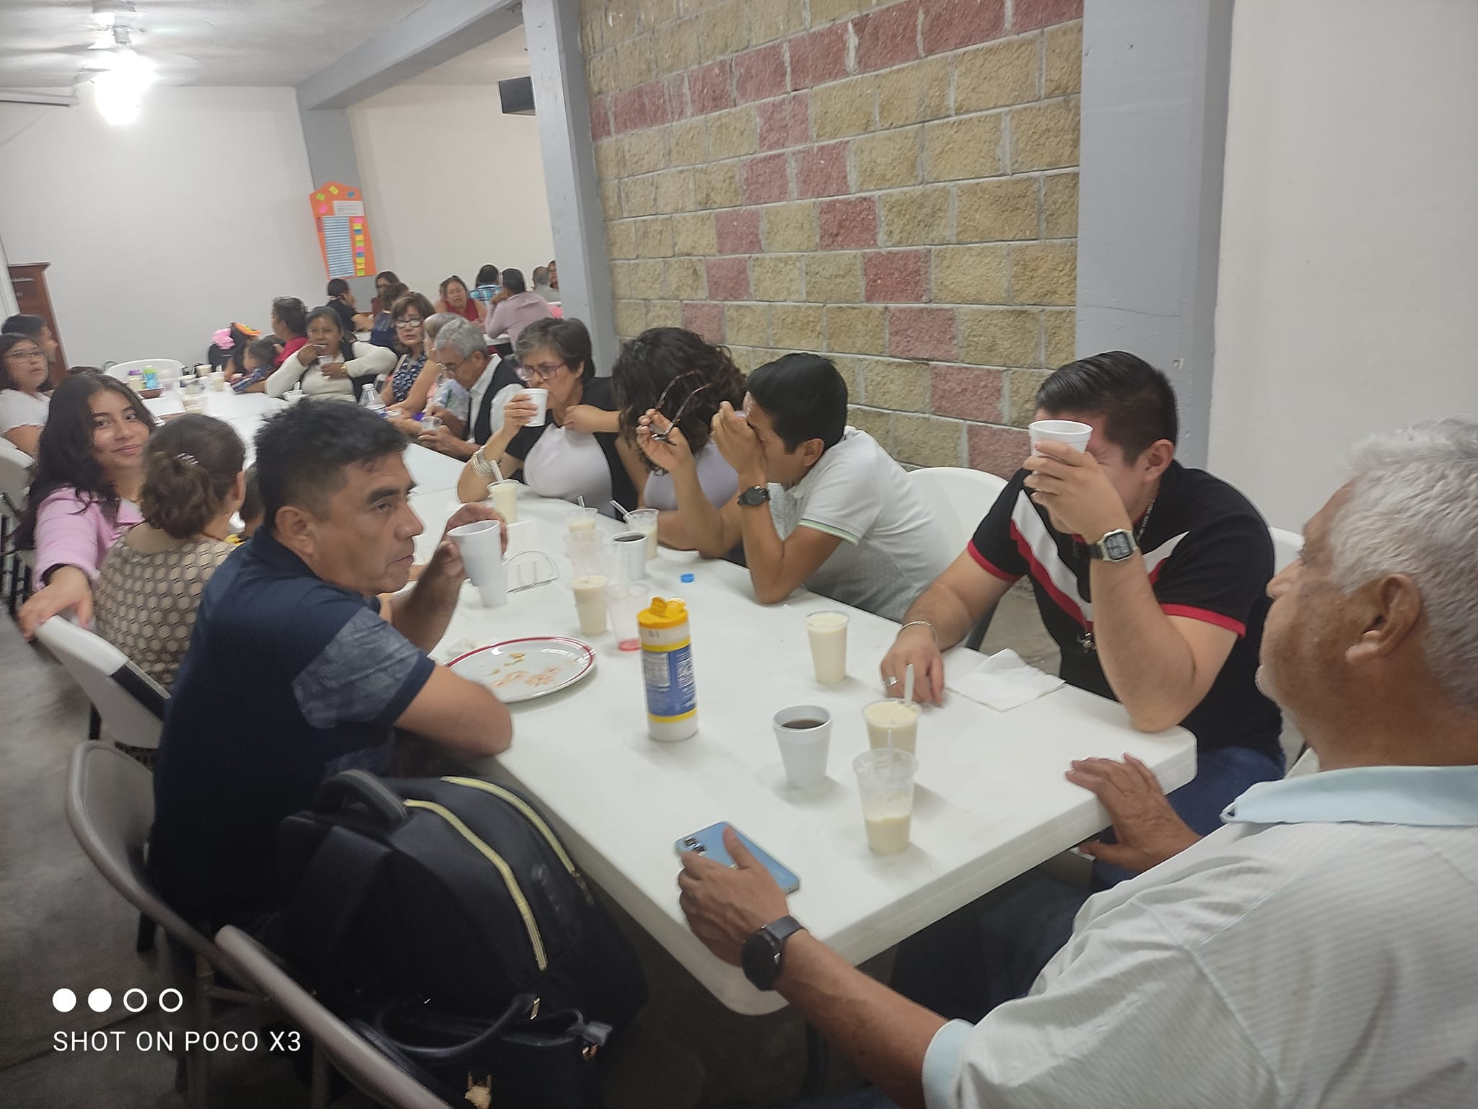
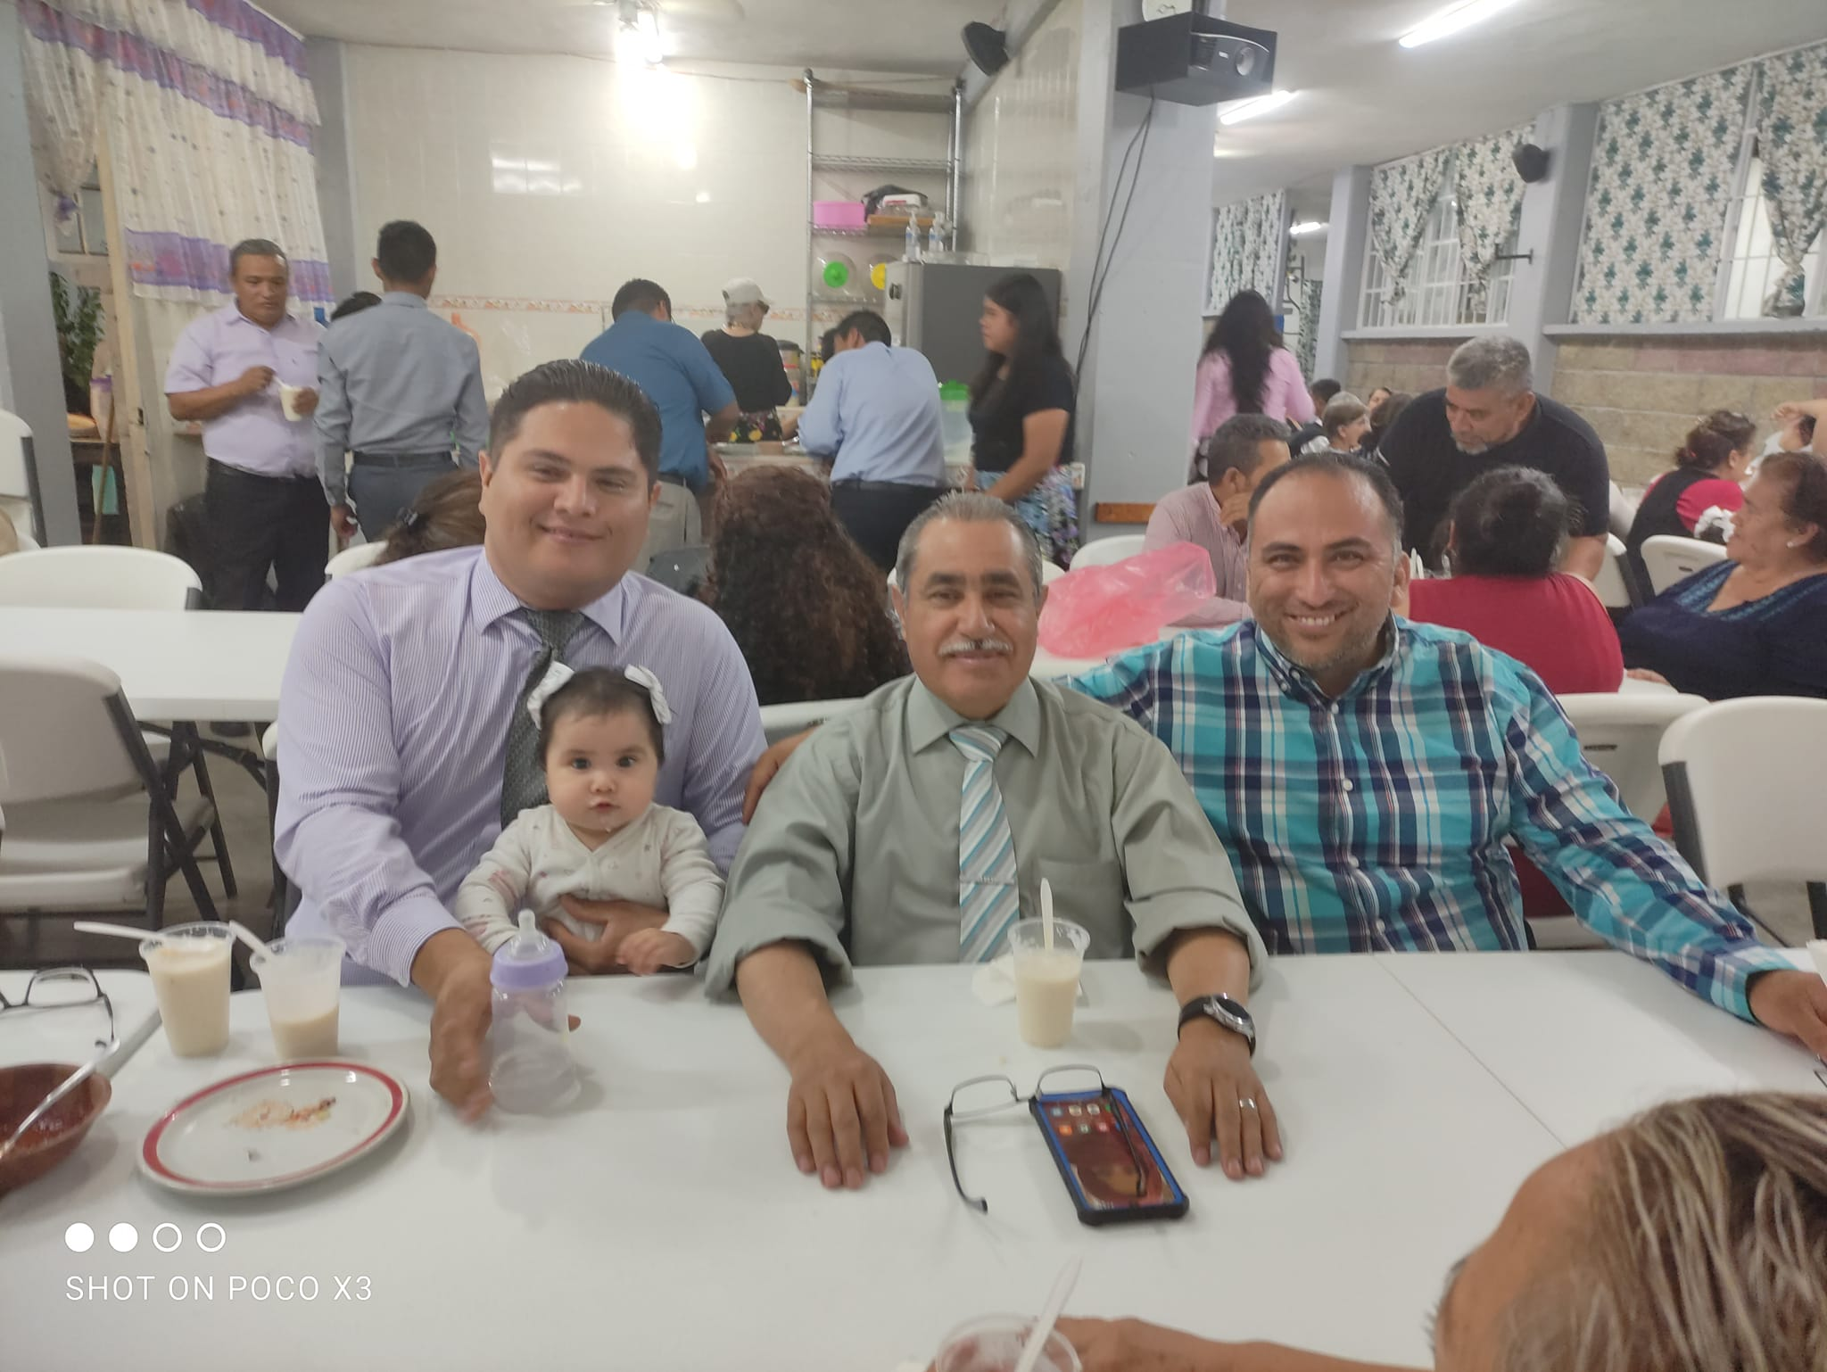
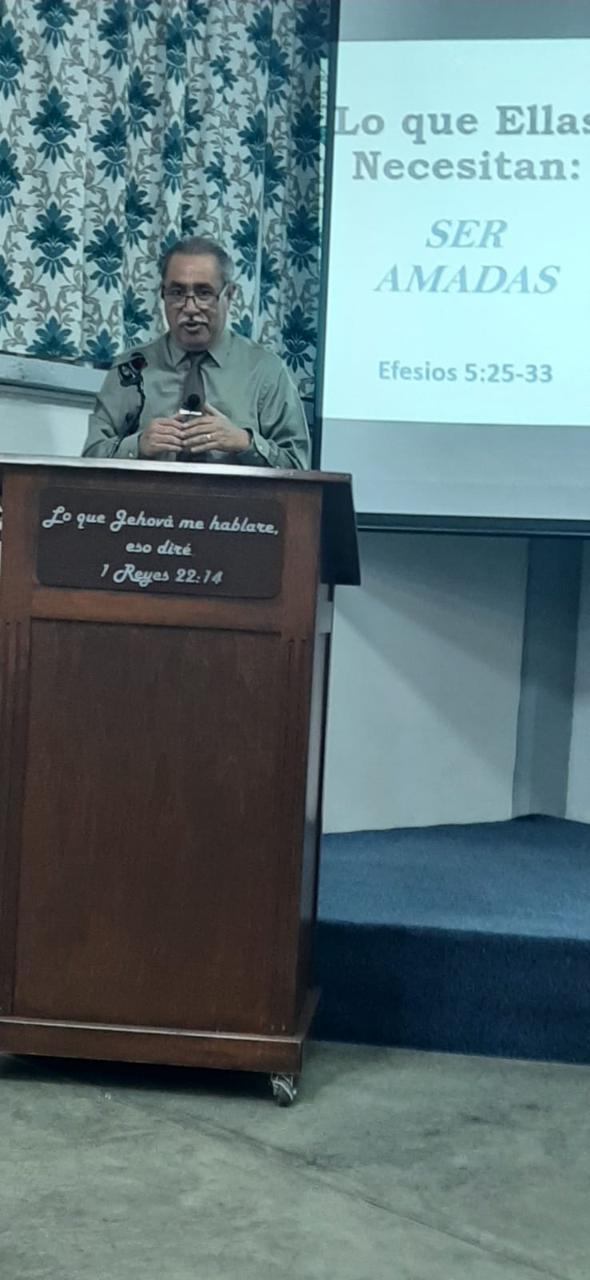
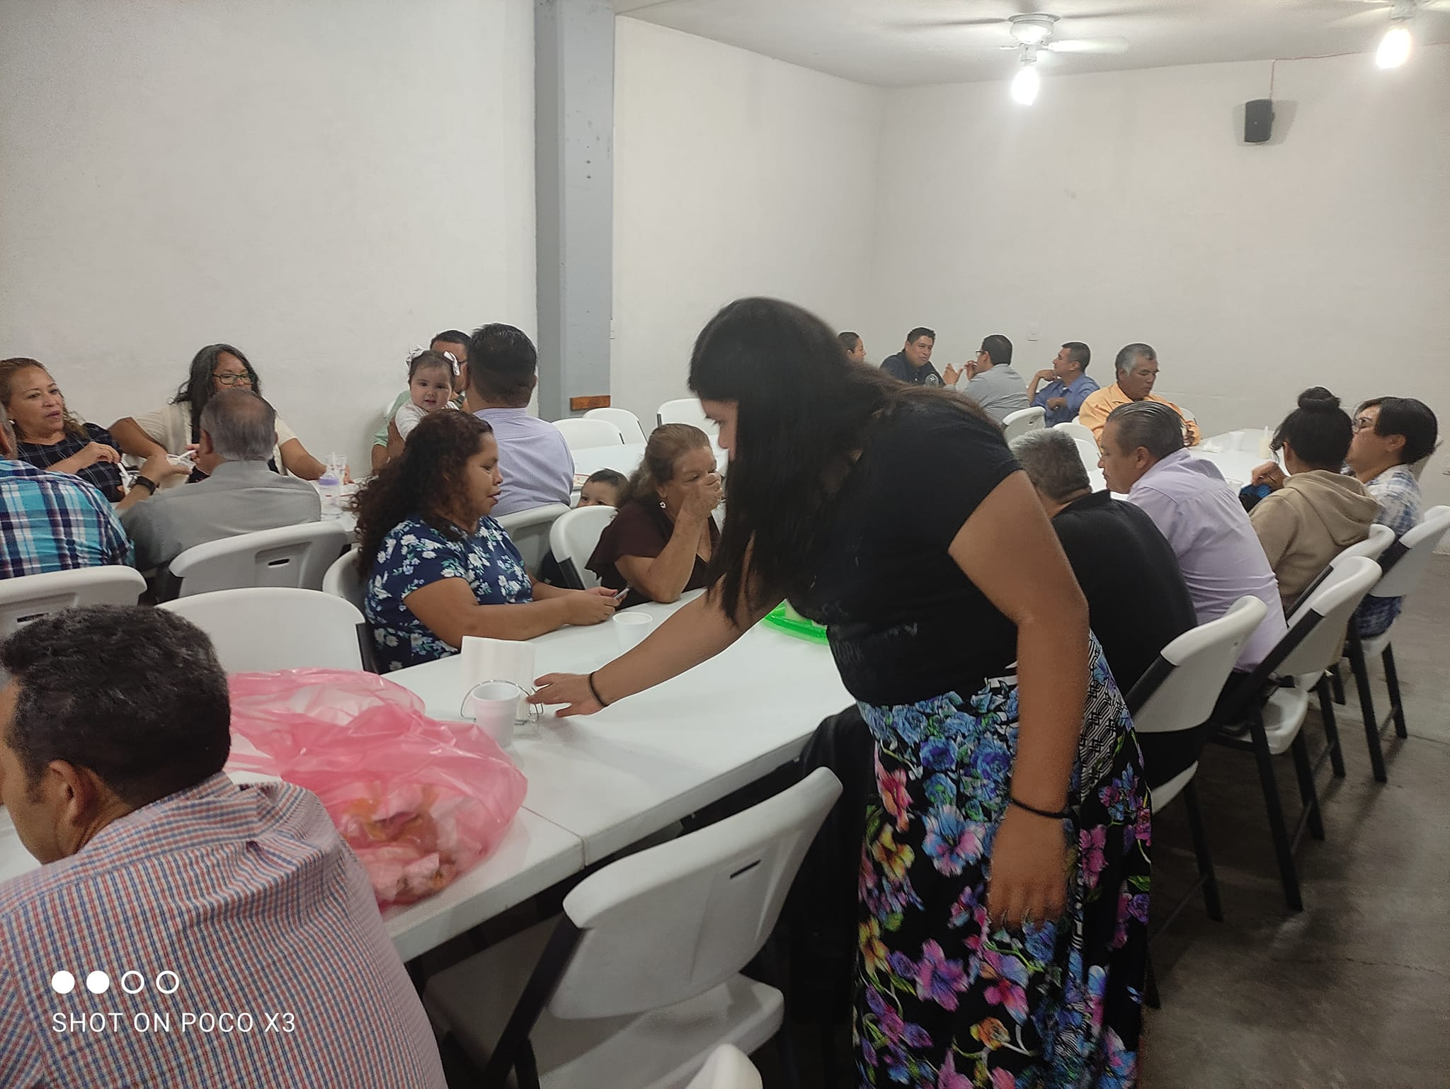
Lectureships and campaiGns
Seminar at Plateros church of Christ – Querétaro
On May 5 to 7 I went to Queretaro City in the central part of the Country to Speak in a weekend seminar about Marriage and Family. It was a very sppecial meeting and Christian fellowship. Likewise we speak about the School to promote it

Slide 7
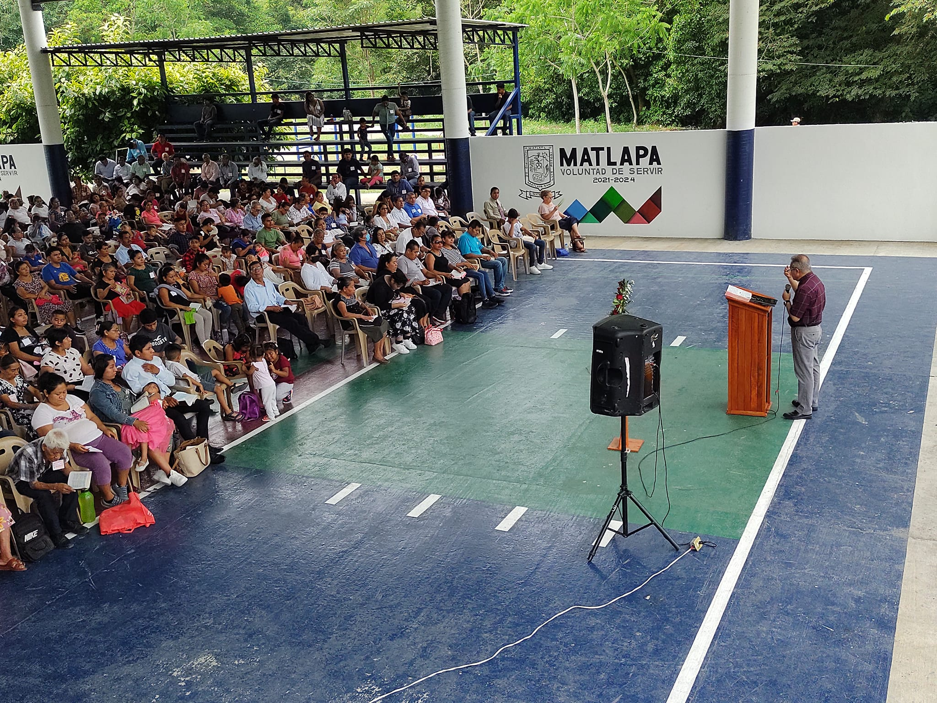
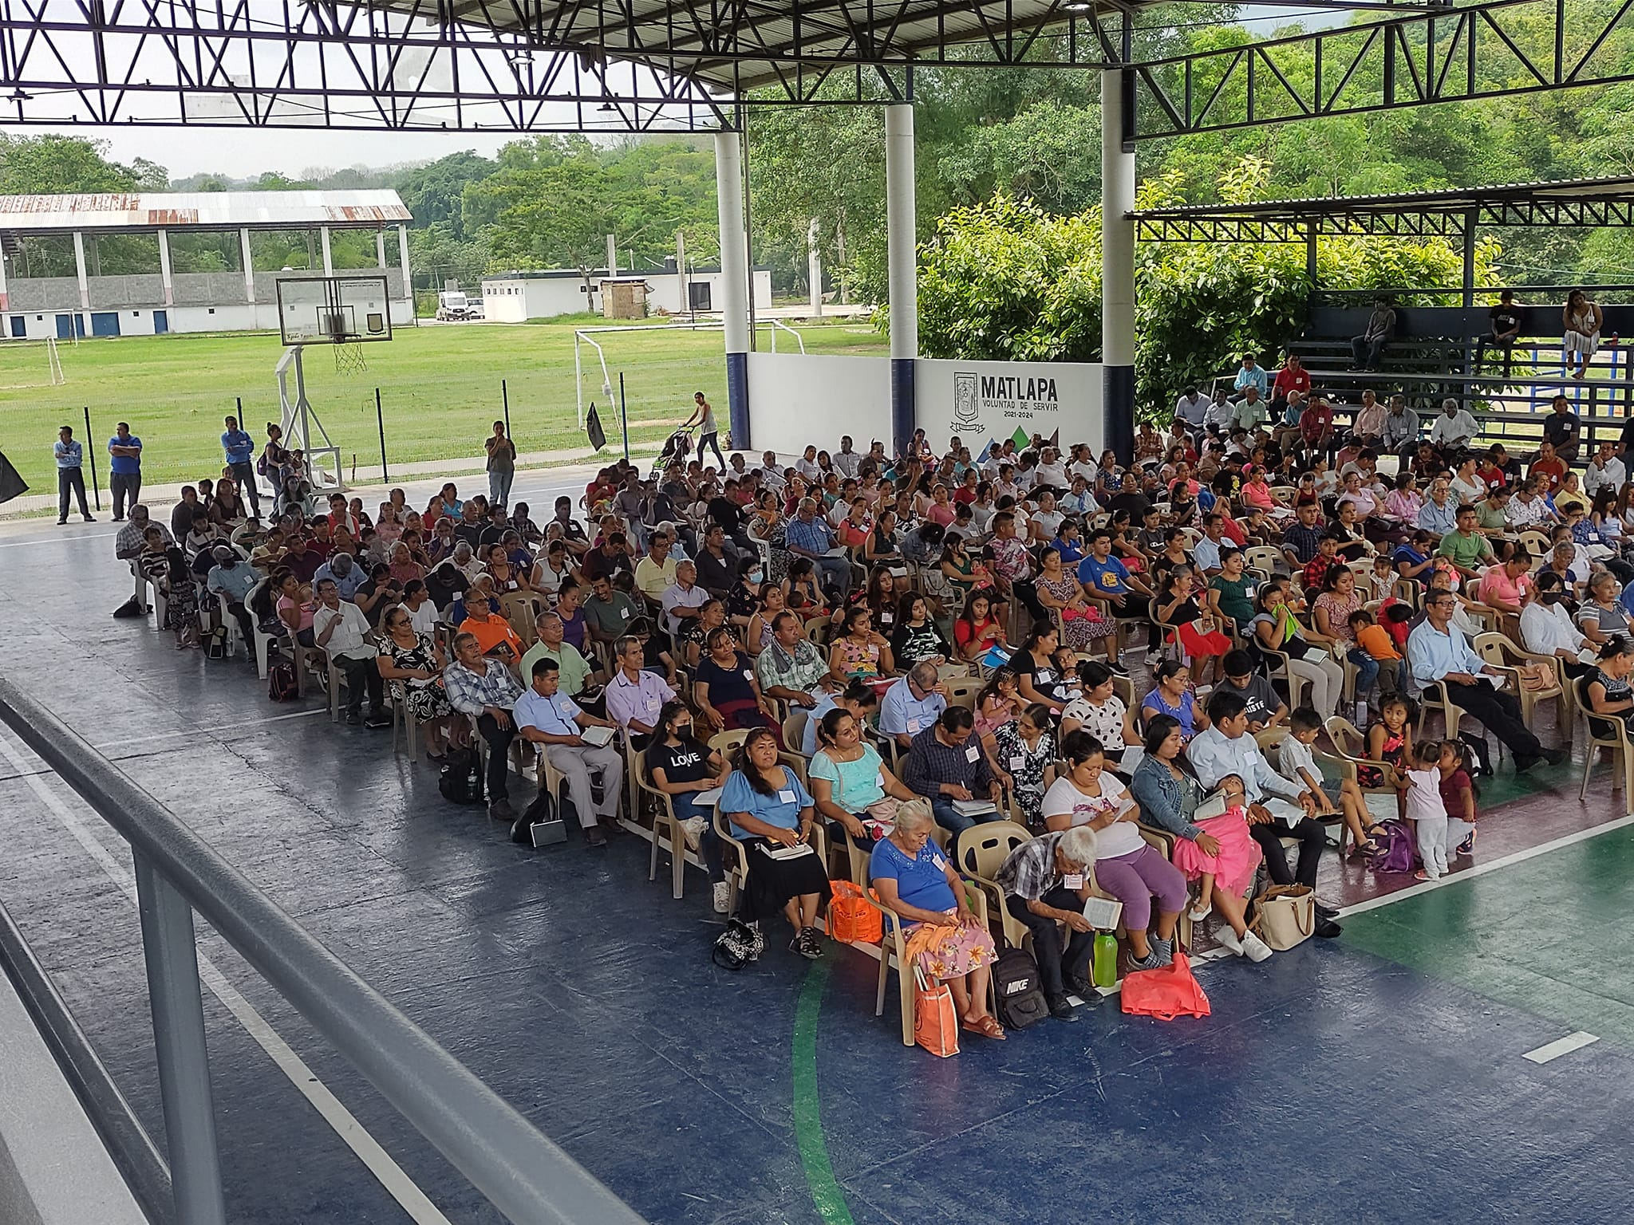
Lectureships and campaiGns
Seminar of the church of Christ in “La Husteca” – Matlapa SLP
On May 20 I went to Matlapa SLP. It is in the región called “La Huasteca”. This is a country place where there are a lot of congregations of the church. Every year they have an special day for meet together and study God´s Word. This year I was invited to be the speaker. We have more tan 500 attendance

Slide 8
LAST BIMESTER OF THE YEAR
As every year, when May is coming, we know the year is finishing and a new class is close to graduate. Students and their families are very excited. They start to think on graduation time and on what will be the place where they will be working for the Lord.
Last subjects of the bimester
Greek by Rafael Ramirez
Philippians & Philemon by Humberto Bazaldua
Holy Spirit by Frnacisco Rodriguez
Life of Christ by Salvador Gonzalez
Old Testament by Jesus Conrado Jimenez

Slide 9
Reception of NEW STUDENTS applications
As every year, we started to receive applications from potential students since the beginning of the year, but is on this last bimester when we start to consider and make some research about them. Usually we have more applications than we are able to accept. This year we have room for 11 new students supported by Brownwood and 1 single students supported by Sierra Ventana. Also, we going to have four online students from Bolivia. We pray God that He gave us wisdom to make good decisions on the selection.

Slide 10
SEMINAR MONTERREY SCHOOL OF PREACHING 2023
From June 19 to 23, we had a Seminar focused on the students, students’ wives, and to those who already are working for the Lord (Elders, laborers and preachers).
It was a great blessing for the school and for many who graduated years before who meet together at the seminar.
Also we had a Evangelistic Campaign by nights which was a great blessing for all the brotherhood in our city. By nights we had an attendance about 400 people. For Gospel Meeting nights the speaker was Wade Webster from Katy Tx.
This event was supported by Brother Dennis Reed’s foundation which covered the complete expenses of it
Two people were baptized for the remission of their sins and were added by the Lord to His church.

Slide 11
SEMINAR MONTERREY SCHOOL OF PREACHING 2023
SPEAKERS OF THE SEMINAR
Eric Lyons from Alabama
Daniel Cates from Tennessee
Francisco Rodriguez from Monterrey
Juan Martin Flores from Guadalajara
Jesus Conrado from Monterrey
Wade Webster from Texas
TRANSLATORS
Rafael Ramirez
Jim Avalos

Slide 12
SEMINAR MONTERREY SCHOOL OF PREACHING 2023
MAIN SUBJECTS OF THE SEMINAR
Apologetics
Intertestamentary Period
Apostle Paul Leadership
Apostle Peter Leadershio
Moses Leaedership
Joshua Leadership
Nehemiah Leadership

Slide 13
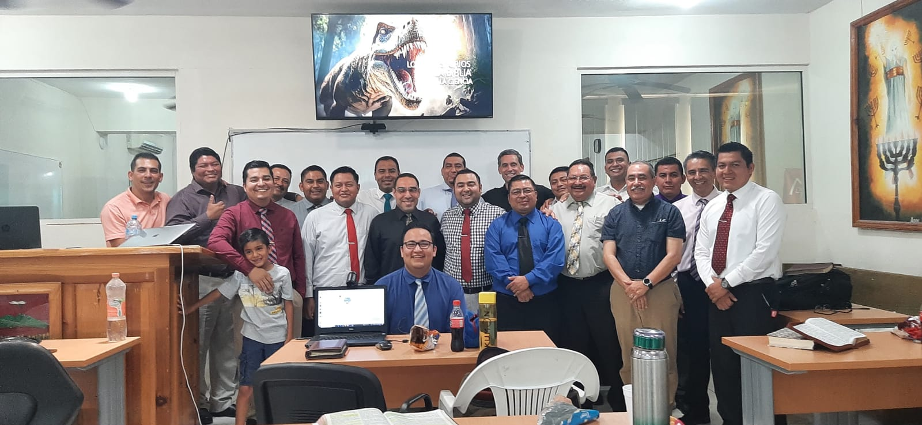
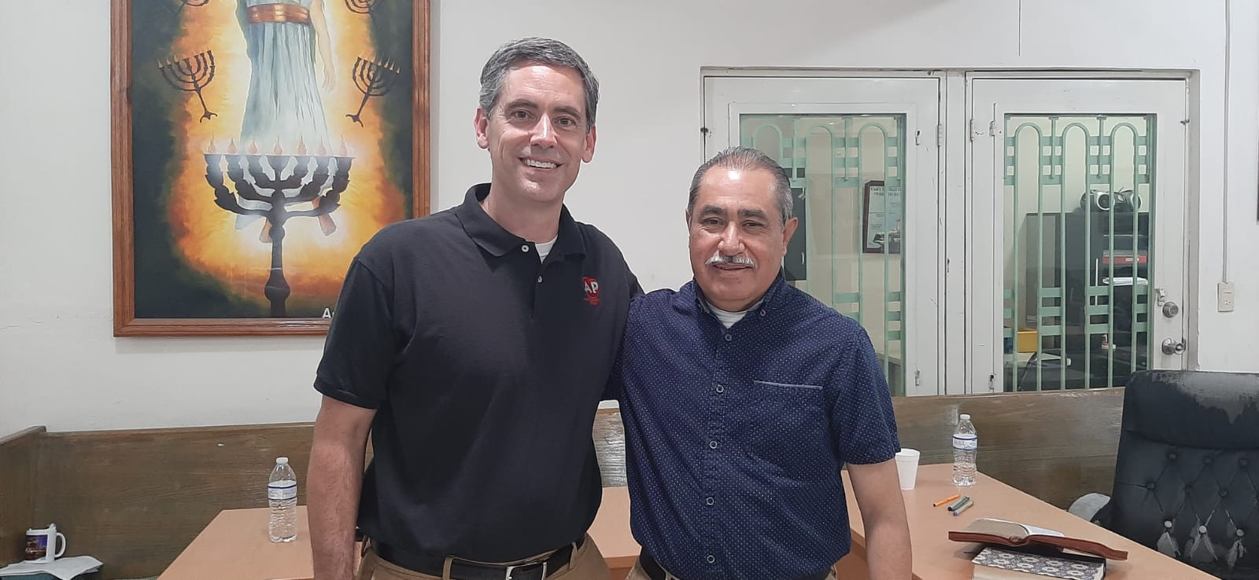
SEMINAR MONTERREY SCHOOL OF PREACHING 2023 – SOME PICTURES

Slide 14
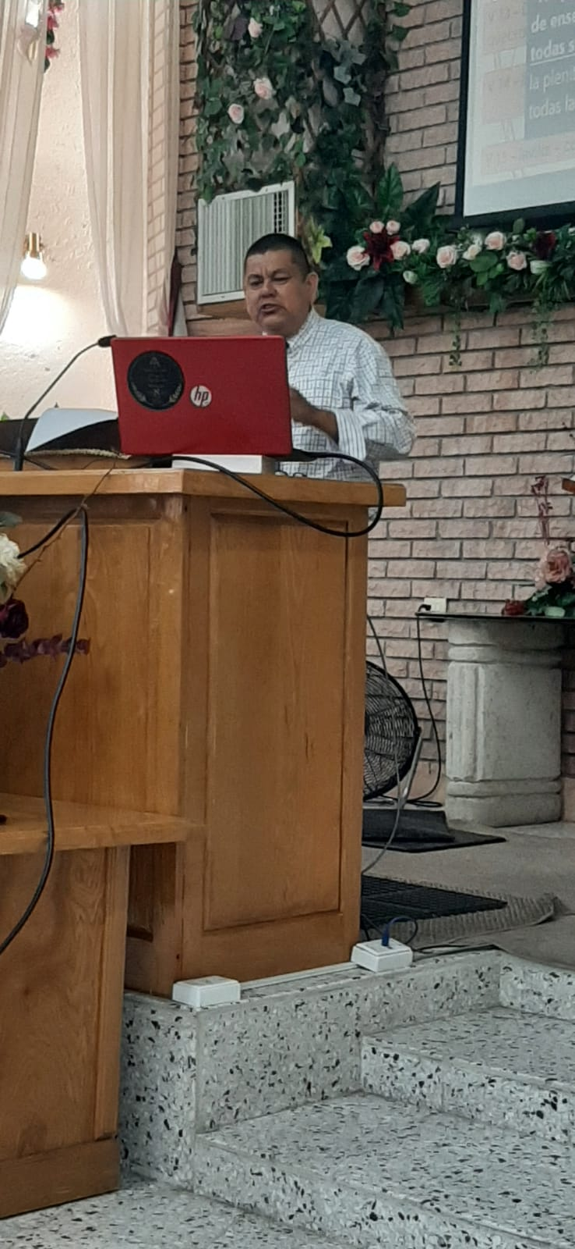
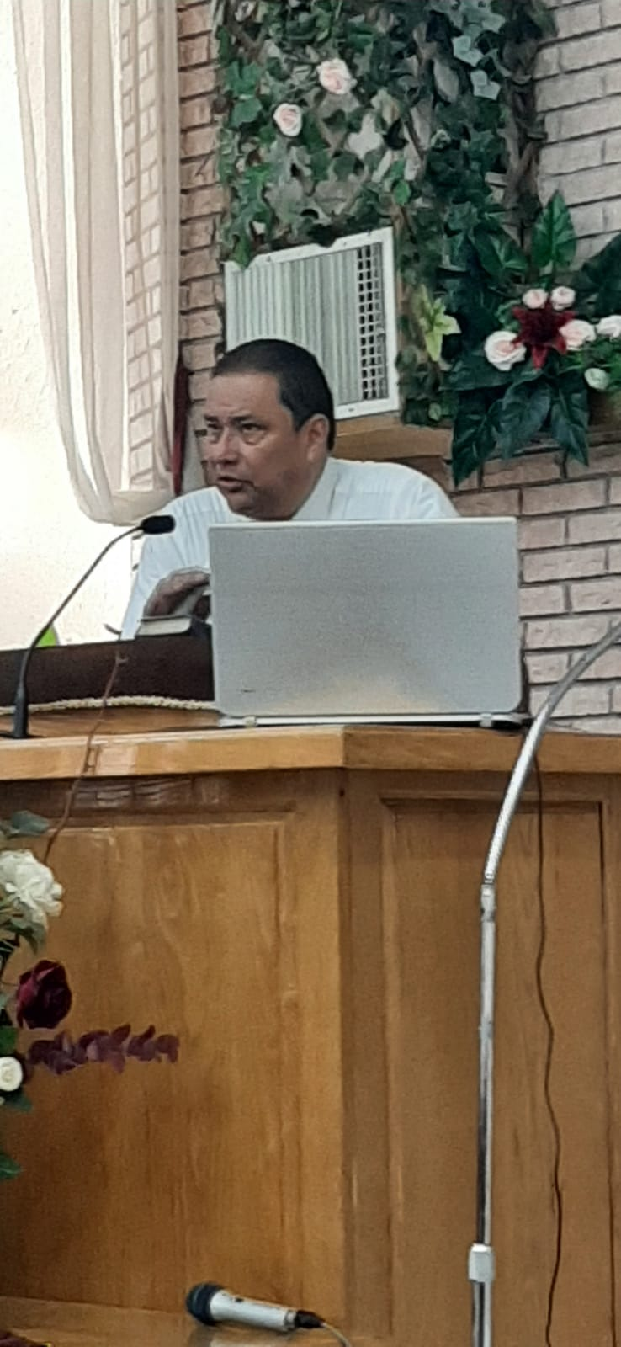
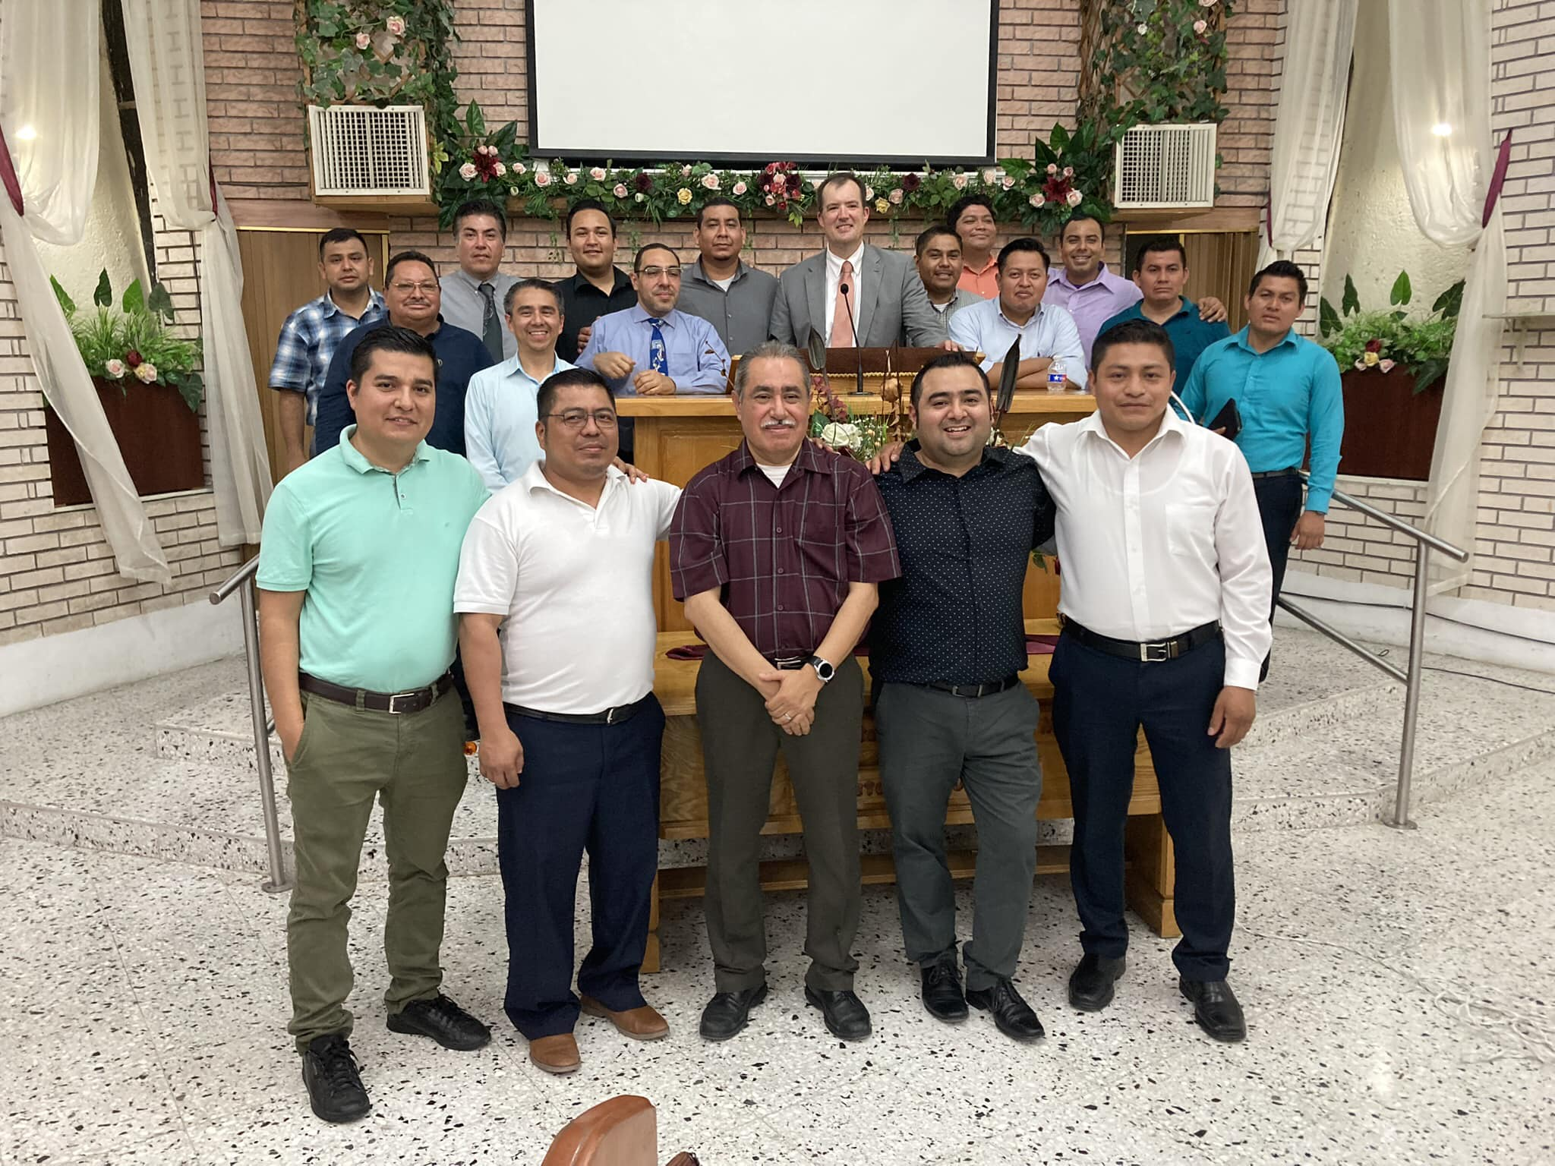
SEMINAR MONTERREY SCHOOL OF PREACHING 2023 – SOME PICTURES

Slide 15
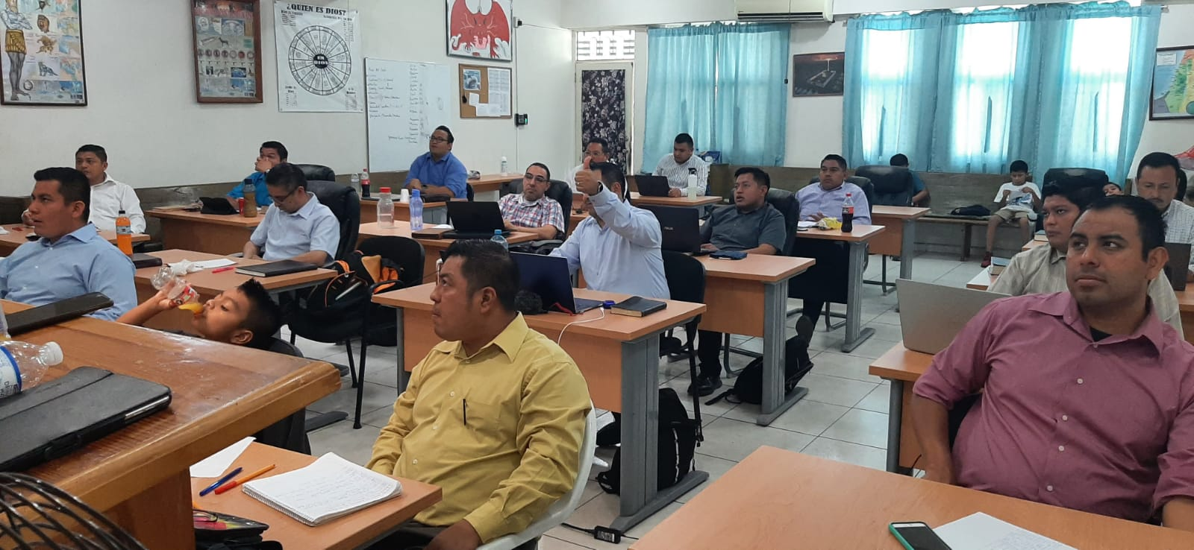
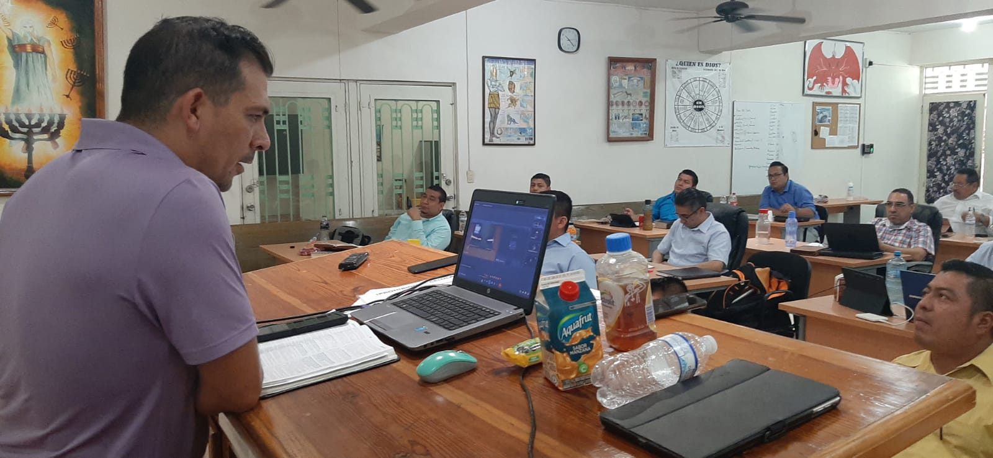
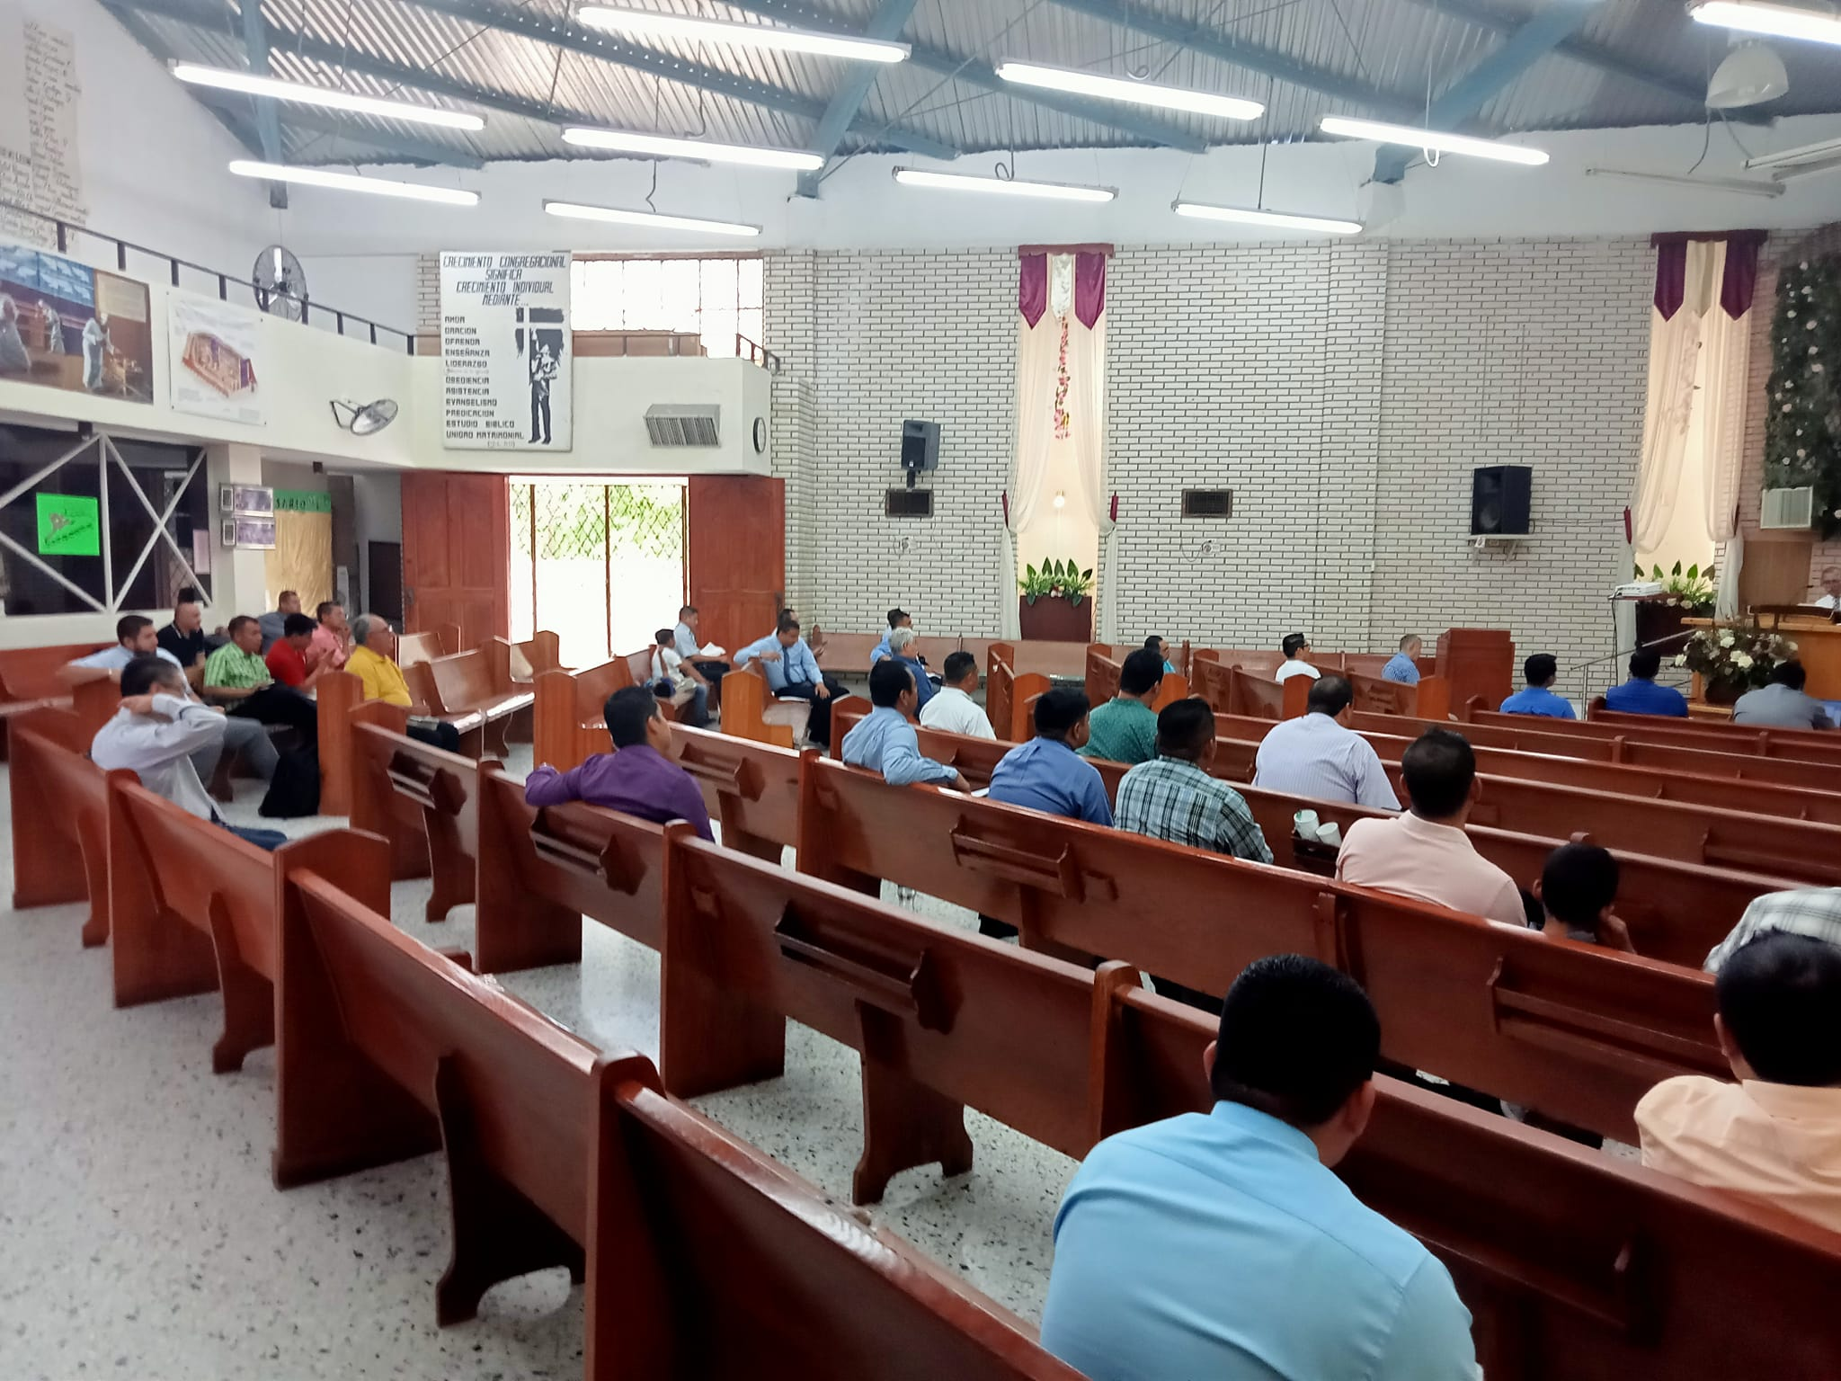
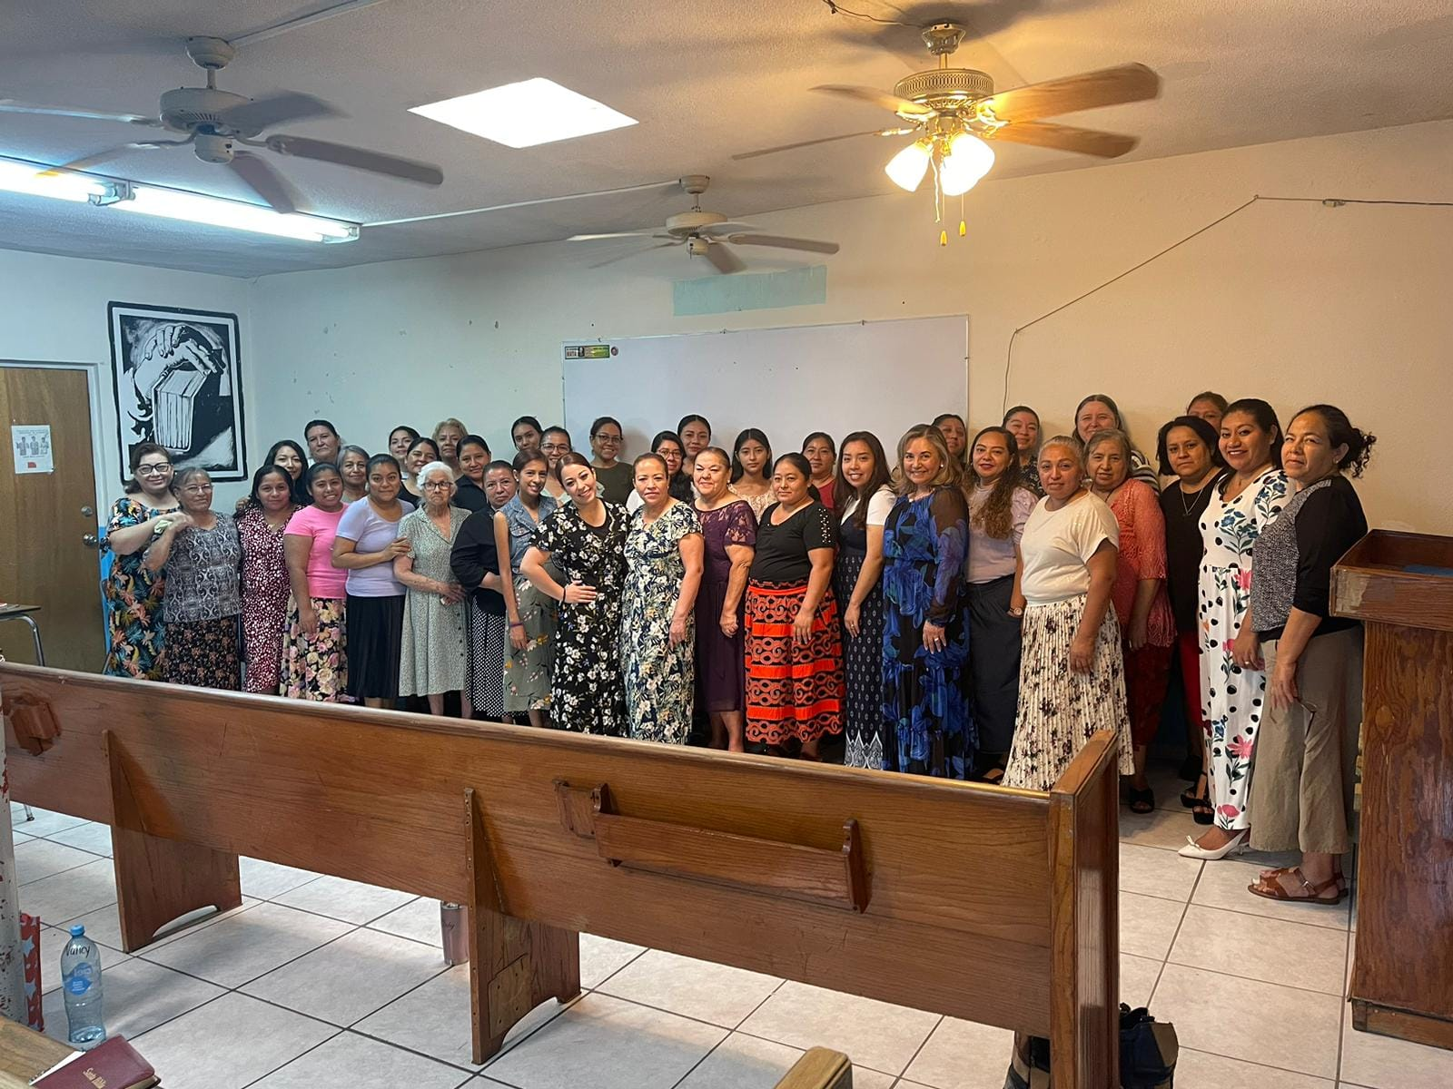
SEMINAR MONTERREY SCHOOL OF PREACHING 2023 – SOME PICTURES

Slide 16
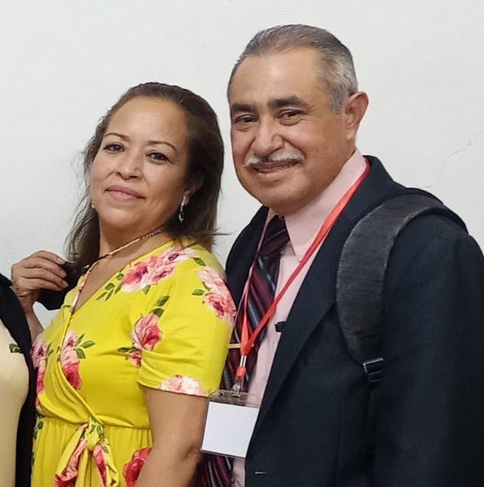
OUR GRATEFULNESS
We want to show you our appreciation and thankfulness for the work and support that you have given to Monterrey School of Preaching every year.
We know that without your spiritual and economic support any of this would be possible to do. We keep you all in our prayers that God may prosper you and your families forever.
We pray that God let you all to continue doing the same work for His glory an honor.
Sincerely
Jesus Conrado & Carmen Jimenez
Director

