Slide 1
Quarterly Report january – March 2023 Monterrey School of Preaching
SINCE 1978
A LIFE PREPARING CHRIST´S LABOURERS
2Timothy 2:2

Slide 2
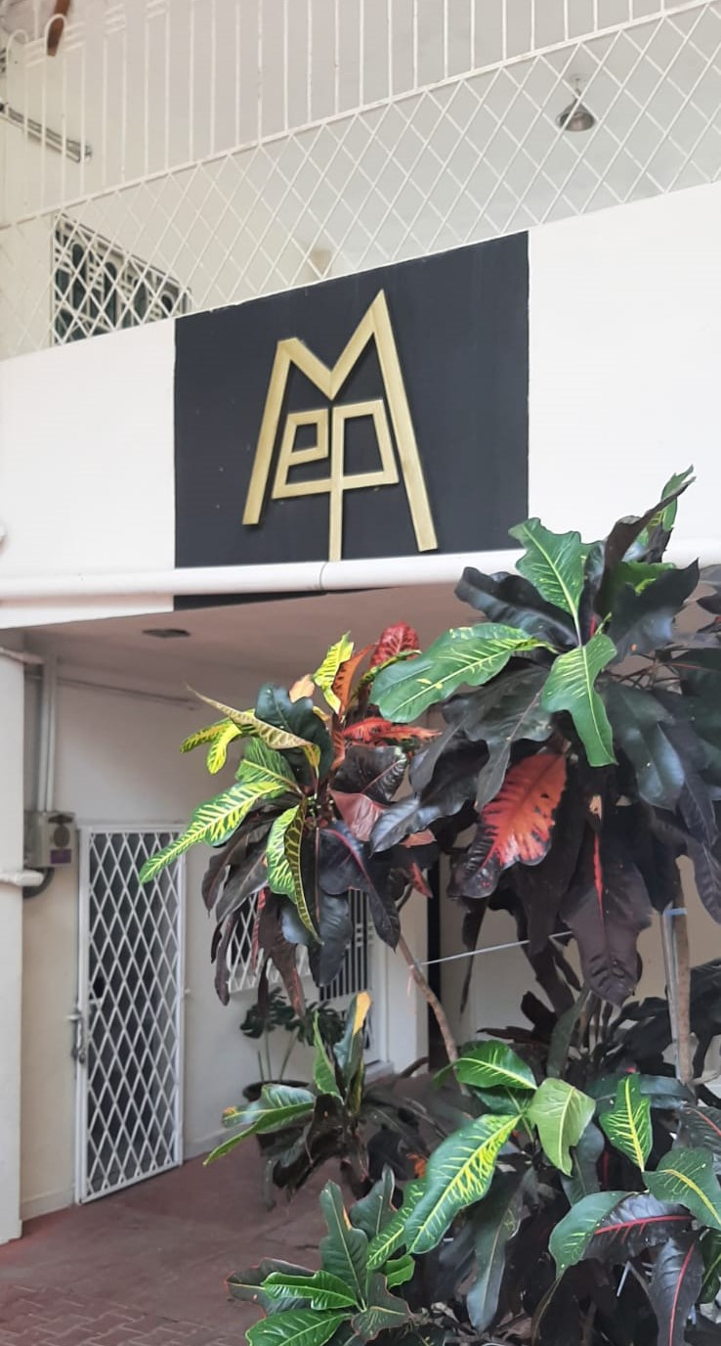
Monterrey School Of Preaching 2023 Beginning

Slide 3
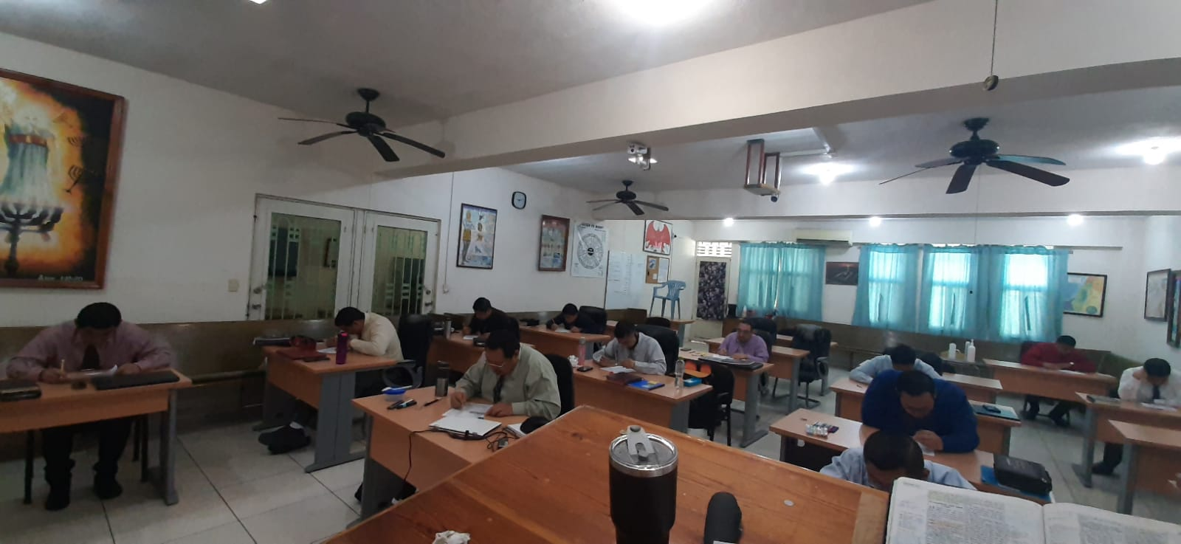
2023 Beginning New Year New Bimester
After end of the year break, students continued with their preparation. New year and new bimester. They started with new subjects:
Genesis, by Jesús Conrado Jiménez
Acts, by Salvador González
Christian Evidences, by Francisco Rodríguez
Job, by Manuel Castillo
Mountain Sermon, by Humberto Bazaldúa

Slide 4
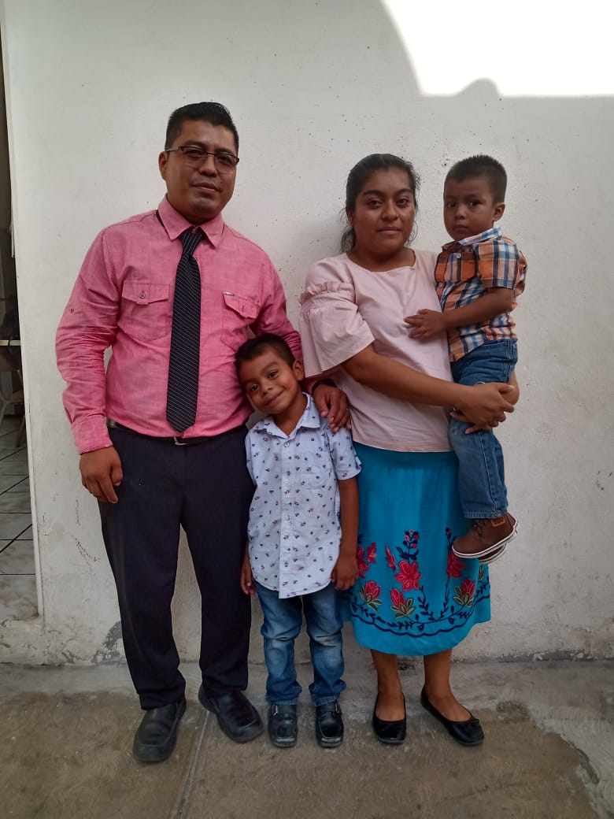
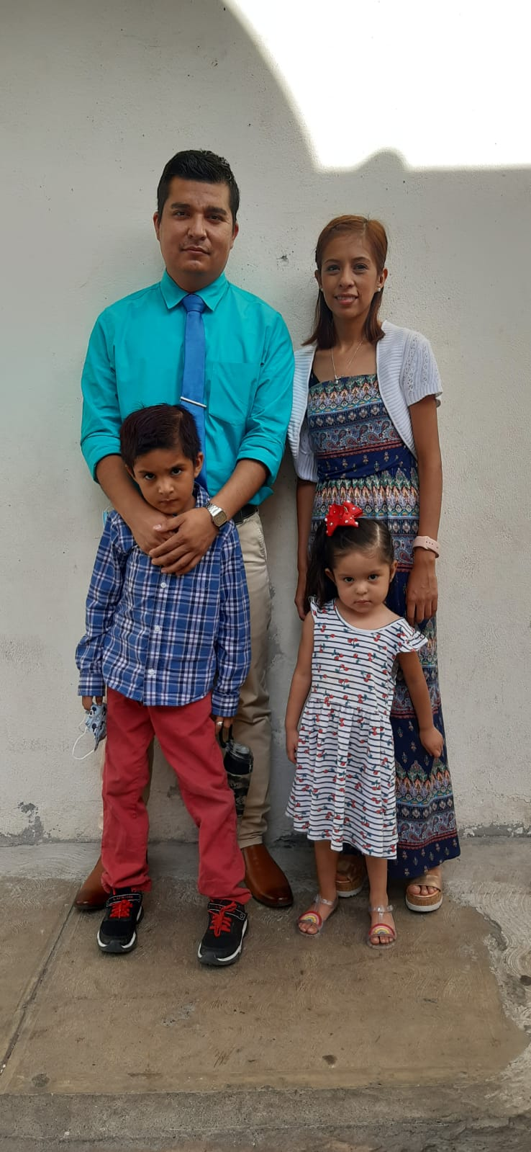
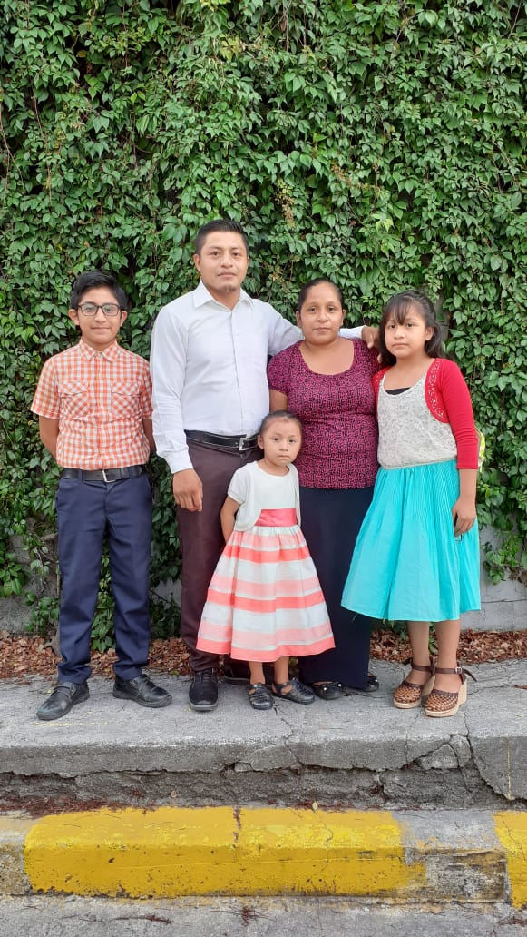
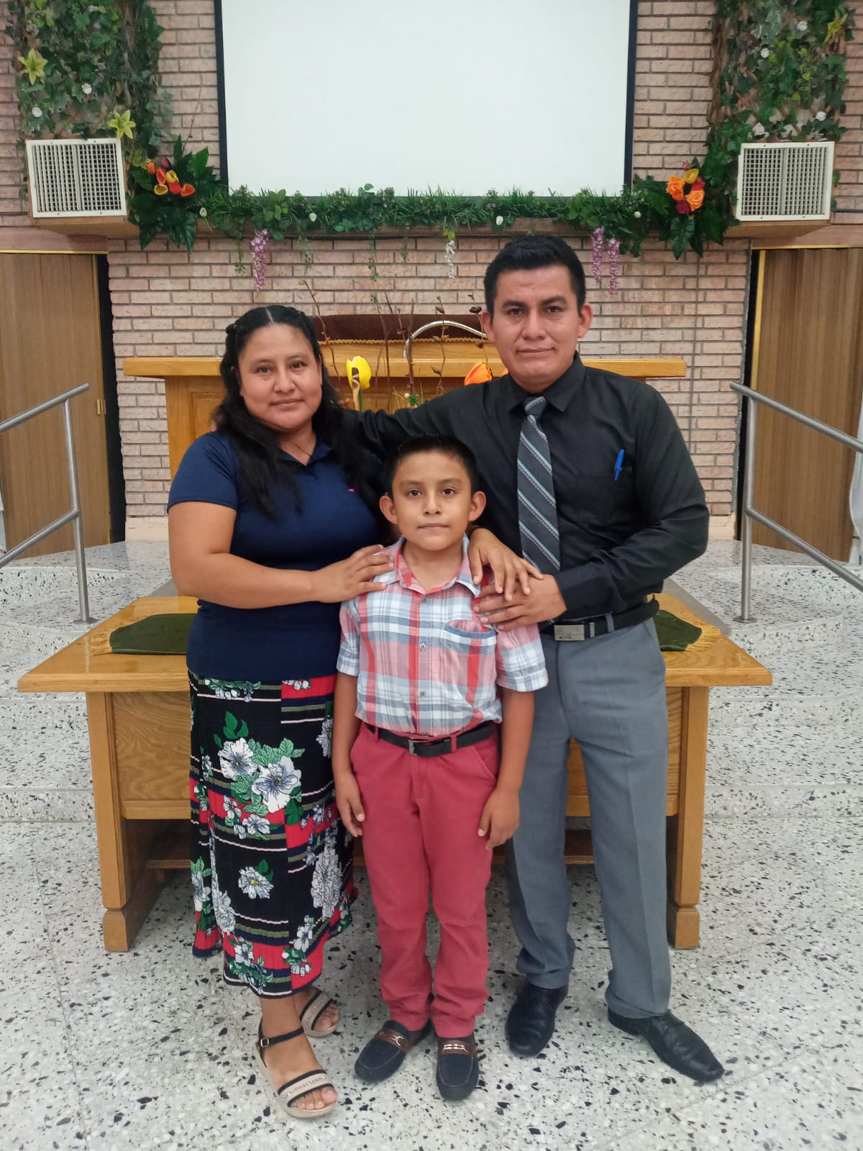
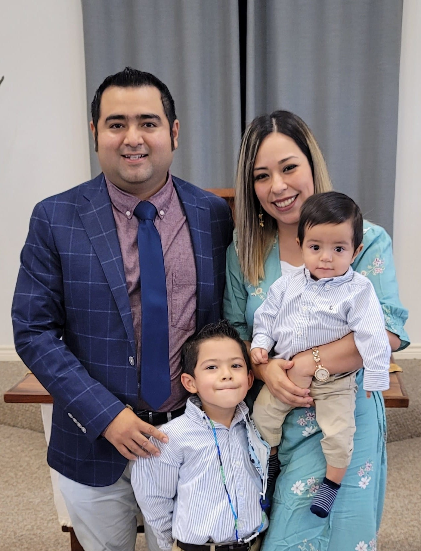
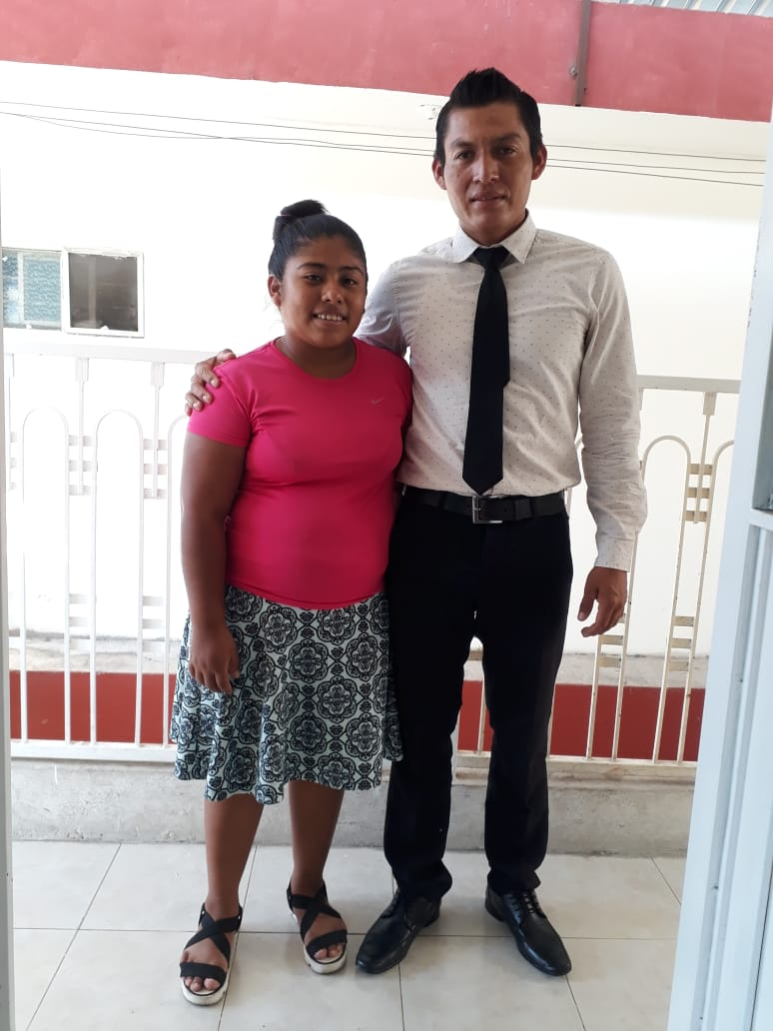
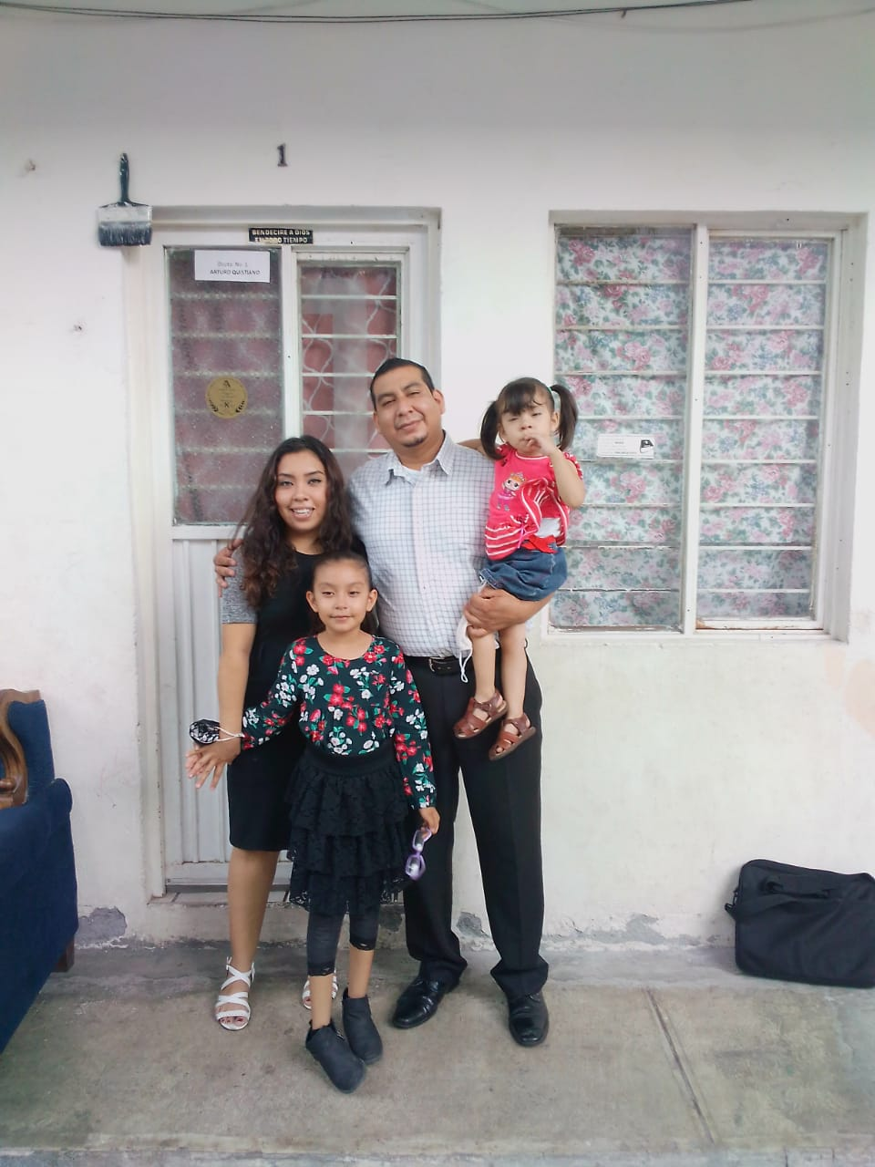
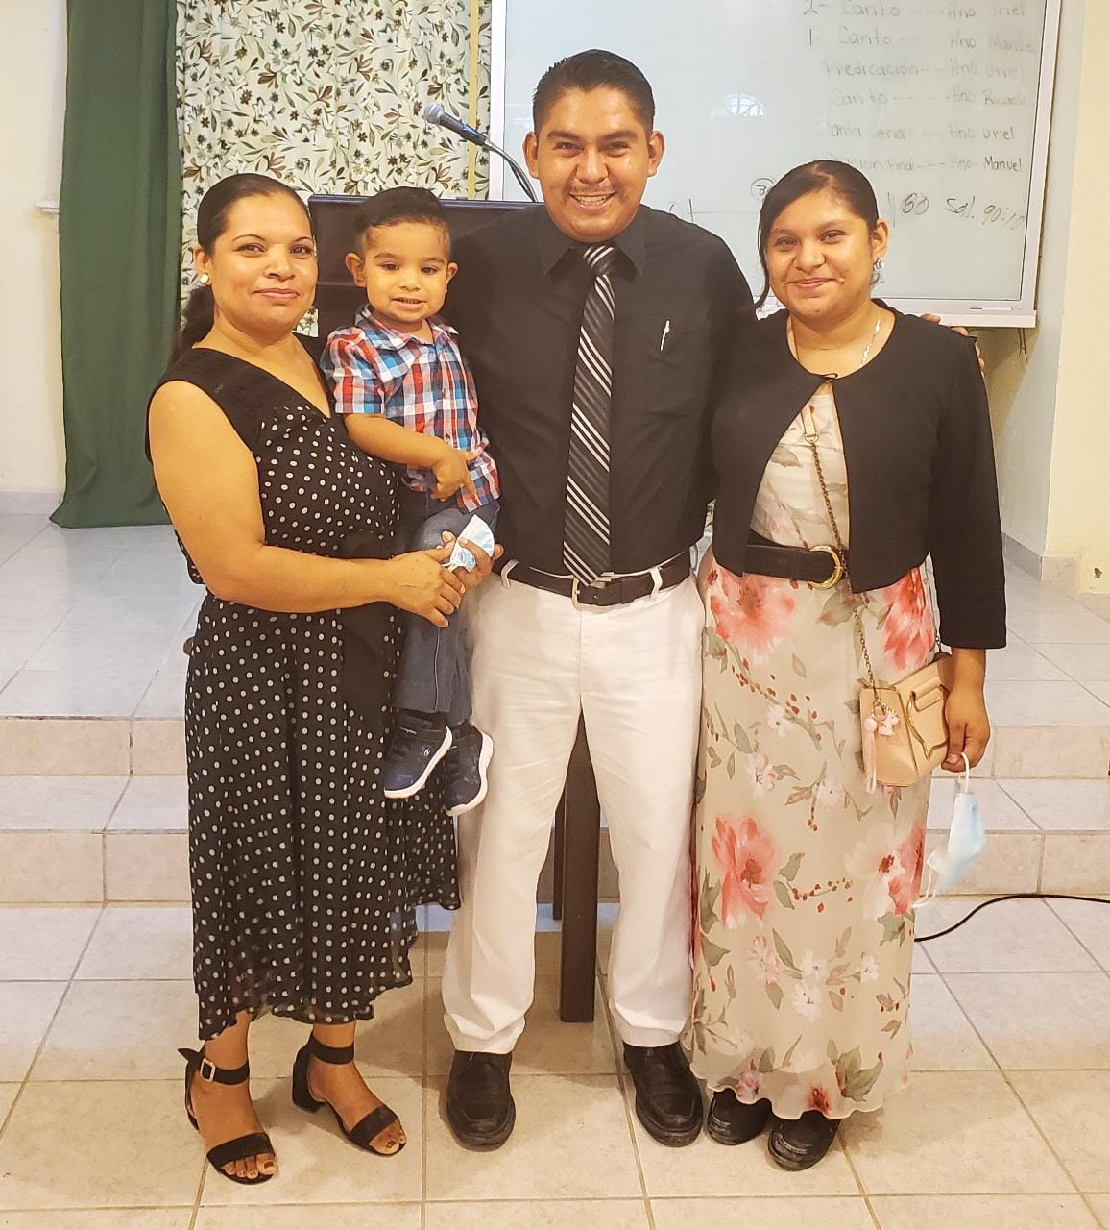
2023 Beginning Last part of the course for second year students
For those who are on second year this is the last part of the course. So, they started the year very excited because their goal is nearly. We pray for their plans in the vineyard of the Lord after school

Slide 5
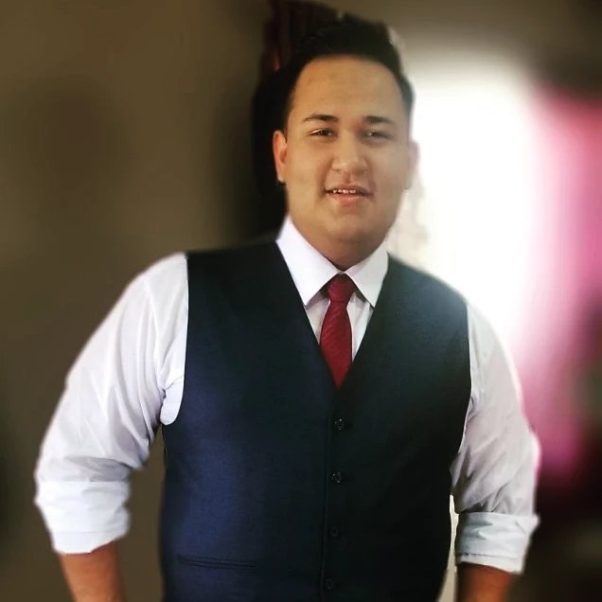
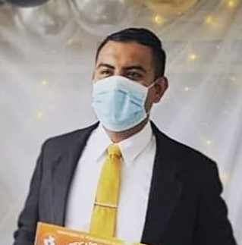
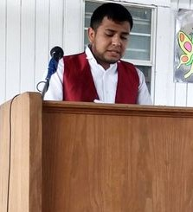
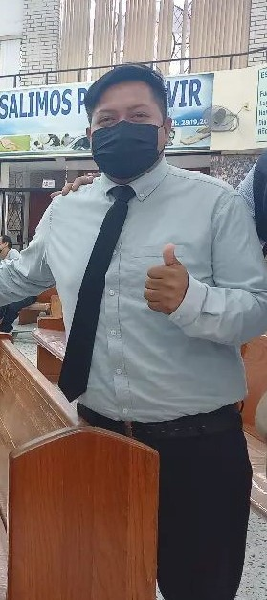
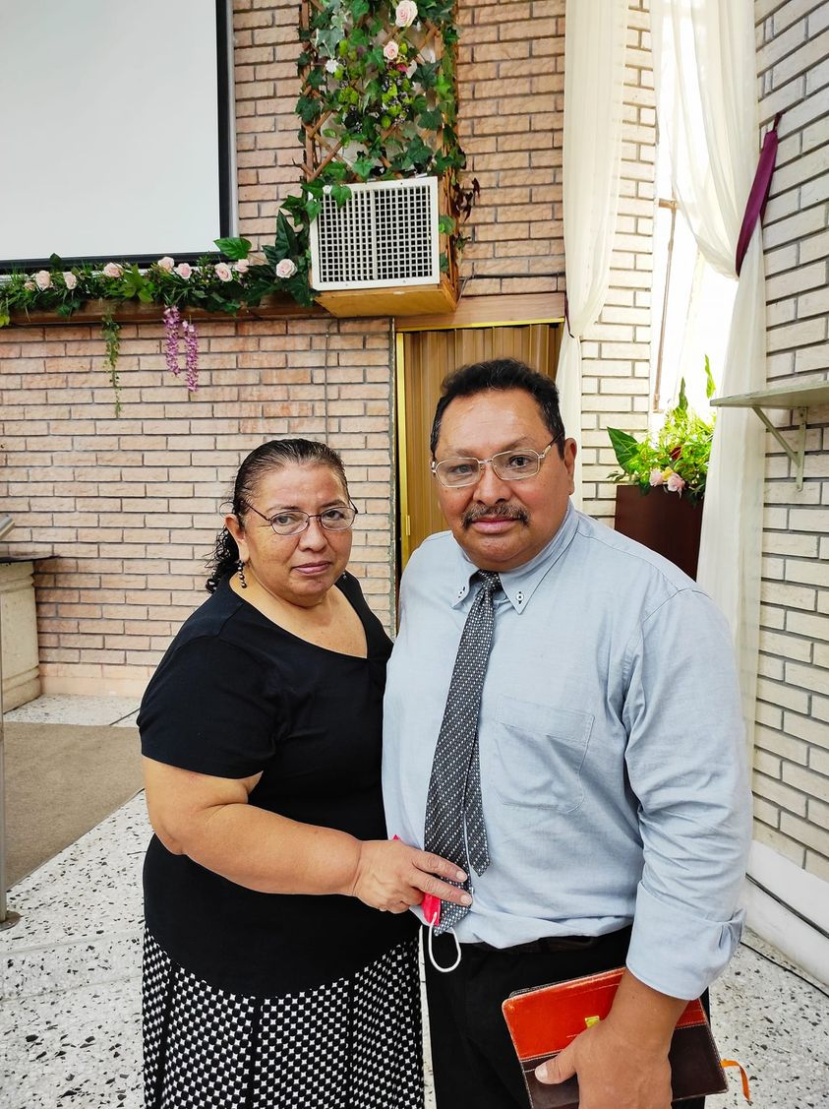
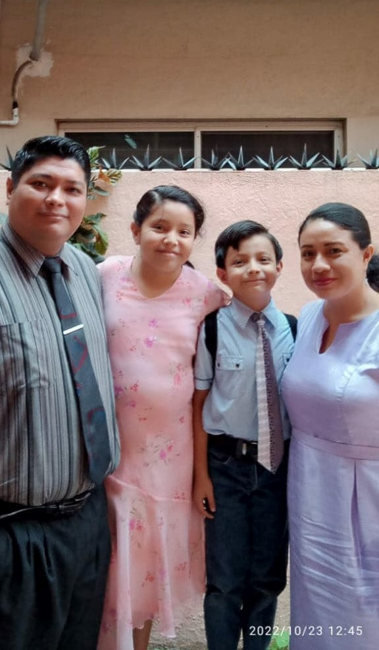
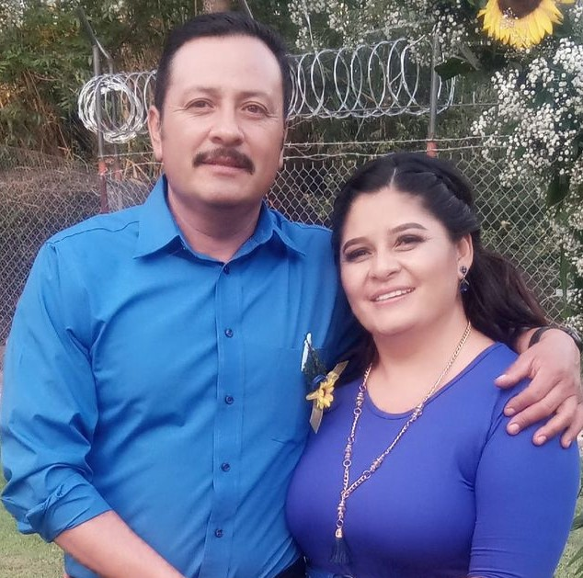
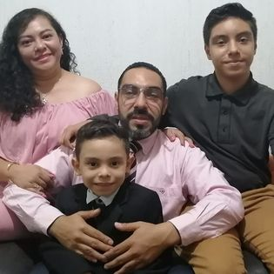
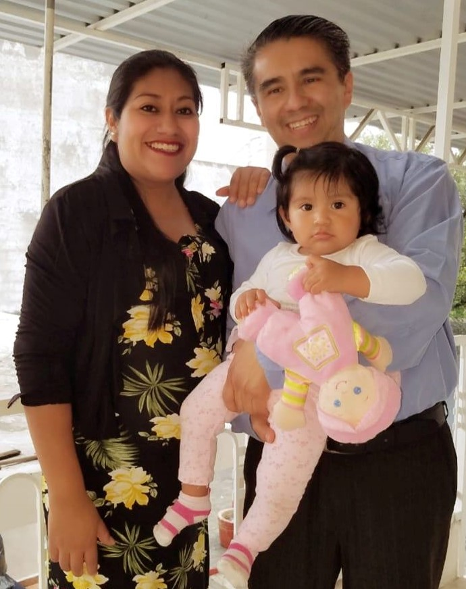
2023 Beginning First year students started very excited for new things to learn
For those who are on first year, this is the time when they have a better understanding about how the school woks and, generally speaking, they are very excited to get more Bible knowledge

Slide 6
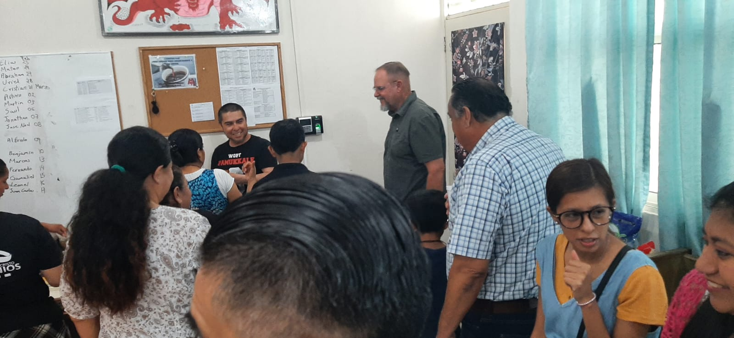
Visit from Brownwood Bill Pursch & Mario Luna
As every February, we received the visit of those who are part of Austin Avenue chuch of Christ, mission committee. Brother Bill Pursch and Brother Mario Luna came unto us to supervise the school work, talk about school plans and to have a fellowship time with the students and their families. We enjoyed their visit and apprecite their support. Lord willing, we going to receive eleven new students this coming year.

Slide 7
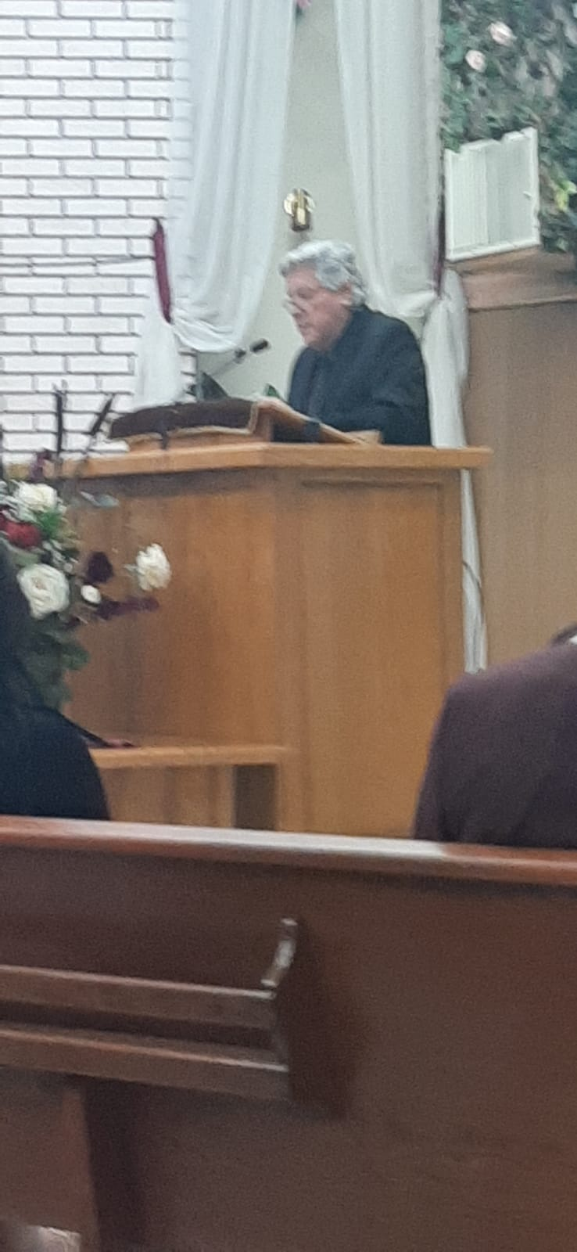
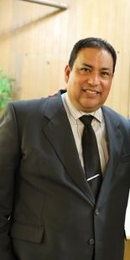
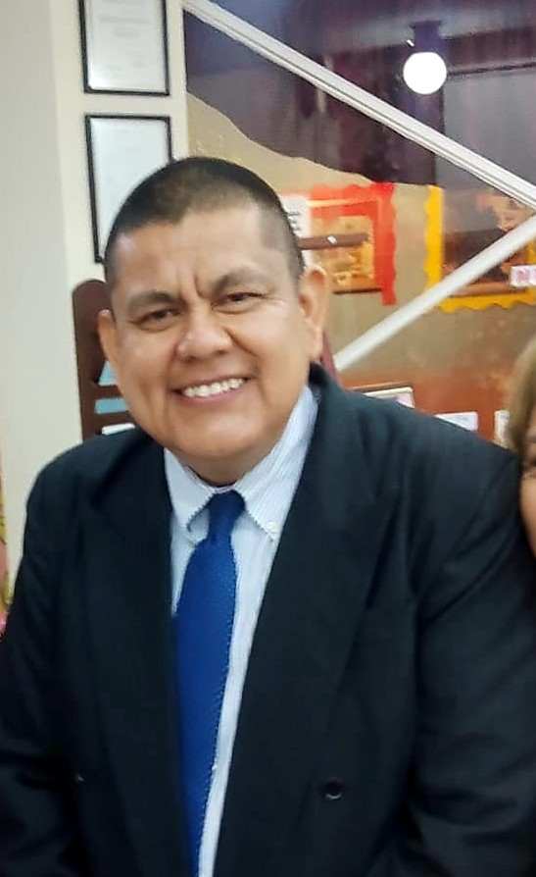
Sierra Ventana Church Of Christ 50th Aniversary Gospel Meeting
SPEAKERS:
David Cárdenas, Francisco Rodríguez, Juan M Flores
Early on March, we had a celebration time because of the 50th anniversary of Sierra Ventana church of Christ. We had a Gospel meeting with preachers who were involucrated with the congregation years ago, they were the speakers and we were so blessed with their teachings and encouragement for the church.

Slide 8
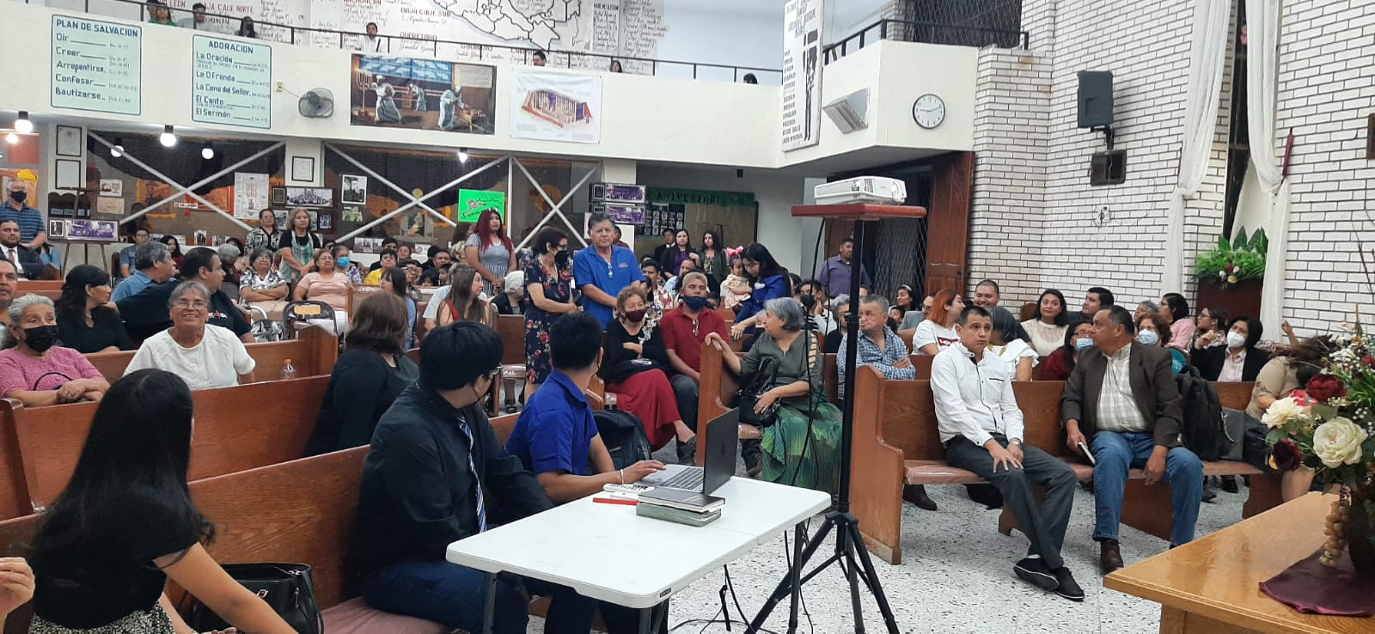
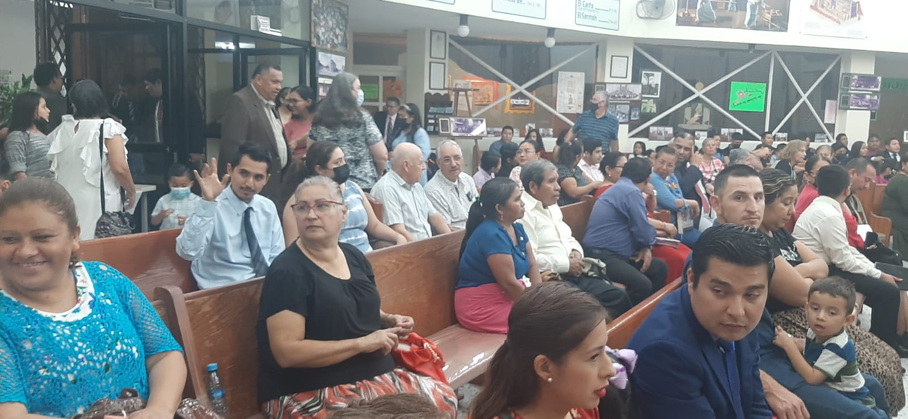
Sierra Ventana Church Of Christ 50th Aniversary Gospel Meeting

Slide 9
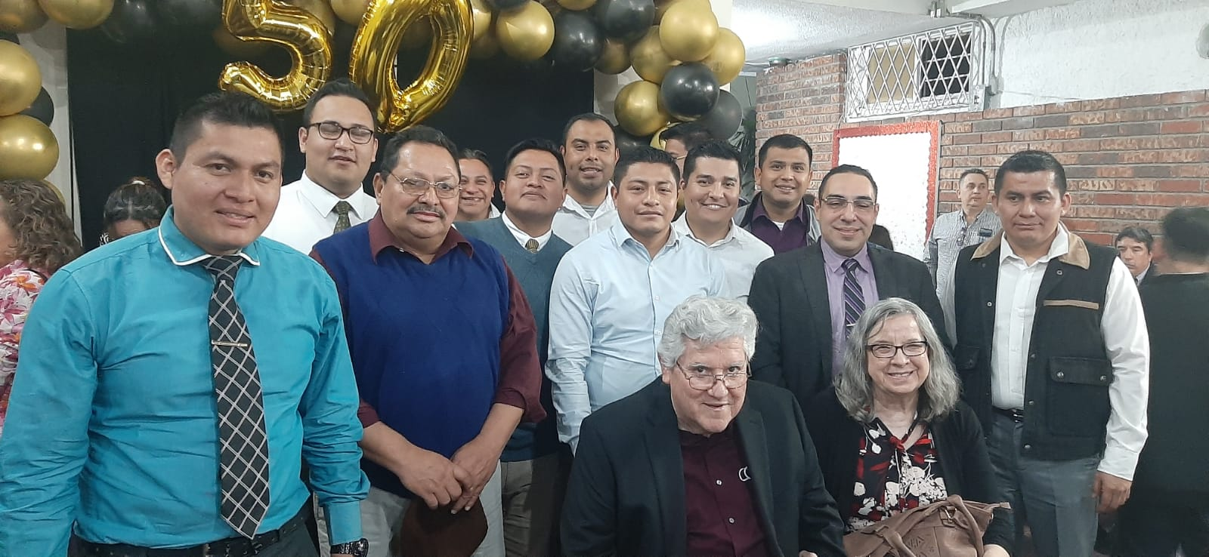
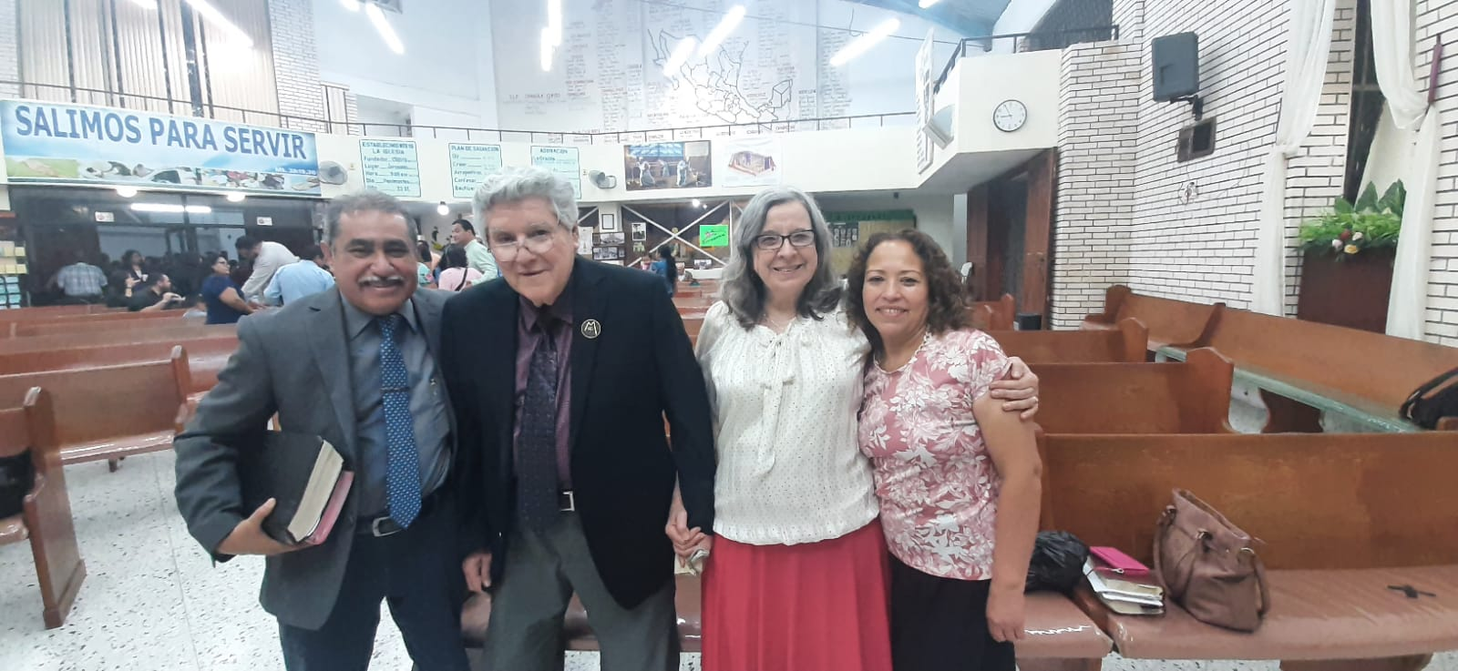
Sierra Ventana Church Of Christ 50th Aniversary Gospel Meeting

Slide 10
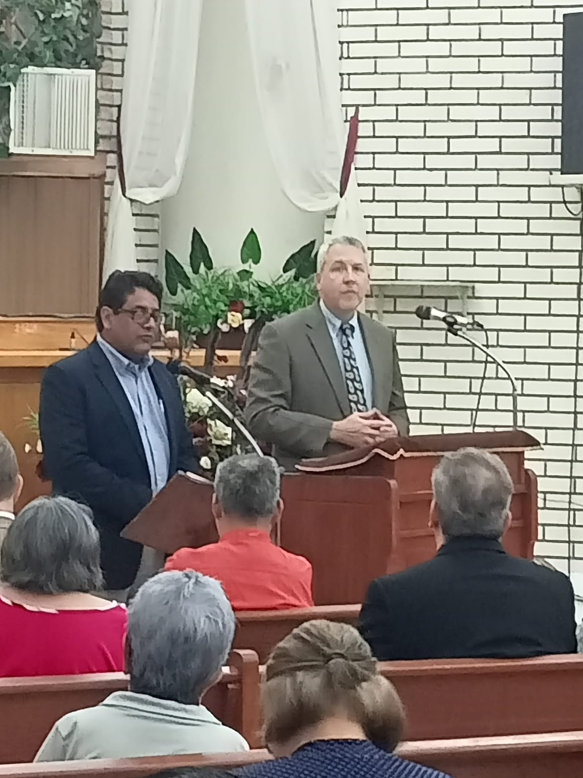
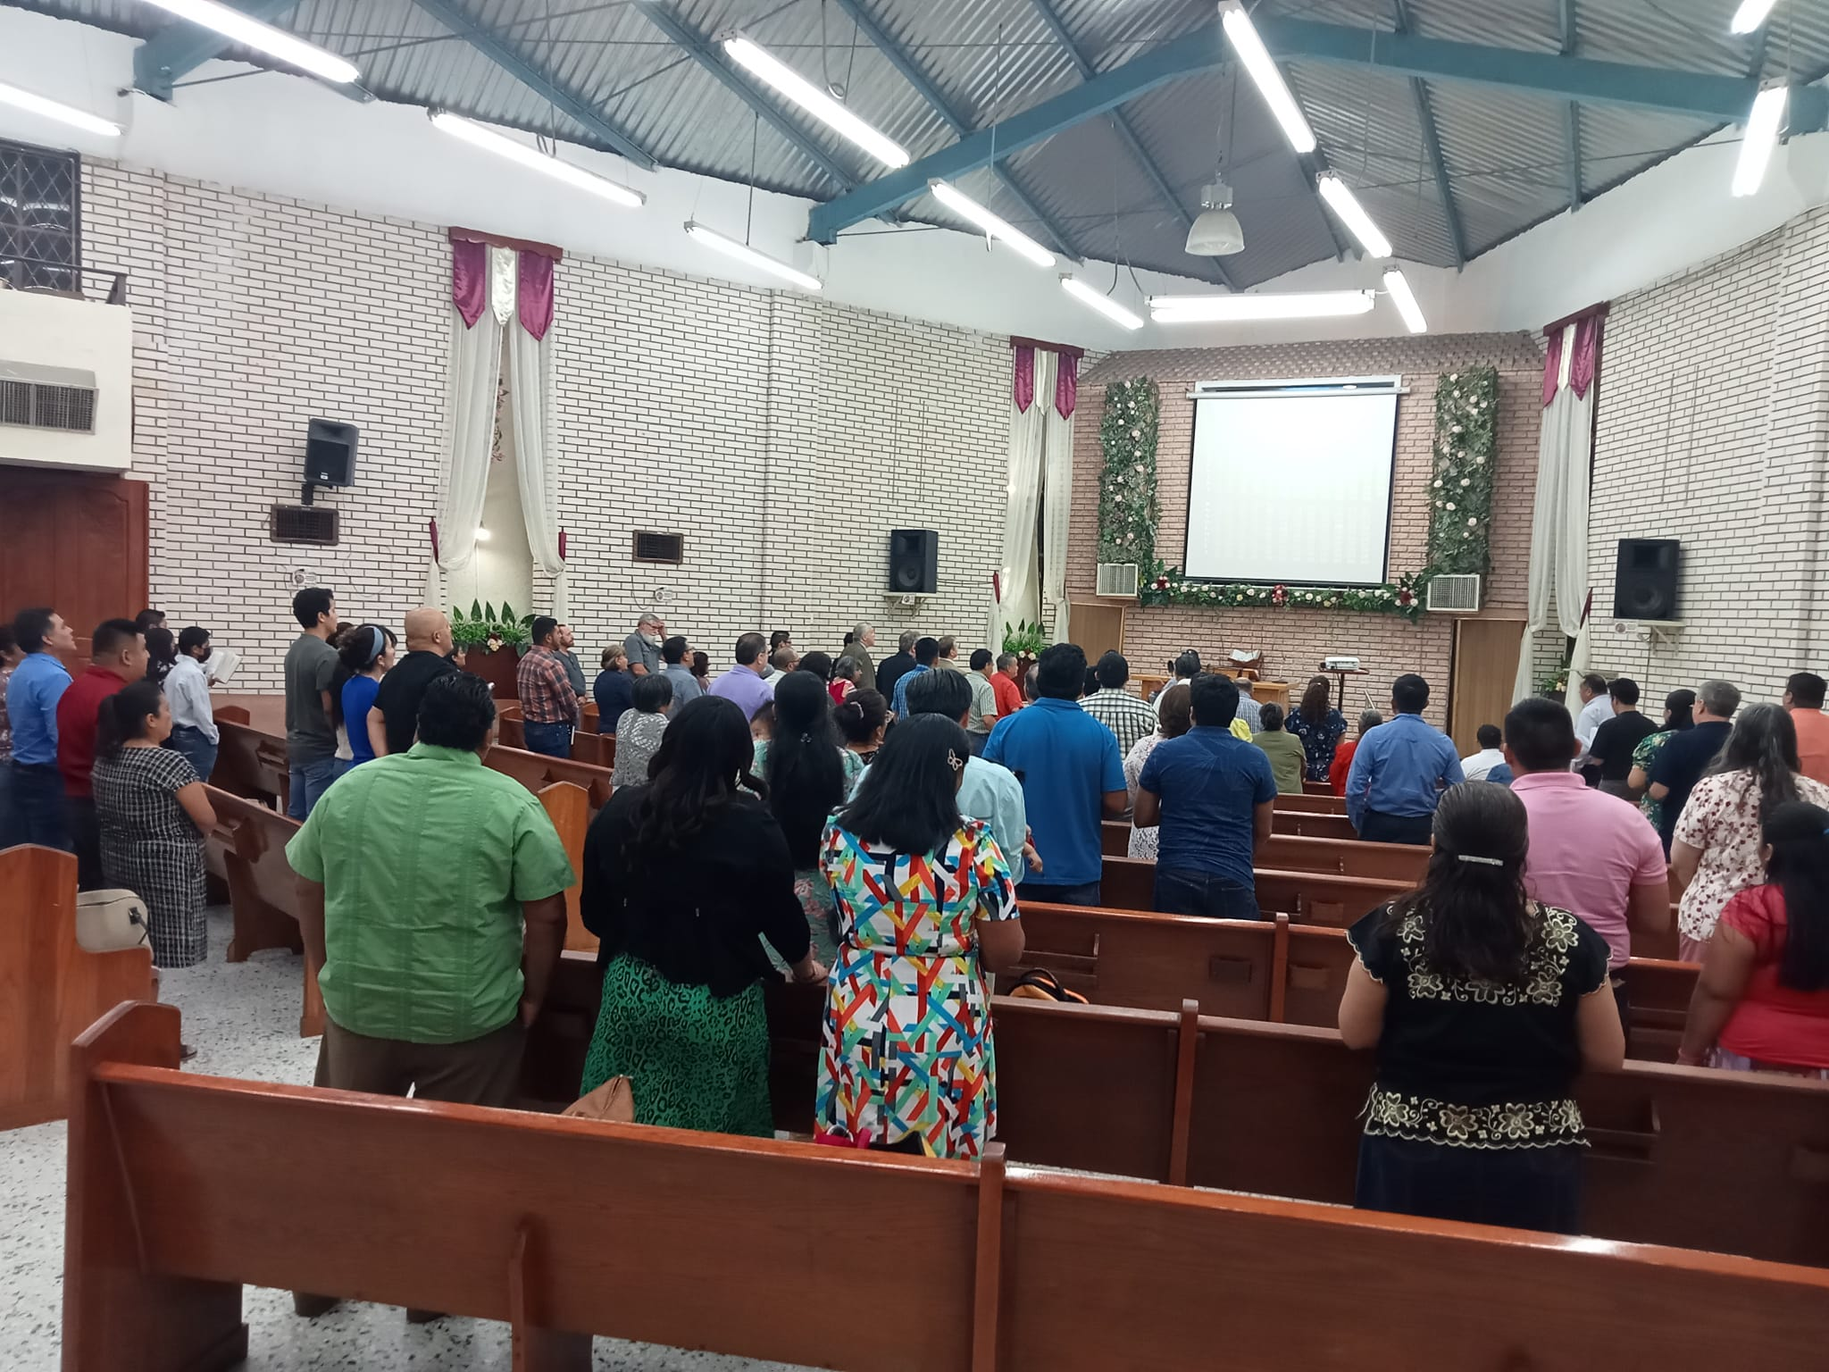
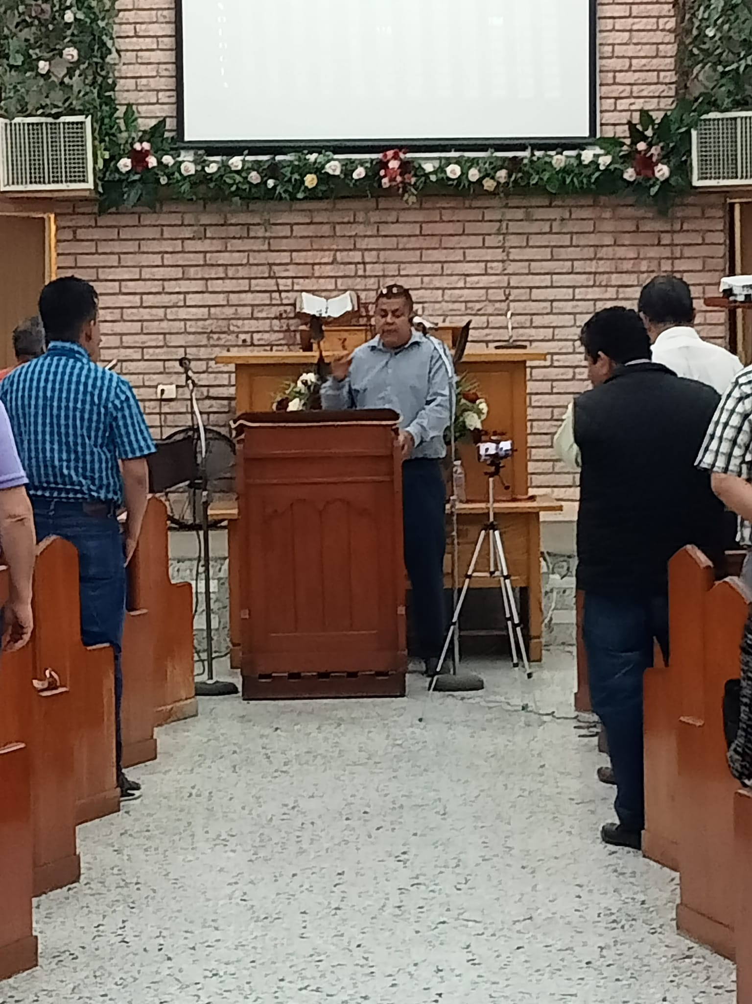
Katy TX Seminar at Sierra Ventana church of Christ
Late on March, we received a Leadership seminar organized by Katy church of Christ for their Mexican missionaries. Three days of sound instruction were made by Brother John Baker

Slide 11
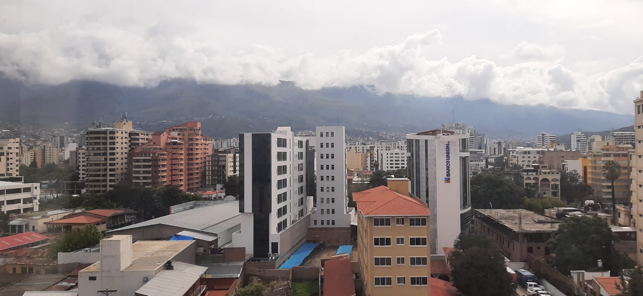
BOLIVIA MISSION & MONTERREY SCHOOL OF PREACHING
Cochabamba, Bolivia
We have a plan to get some students from this country on August 2023. It may be three marriage studenst and one single student

Slide 12
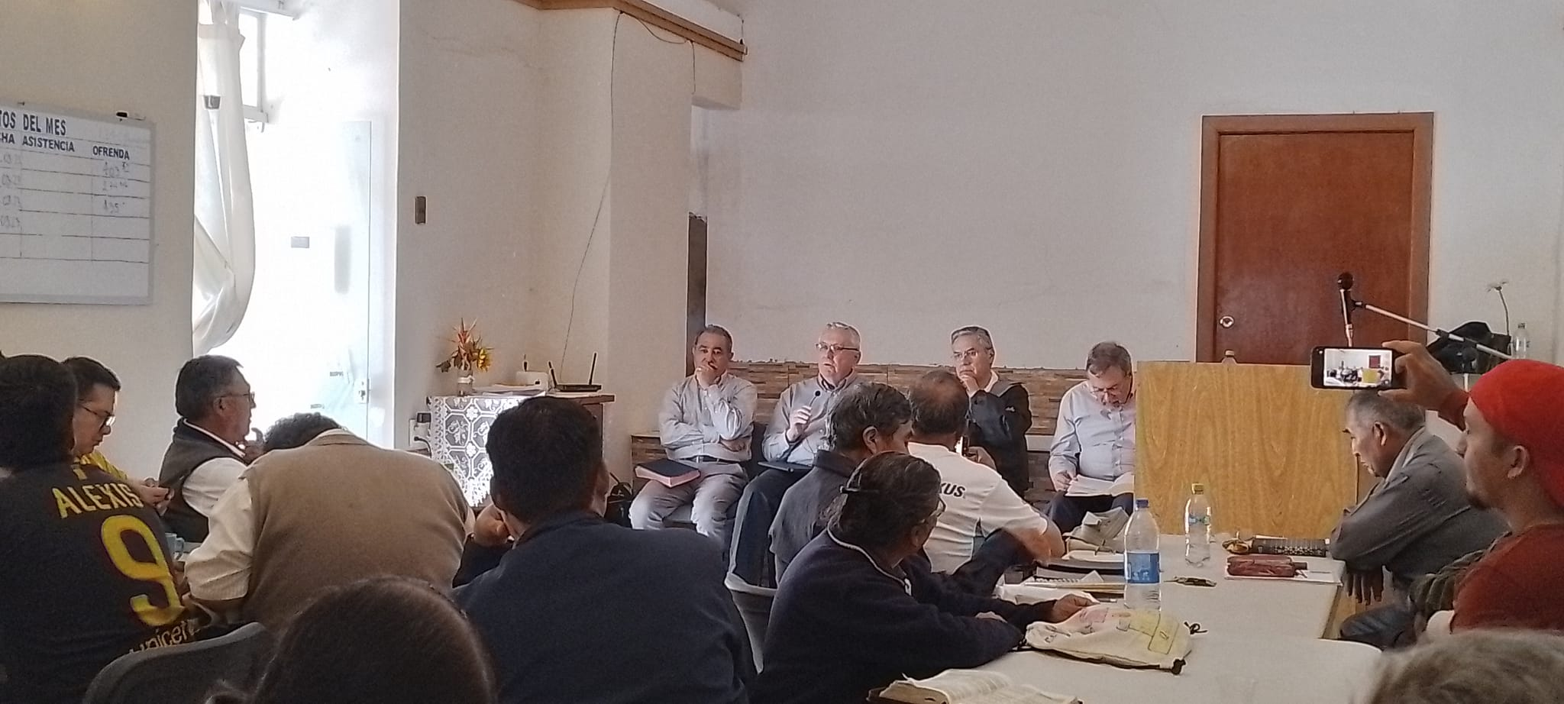
BOLIVIA MISSION & MONTERREY SCHOOL OF PREACHING
We stayed at Cochabamba for a week. We had a Lectureships at Cochabamba congregation and we attended Sacaba chuch of Christ on Sunday for the opening of their building.
Lectureships at Cochabamba March 2023

Slide 13
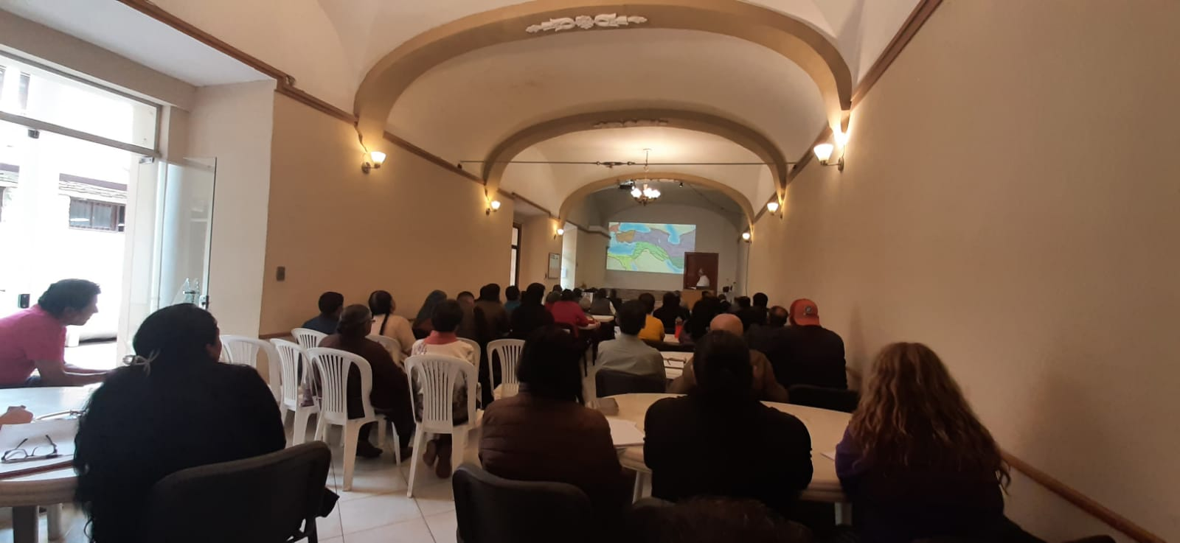
BOLIVIA MISSION & MONTERREY SCHOOL OF PREACHING
About seven interviews were made in order to have potential students information, and now we have seven applications to select four students. They are from La Paz and Tiquipalla
Lectureships at Cochabamba March 2023

Slide 14
General Activities of the Students
Twice a week they have a devotional time at the apartments
Students conyinue going unto local congregations Sunday morning as part of their training
Students and their families continue supporting Sierra Ventana activities like visiting bortherhood
Appartments Devotionals
Supporting local congregations
Visitation

Slide 15
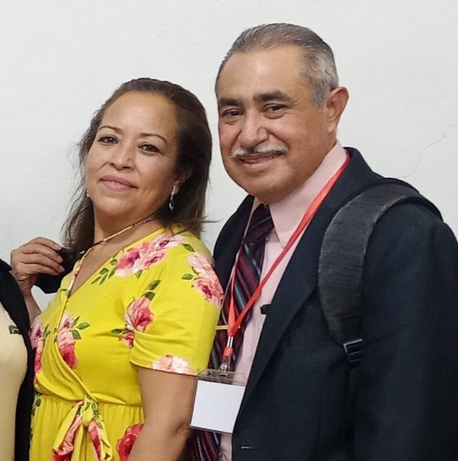
OUR THANKFULNESS
We want to show you our appreciation and thankfulness for the support you have given to Monterrey School of Preaching every year.
We know, without your spiritual and economic support any of this would be possible. We keep you all in our prayers that God may bless you and your families forever.
We pray God you may keep doing the same work for His glory an honor.
Sincerely
Jesus Conrado & Carmen Jimenez
Director

