Slide 1
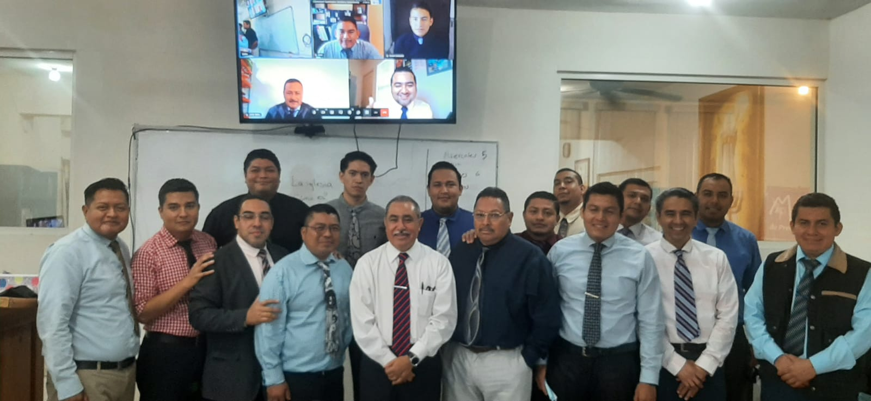
Quarterly report October – December 2022 Monterrey school of preaching A Life Preparing Workers For The Lord
www.monterreyescueladepredicacion.com

Slide 2
2023 & 2024 Classes
From October to December include the end of first bimester and second one. This is the time when students start to take more confidence in their day by day at the school. They already know how each instructor works and now they are involved in many activities and school requirements. For some of them, it is easy to get but for others ones it is hard, but at the end, ach of them make is own effort

Slide 3
Local congregations support
After pandemic, one the great blessings that happened, is that we are able again to support local and foreign congregations by our students. So, since the beginning of this scholar year, we start to send students and their families every Sunday, to do this work for the Lord’s church.
This is one of the essential parts of the training because students have the opportunity to improve their preaching skills.
Also, they are learning from the experience of older preachers and the challenges that they are facing in their local work.
Fellowship with the Lord´s church is done, and all of it is good for the encouragement of the student and his family.
Some of the students stay in the same congregation every Sunday, but others are rolling up at diferent congregation every weekend. The church in our city has been so blessed by the years for the support that the school has given to many local congregations.

Slide 4
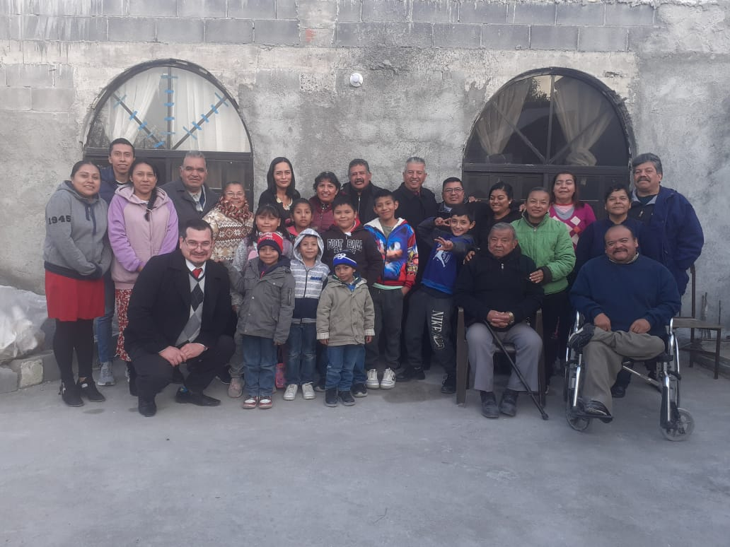
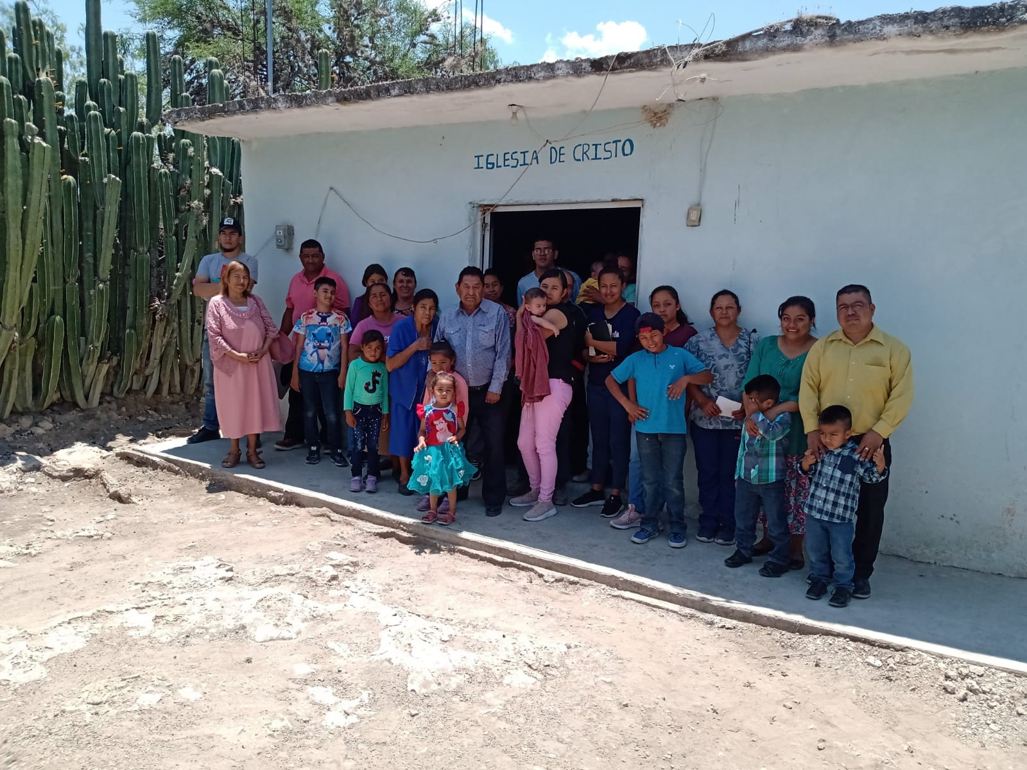
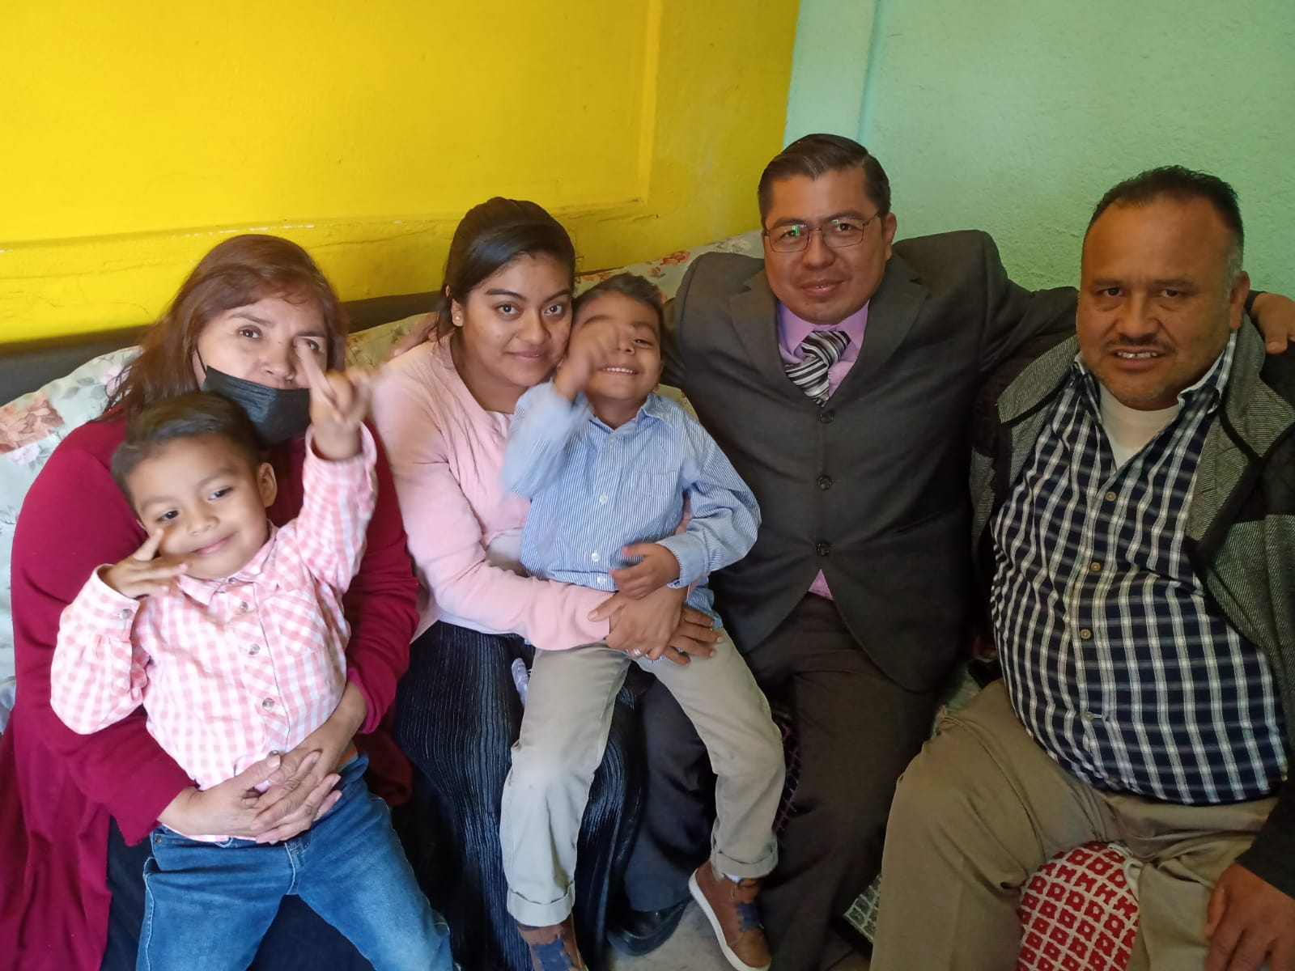
Local congregations support
These are some of the congregations which Brother Saul Alexander has been supported: Las Malvinas, El Milagro SLP, La Estanzuela. Saul, his wife Magali and their children are now supported every Sunday to “Las Malvinas” church of Christ

Slide 5
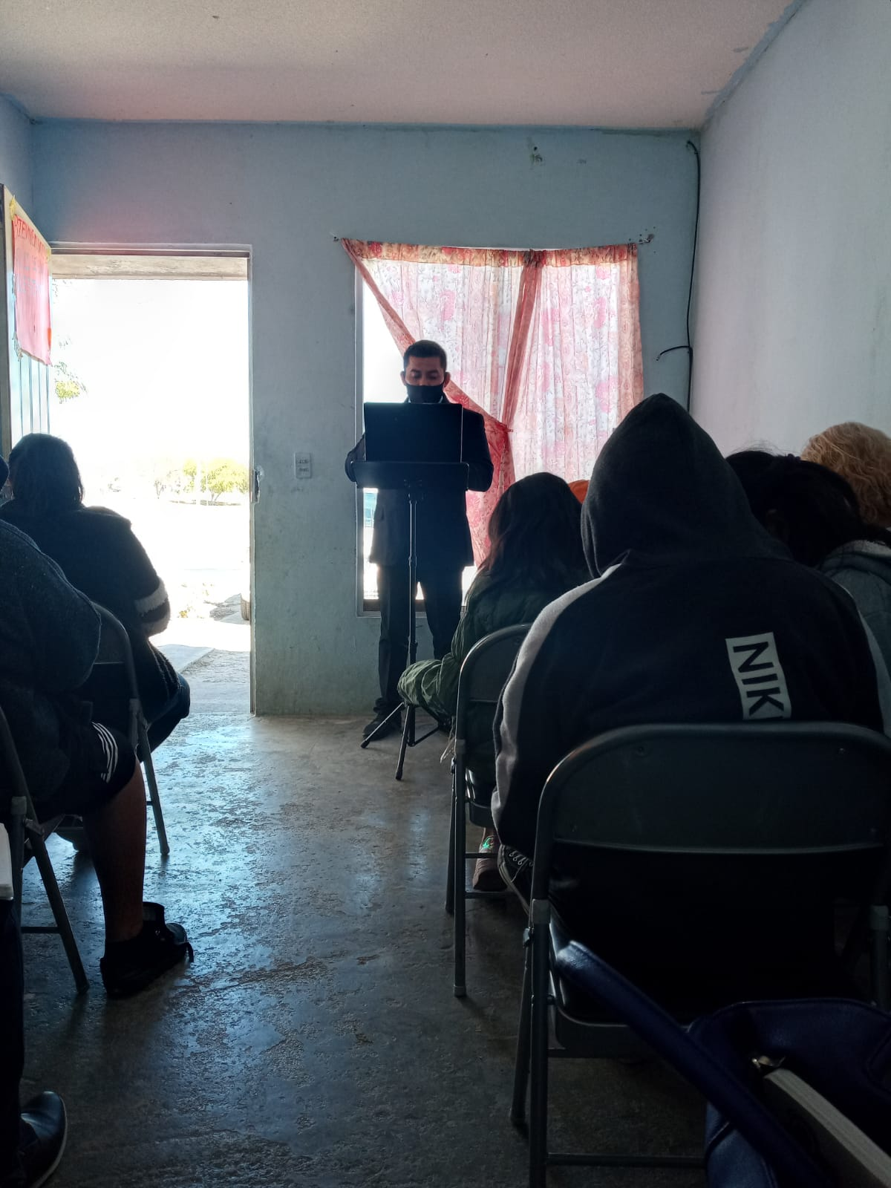
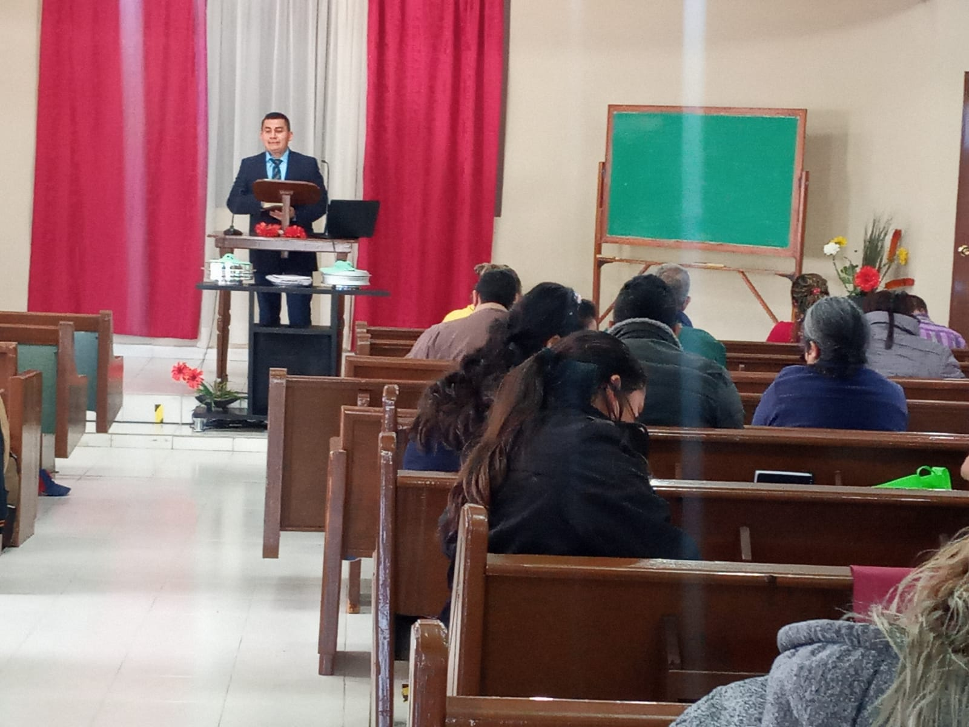
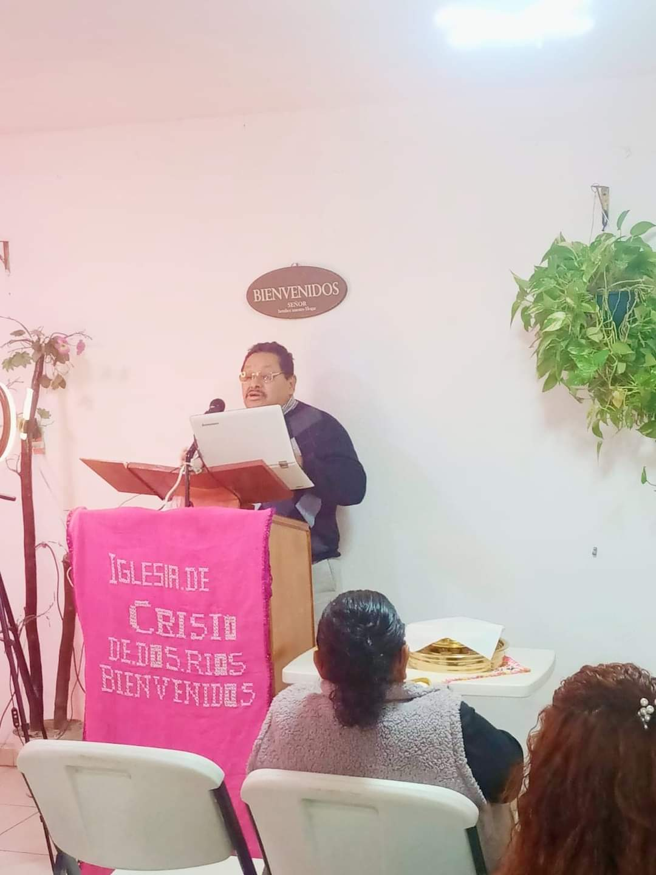
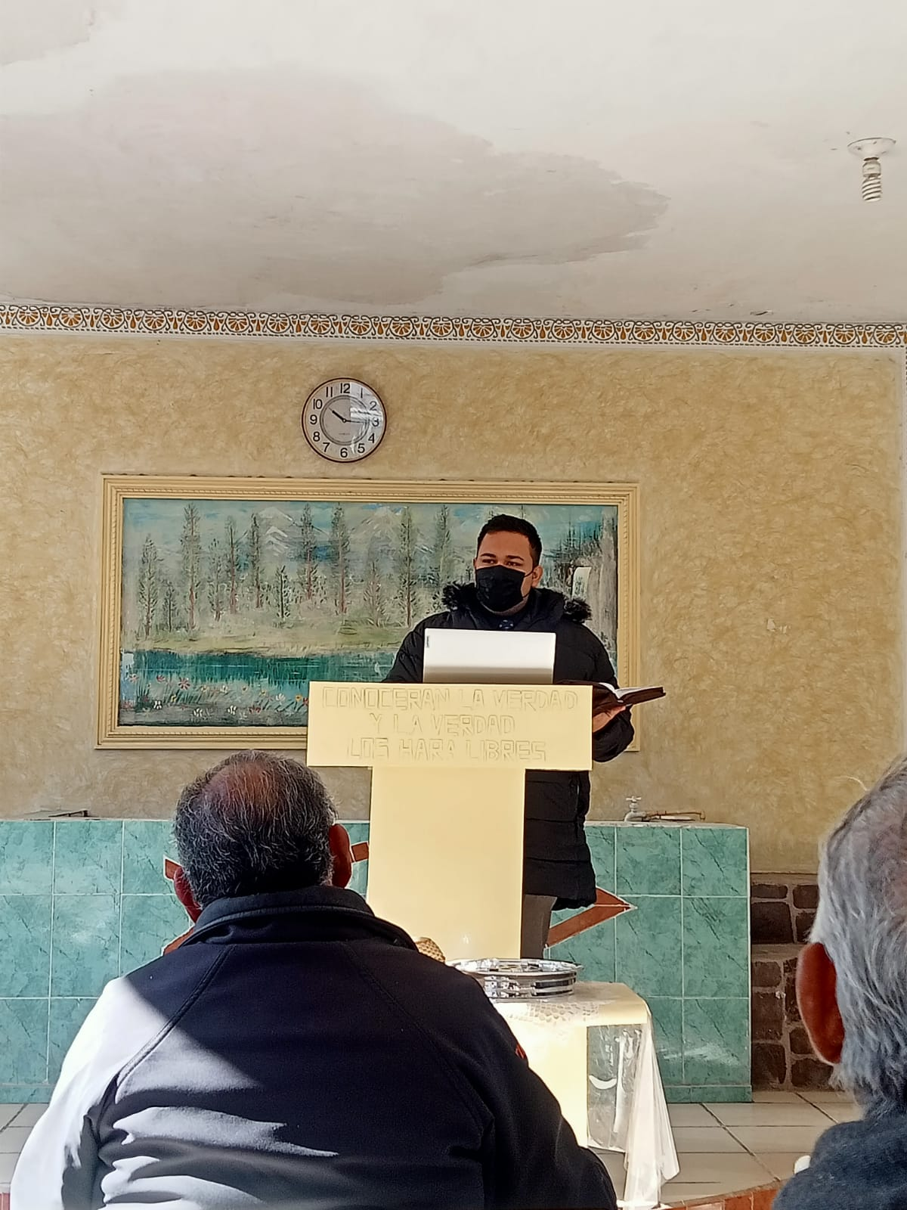
Local congregations support
Jonathan Barrera, first year student. Young man, but very interested Bible student. He loves teach youth class and support congregations like “Independencia”, “Los Ebanos”, “Miguel Aleman”, etc.
Mateo Alvarado and his family were supported during their first year to Allende church of Christ. Now they supported “La Ferrocarrilera” church of Christ every Sunday. Mateo is a good student and he loves make door knocking and to have home Bible studies.
Alfredo Cerecedo, first year student has been supported several congregations like “Dos Ríos”, “Zaragoza”, “Zapata” etc. He has good experience.

Slide 6
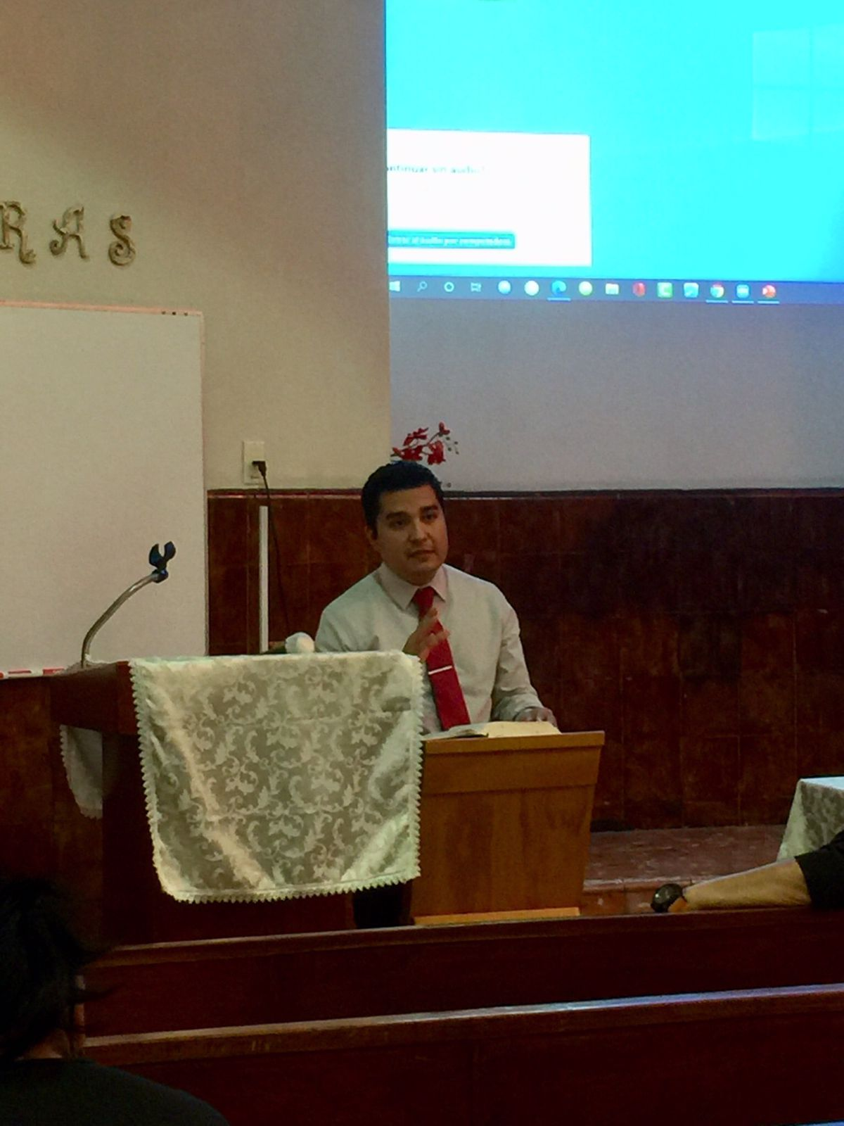
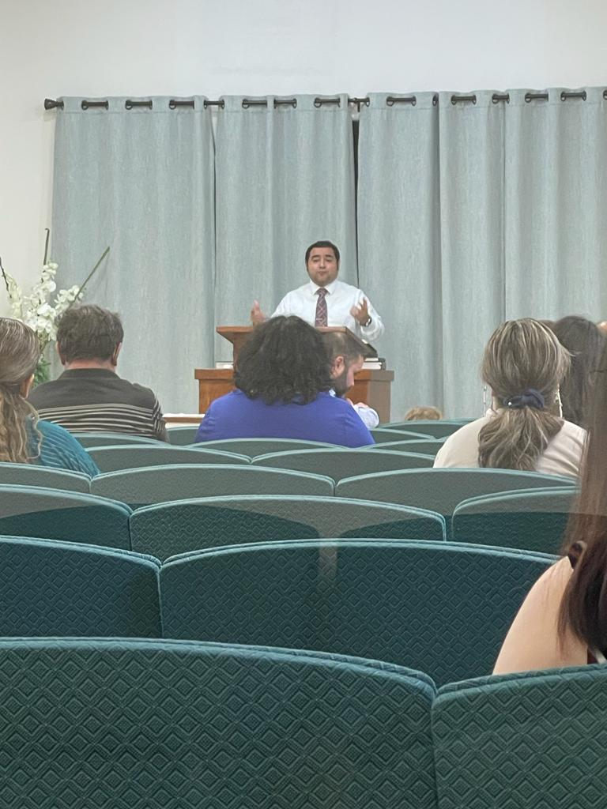
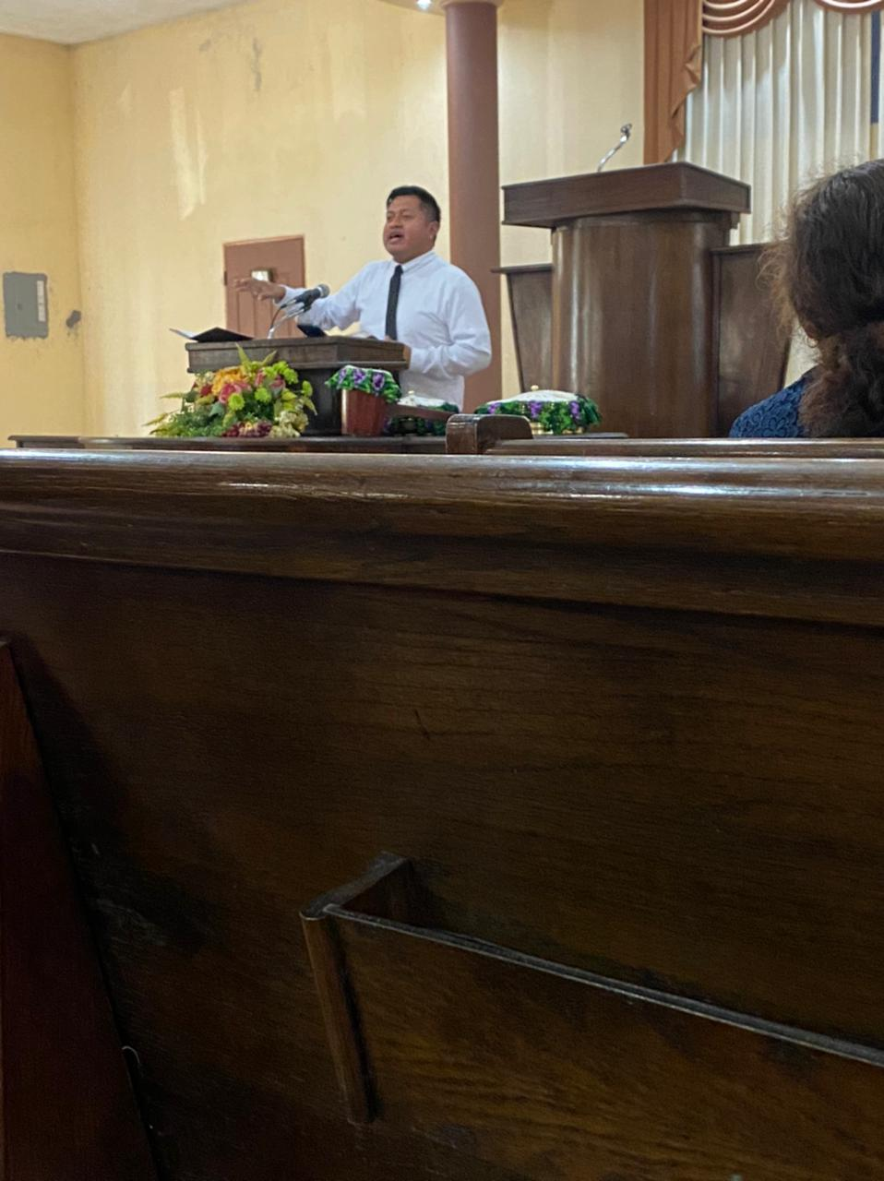
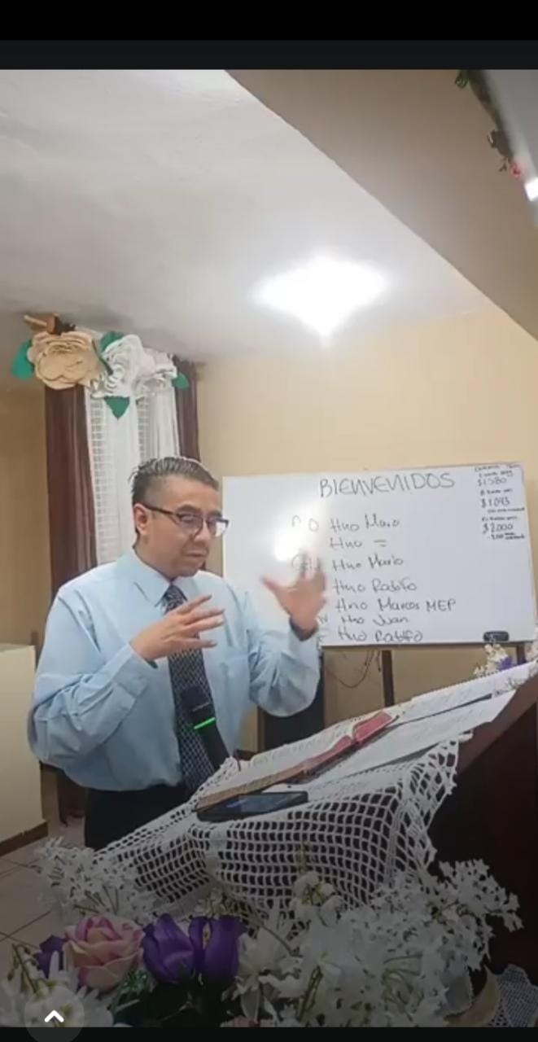
Local congregations support
Cristian Maldonado from Monterrey. He and his family are supporting several congregations like “Mitras”, “San Carlos”, “Escobedo”, etc. He si a really good God´s Word teacher. He is working hard for the church.
Martín Rodríguez. Online student. From Brownsville Tx, He and his family has been a good support for Northdide church of Christ at this place. They Love God´s Word. Now, he is working as associate preacher.
Leonel Santiago, he is single student and he has been supported several congregations like “Miguel Aleman”, “Zapata”, “Garcia”, “Zaragoza”, etc. He is good student and he loves teach youth class. Also is a good support for the students in whatever need.
Marcos García. First year student has been supported several congregations in Monterrey. He is married and is taking experienece during this first year

Slide 7
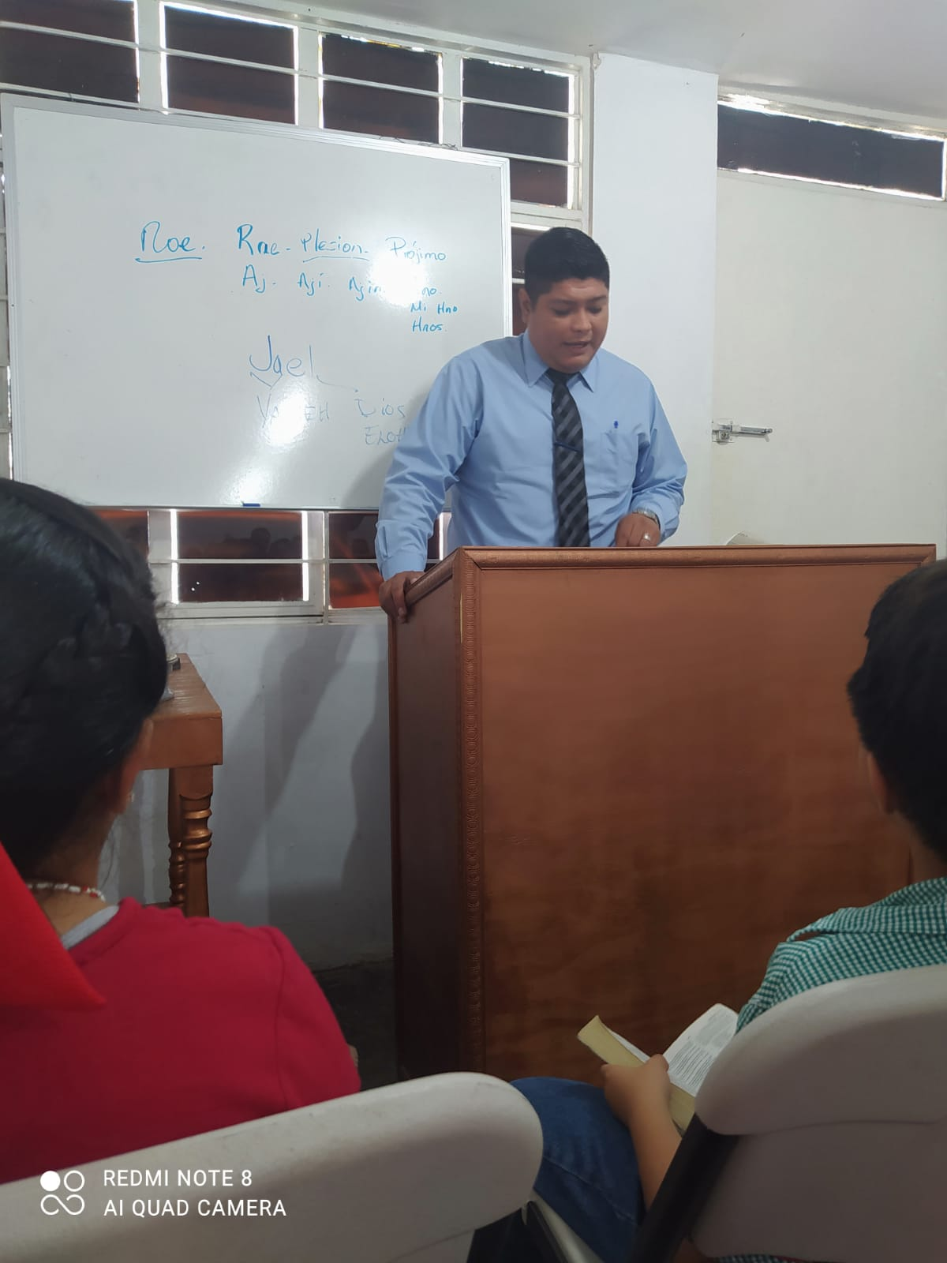
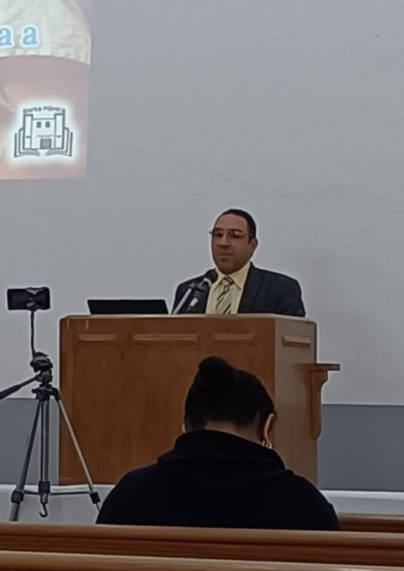
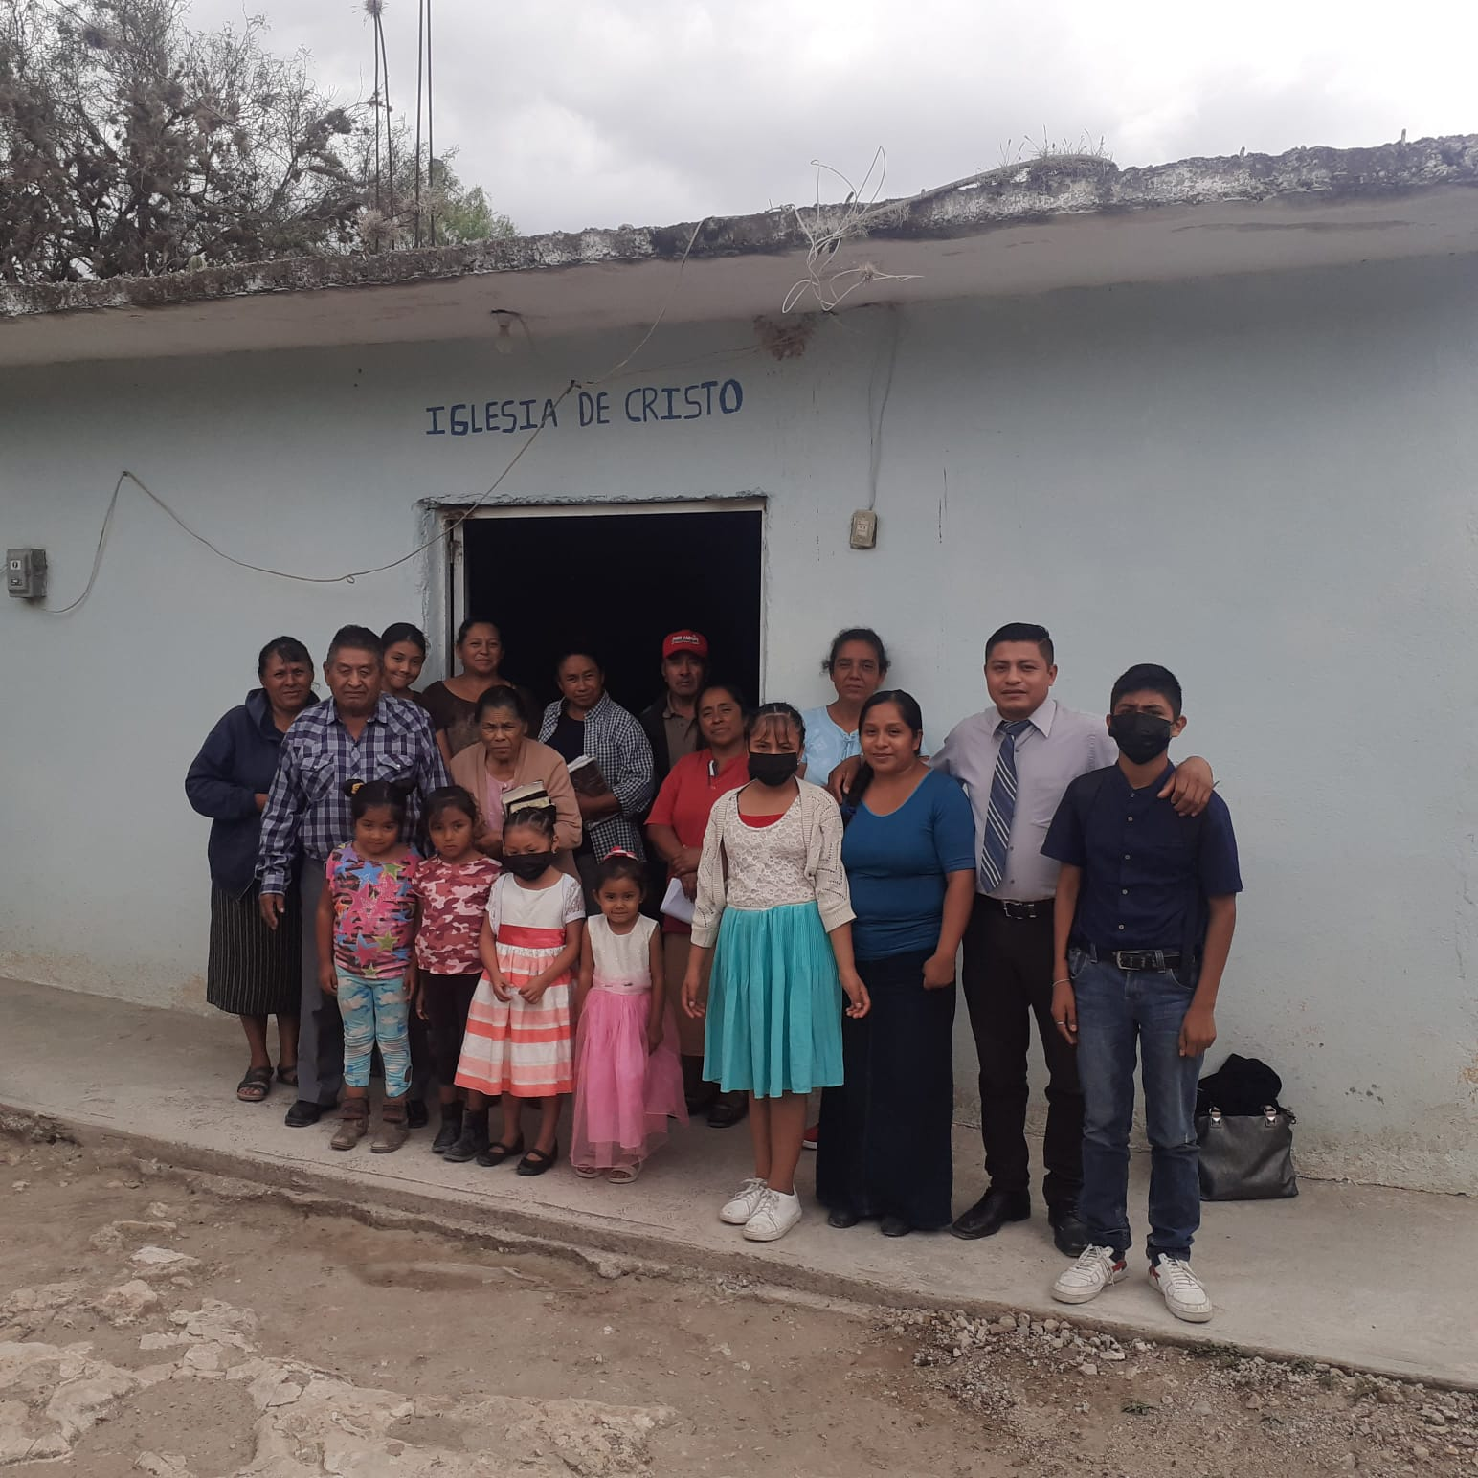
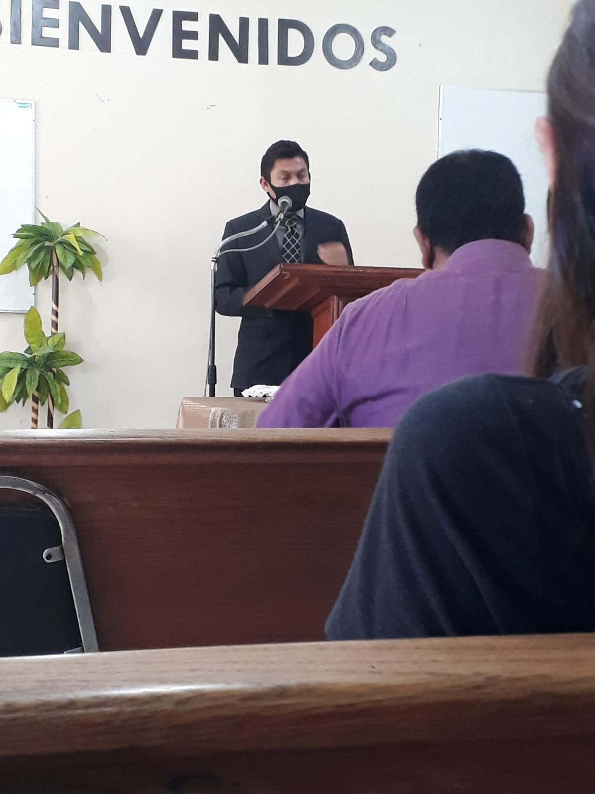
Local congregations support
Fernando Mendoza
First year student. He and his family are very friendly and now they are supporting several congregations. They are good servants of the Lord
Benjamín García.
First year student. He and his family are supporting congregations as Santa Mónica, Dos Rios, etc. They Love de Lord.
Abraham Antonio. From la Huasteca. He and his family are supporting congregtions like Escobedo, García, Tamauipas, etc. They are very good evangelistic people. They are blessing for the school and for Sierra Ventana
Elías Alvarado. During his first year was supporting Allende, but now has been supported at Los Reyes church of Christ in Monclova Coahila. They have a plan to keep him after graduation.

Slide 8
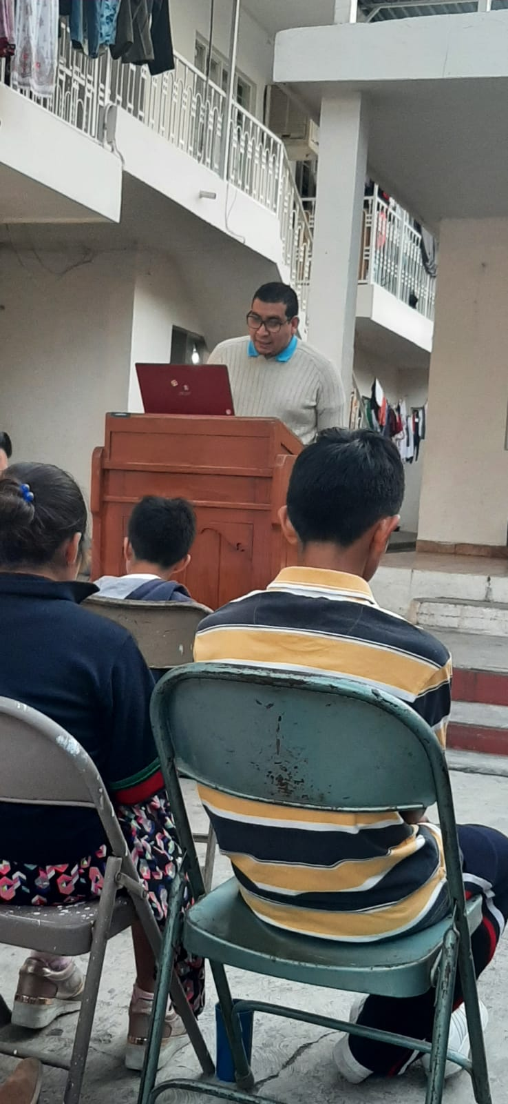
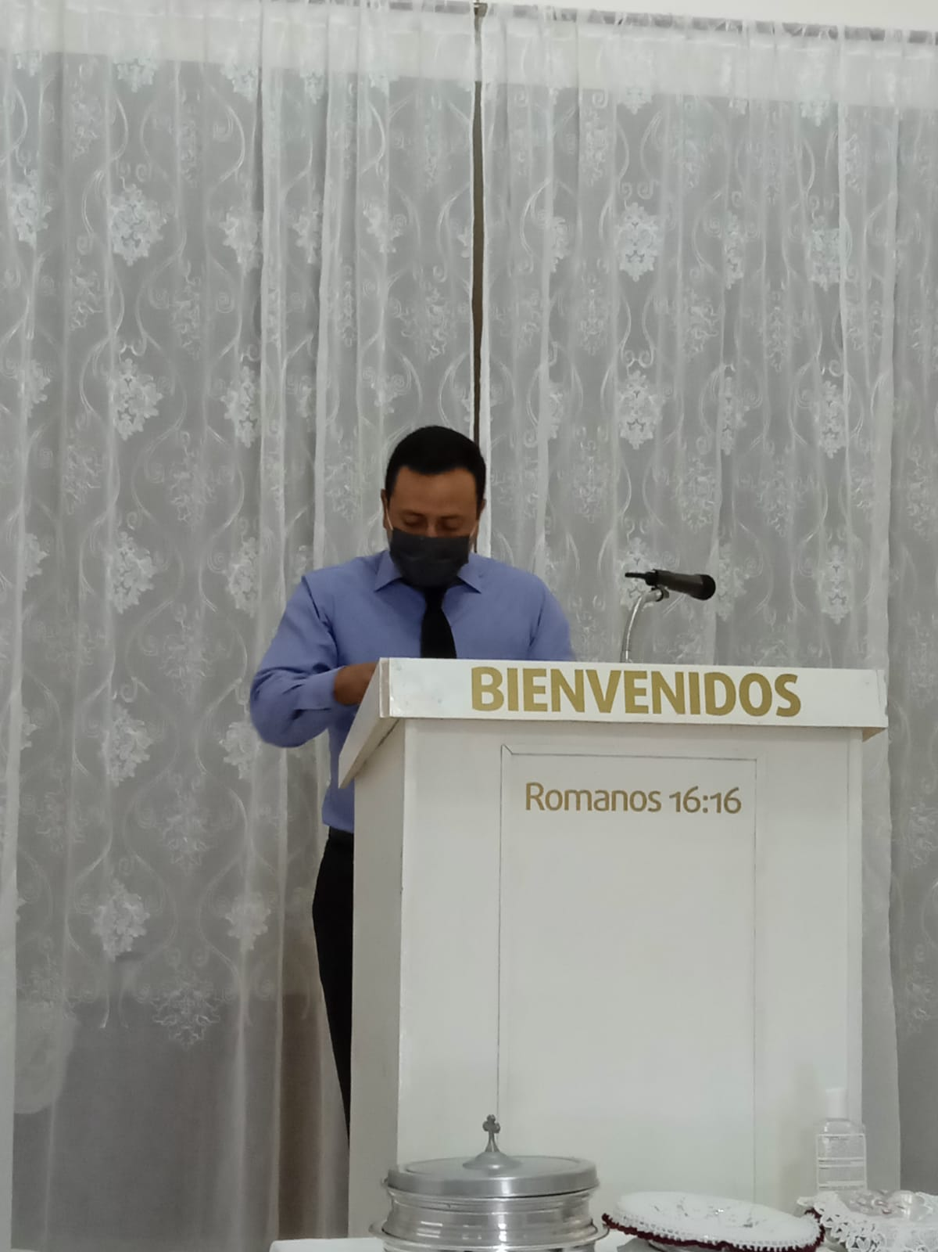
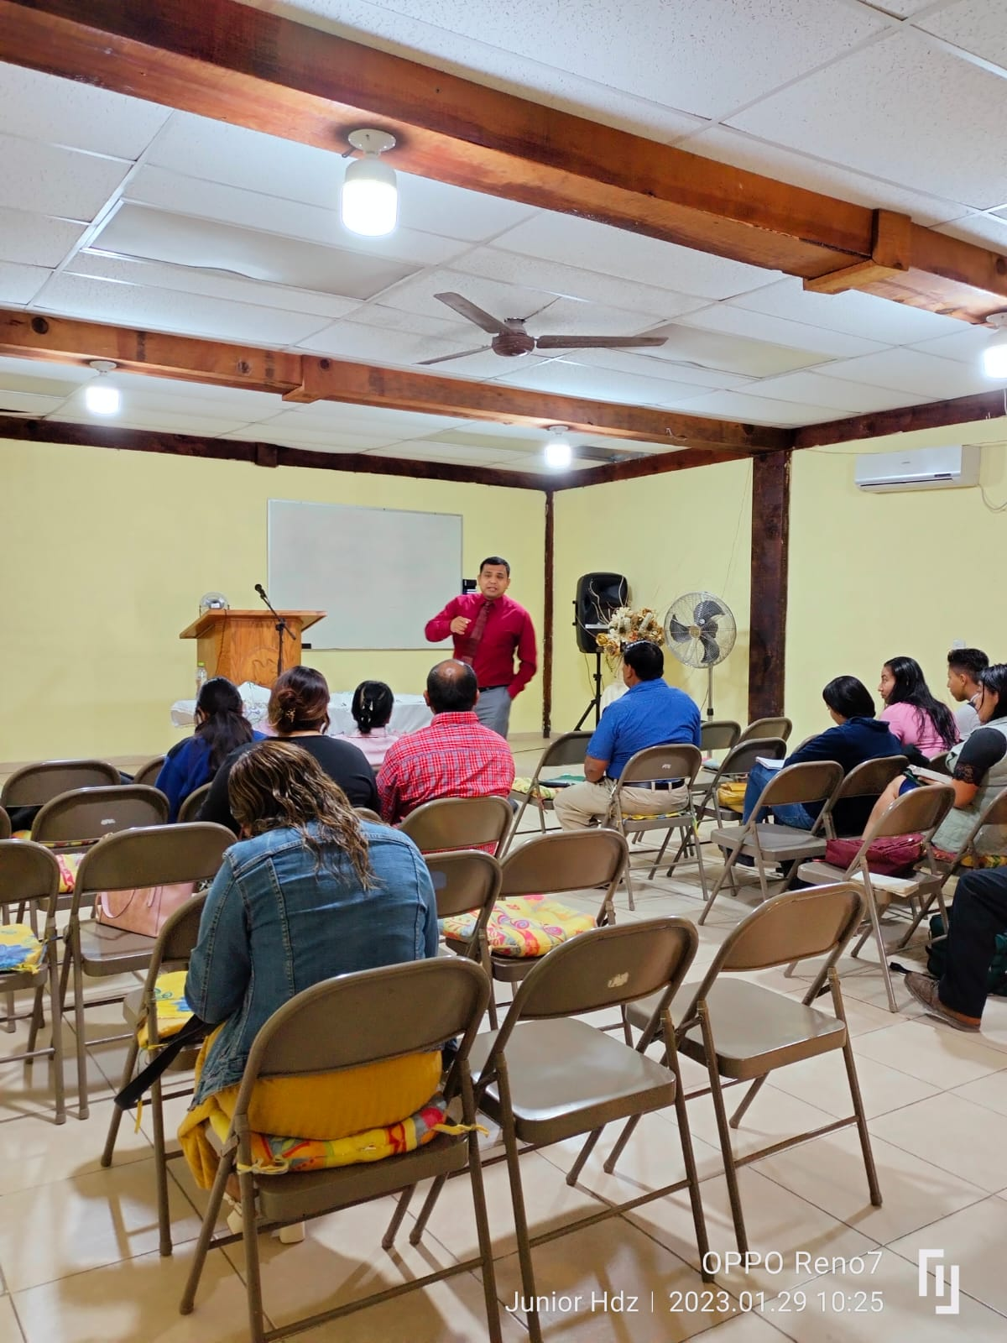
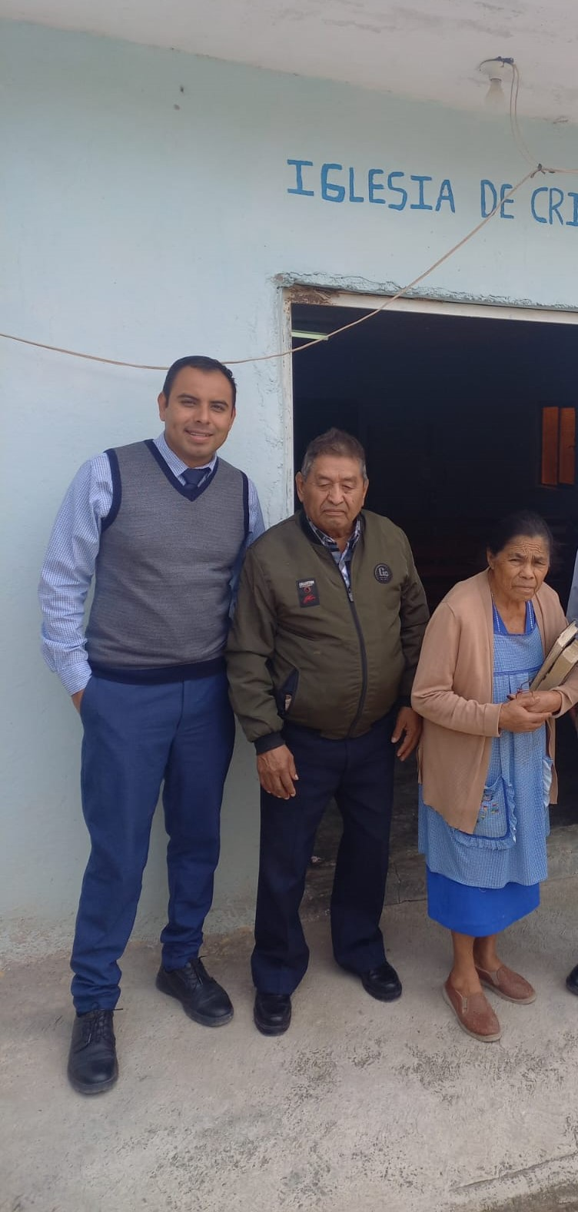
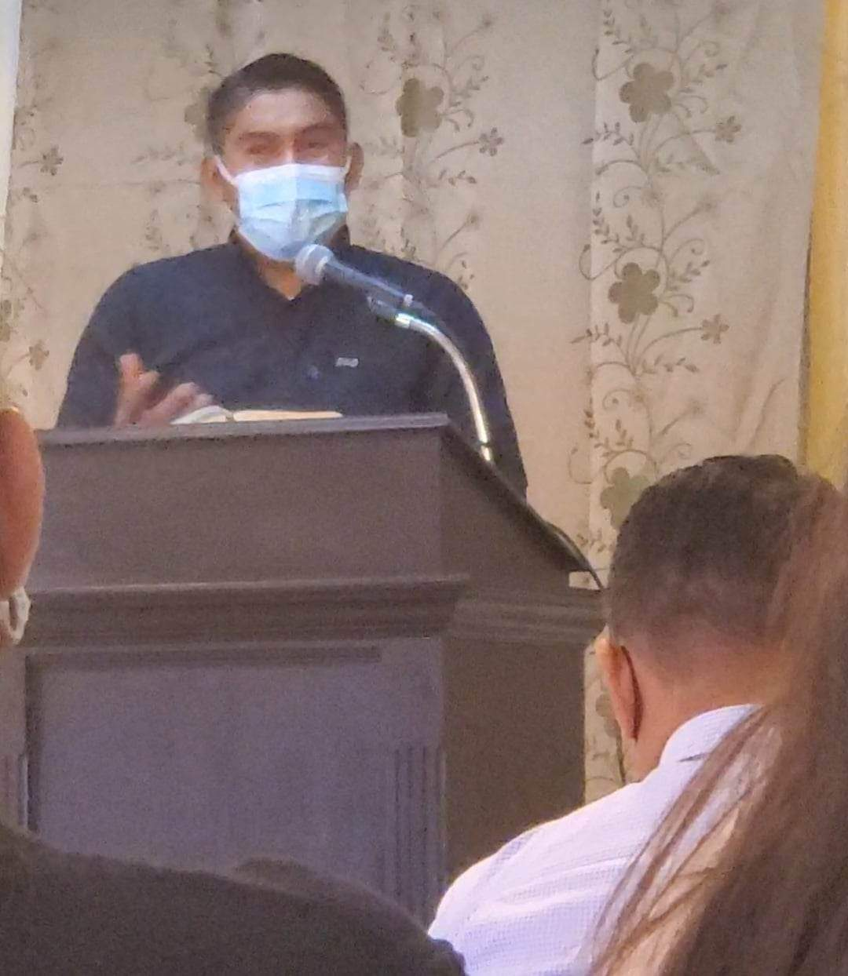
Local congregations support
Luis Uriel López. Online student. He and his family are doing good job at “Cavzaso Lerma” church of Christ in Matamors Tam. He loves God´s Word and is very good student. They love work for the Lord and to serve to the brotherhood
Arturo Quistiano.
Second year student. During his firs year serced at Las Malvinas but now is in charge of youth class at San Bernabe
Noel Barrios
Online student. He is the pulpit minister at “La Constancia Durango. He and his family are doing good job with the church
Gamaliel Menes
Single student, he is supporting several congregations like Estanzuela, Tamaulipas, etc. He is good Bible student
Carlos Tenorio. Single student from Sierra Ventana. He is supporting at Garcia church of Christ. He is good youth teacher

Slide 9
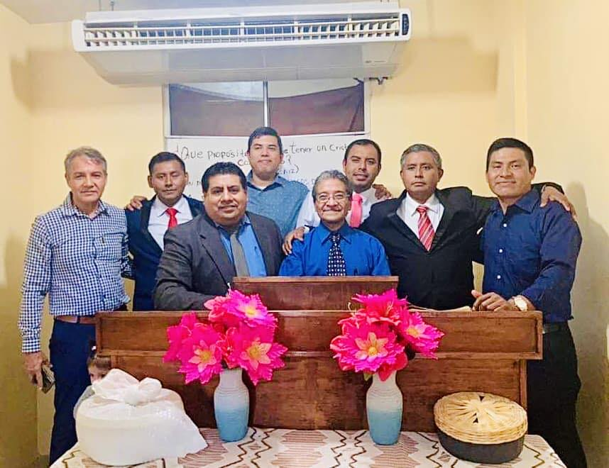
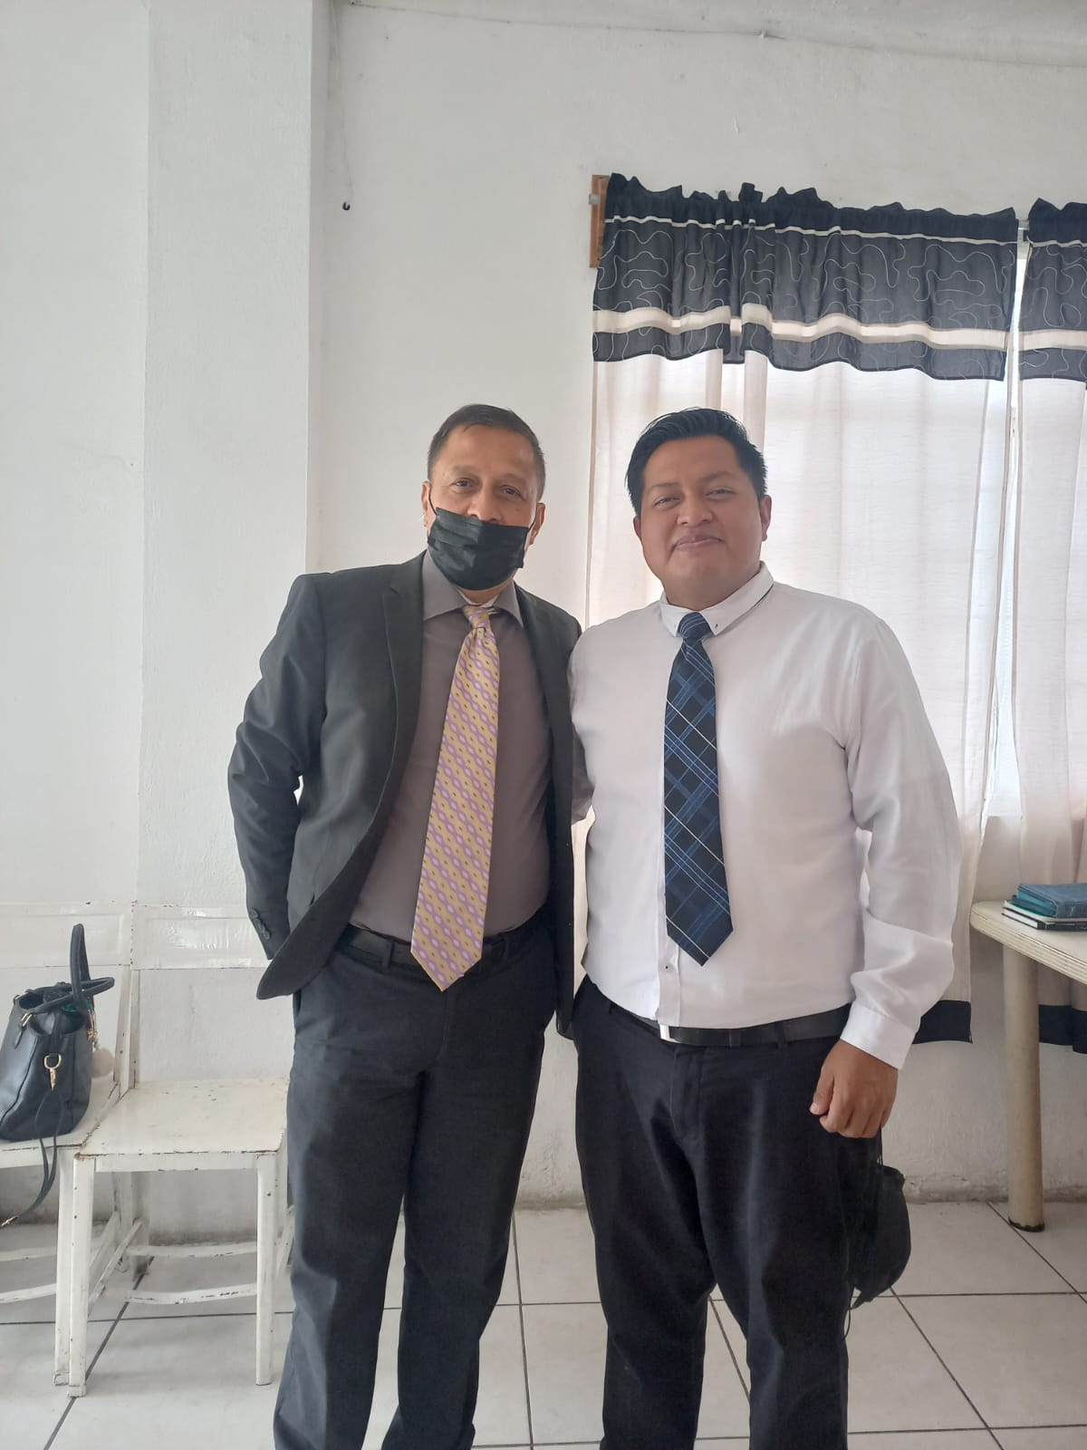
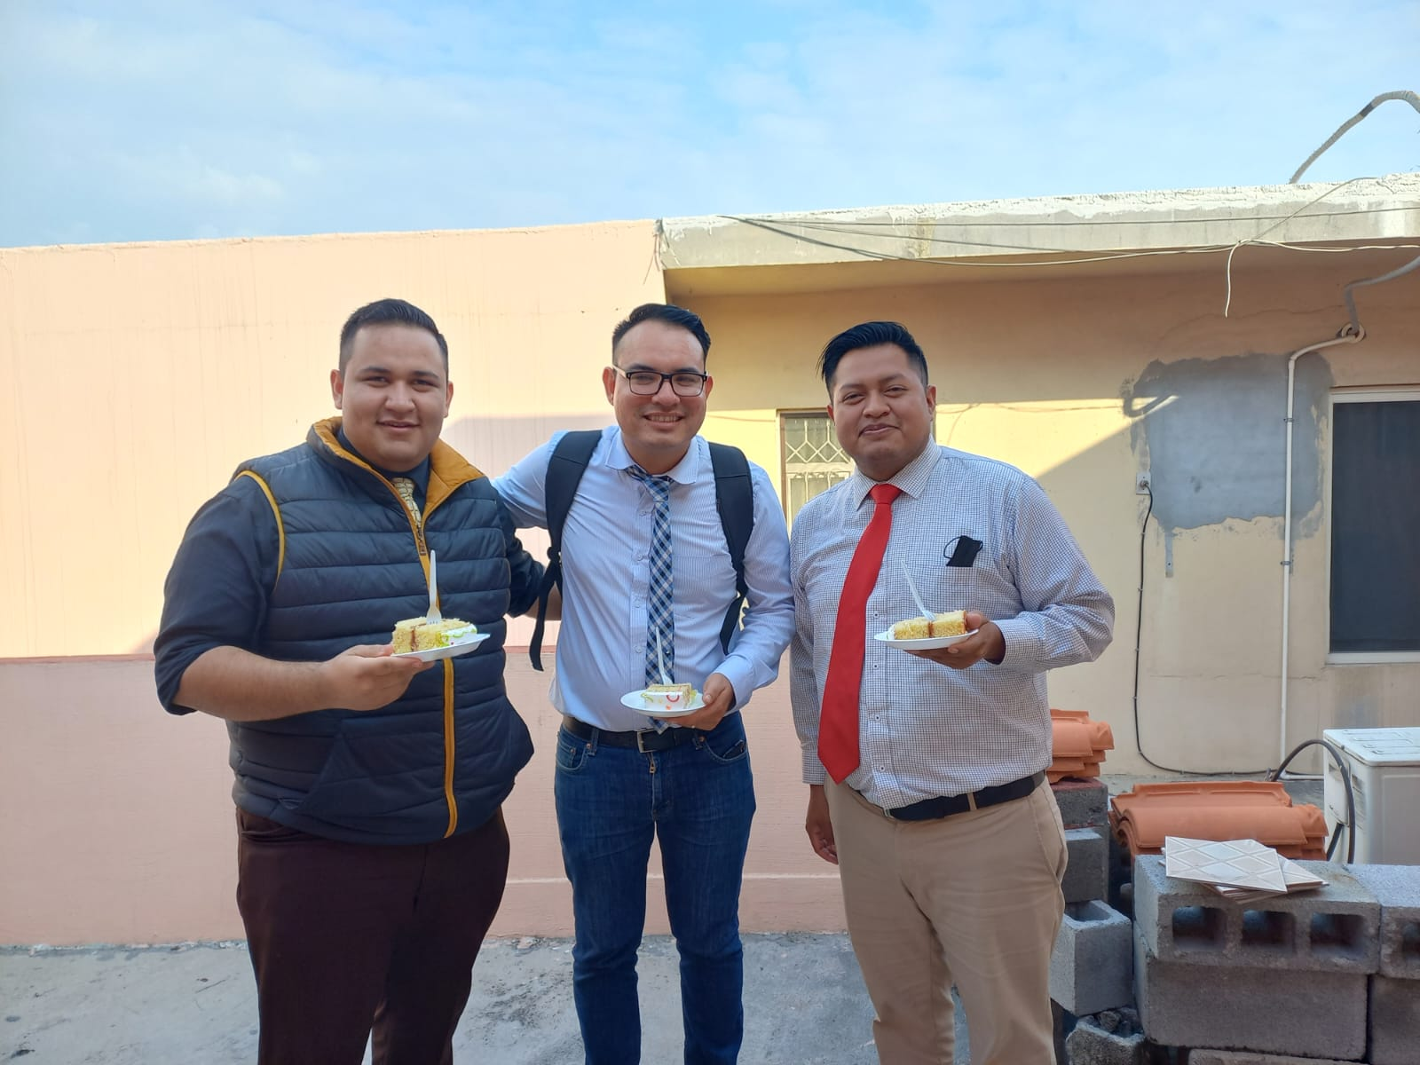
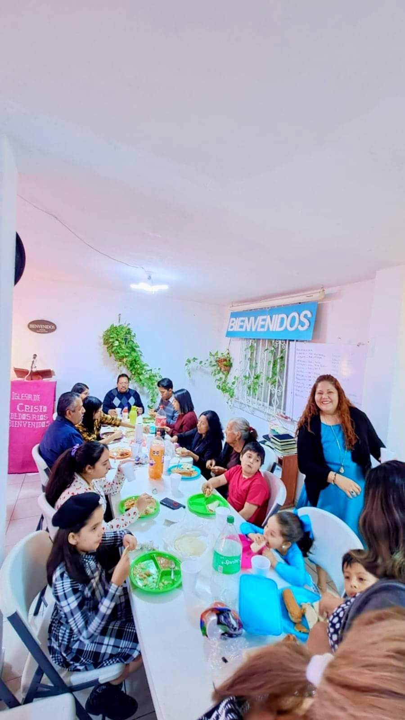
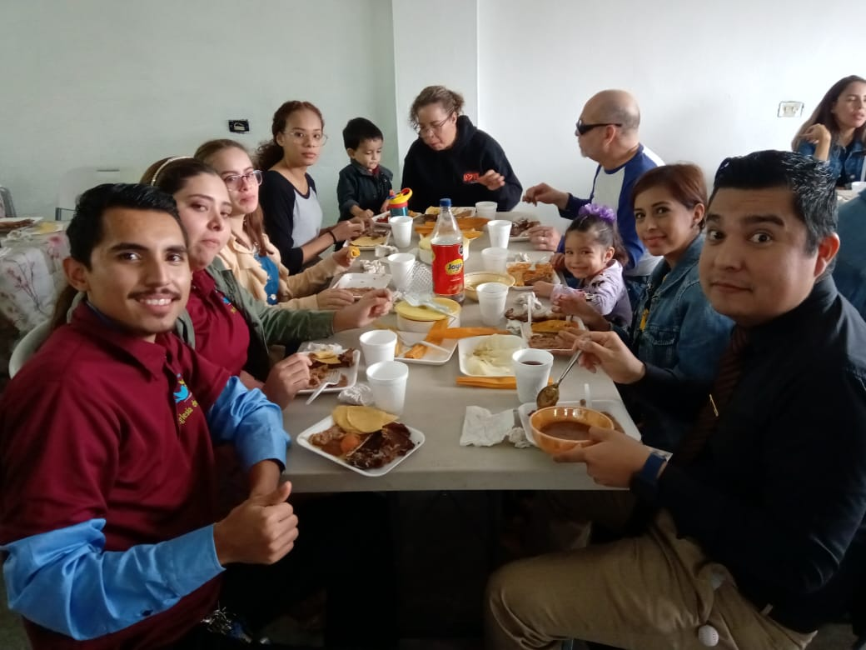
fellowship meals with those who students supported

Slide 10
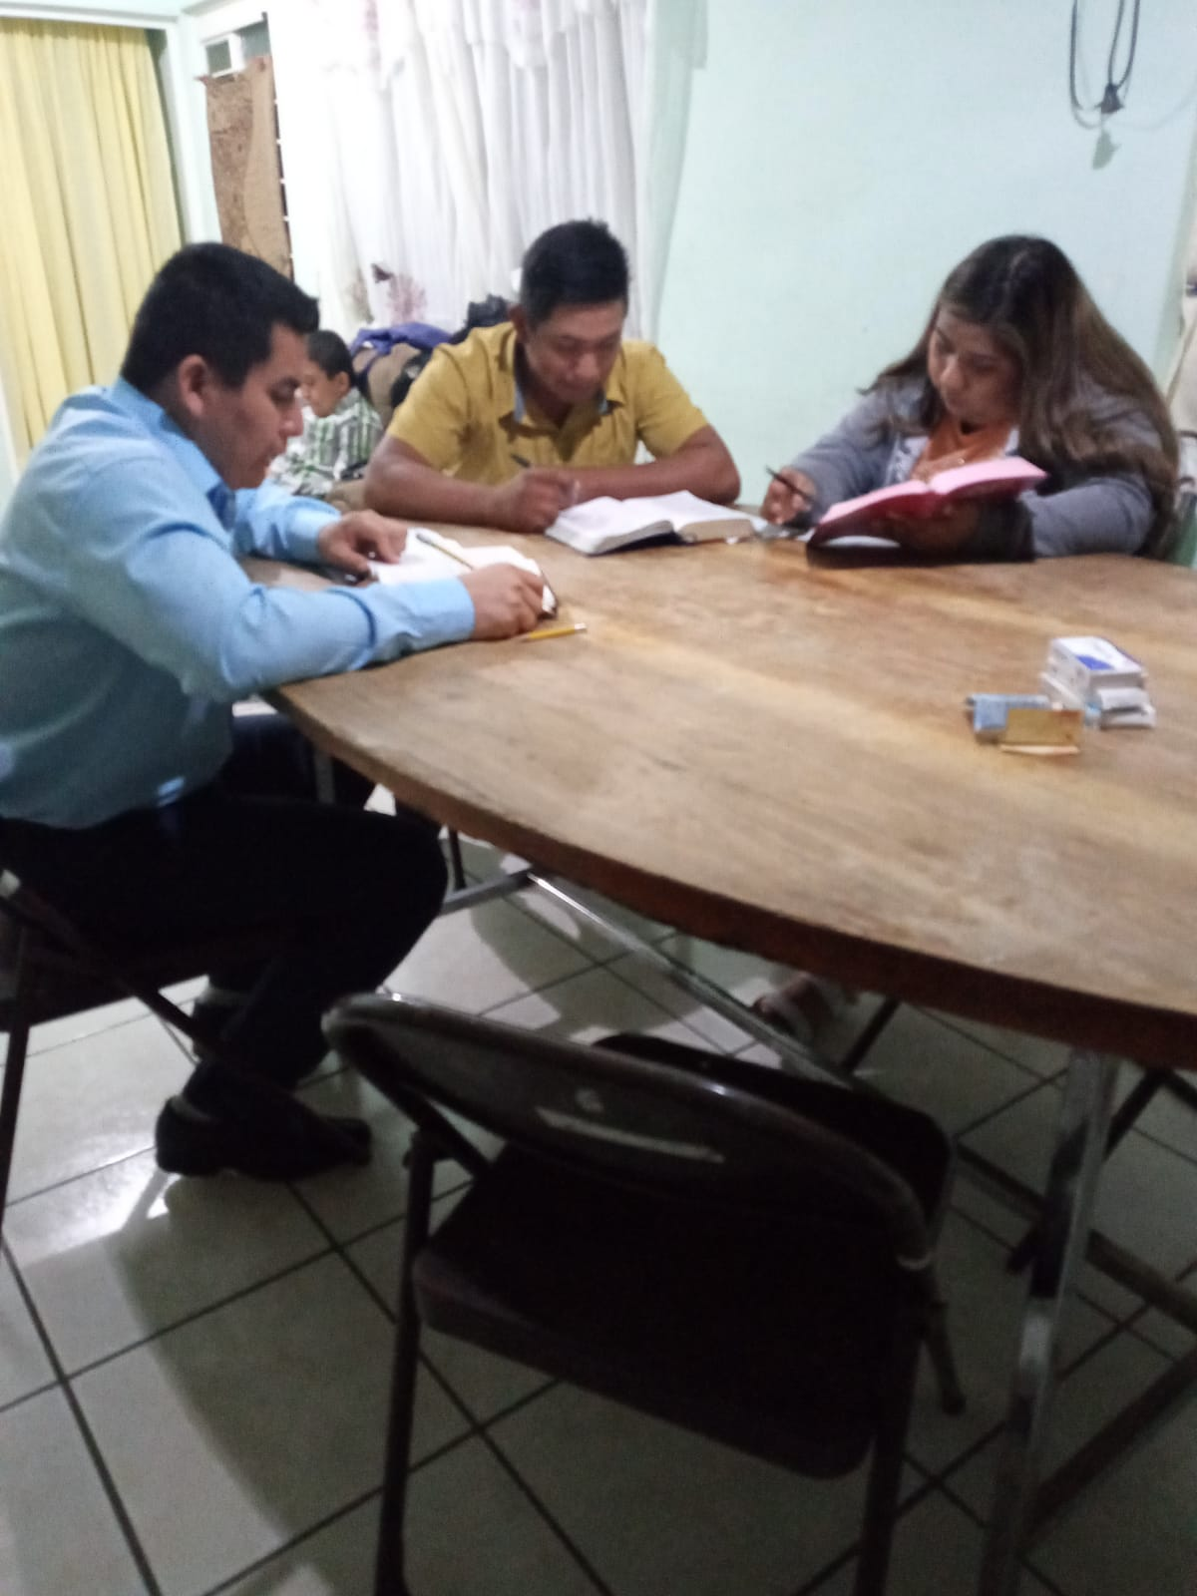
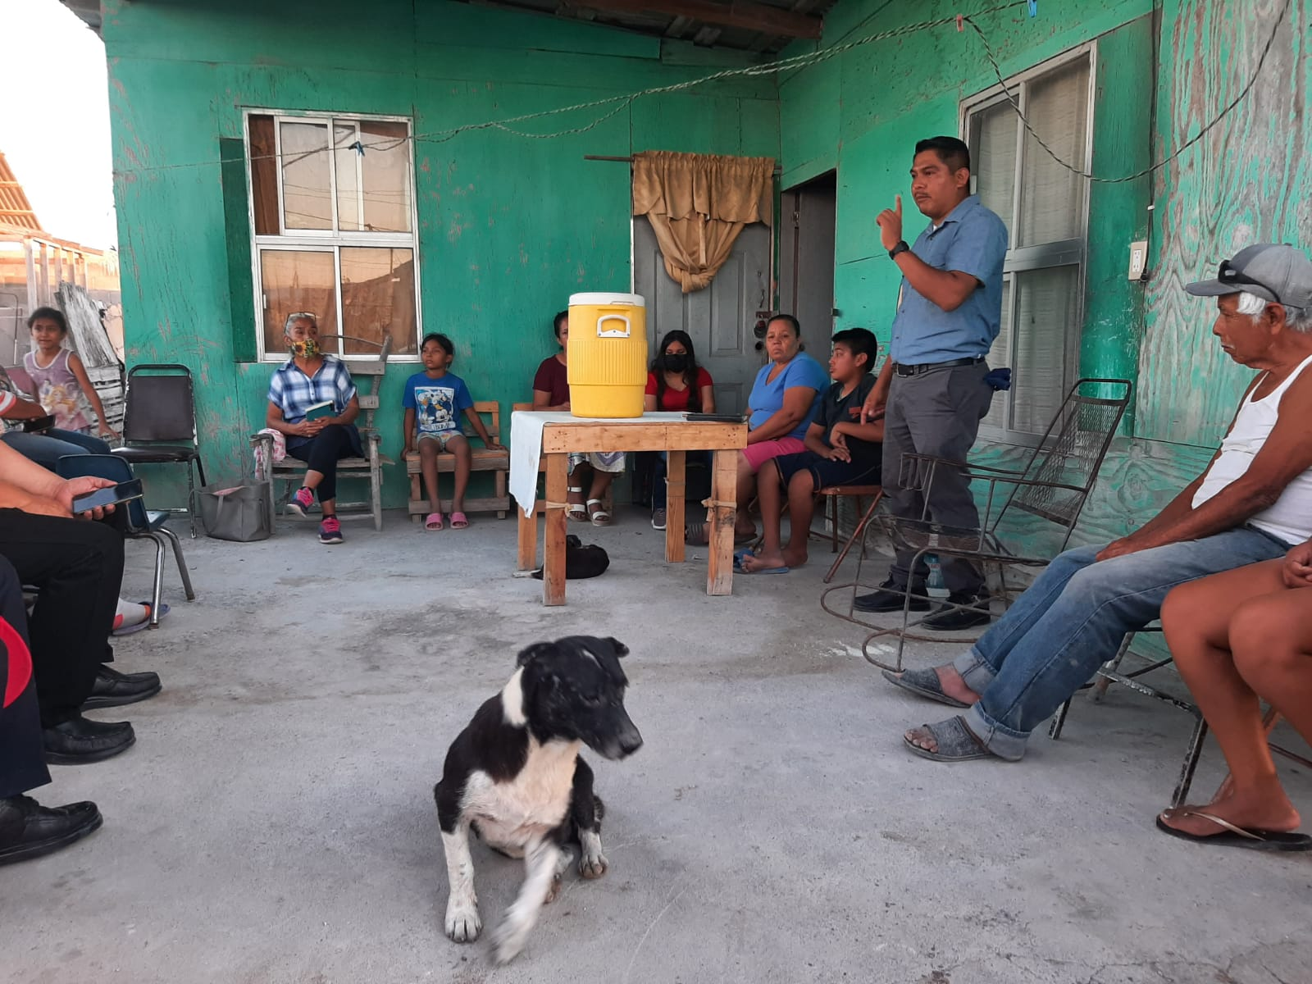
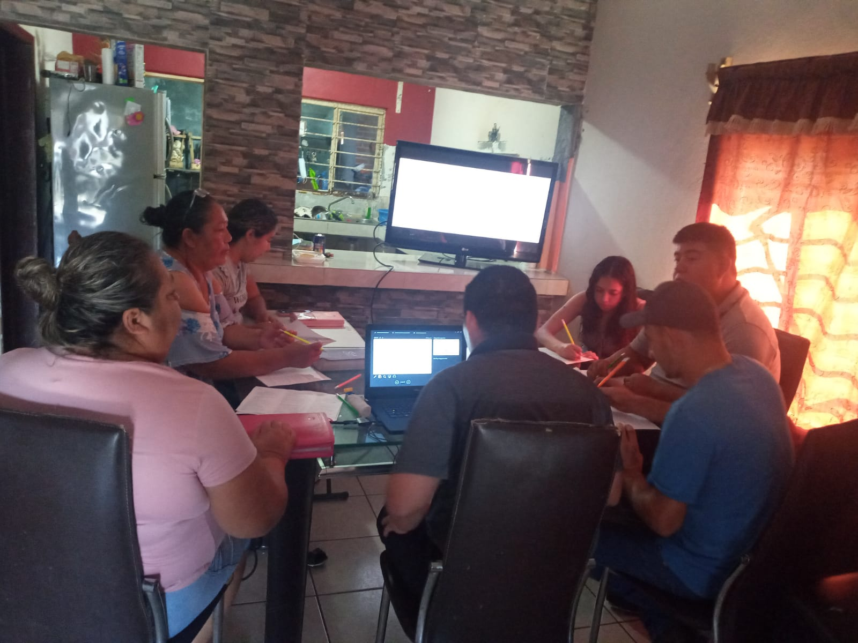
Home bible studies
During their preparation at MSOP, students received two evangelistic methods. Then, it is very important for thier training to have Home Bible studies. In fact they have it as a requirement. Usually they get it when they go to support congregations or when as school, we have door kncking. All of this is done in order to bring people unto the Lord Jesus Christ.

Slide 11
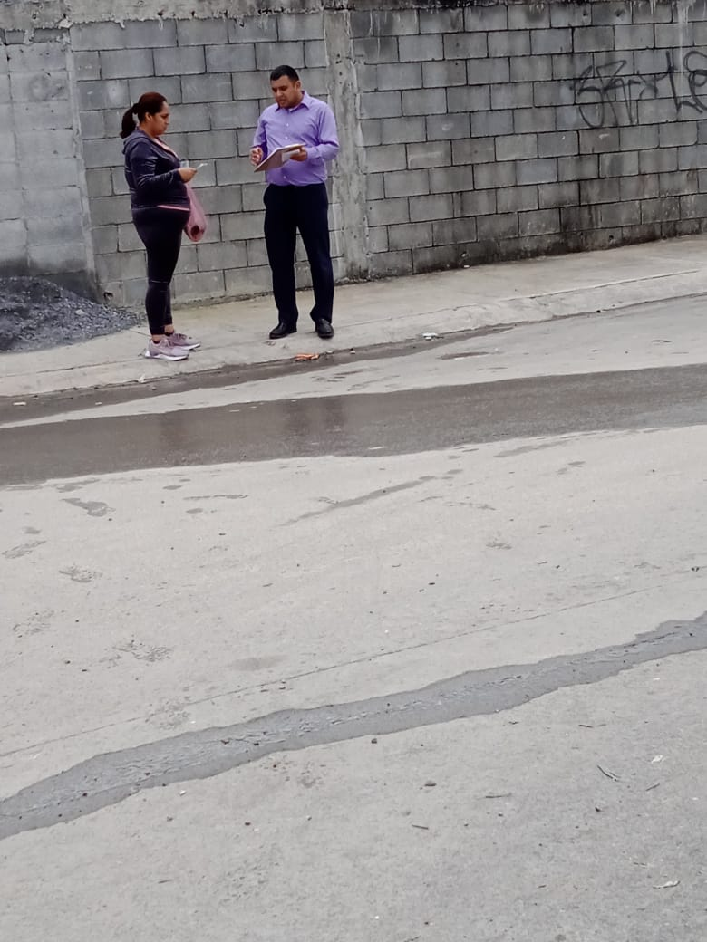
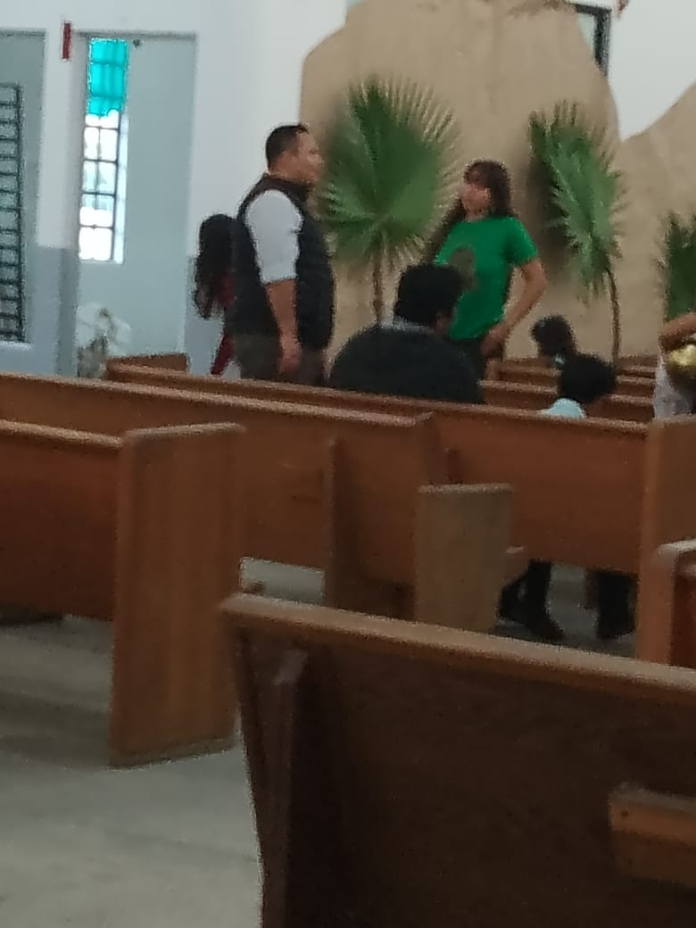
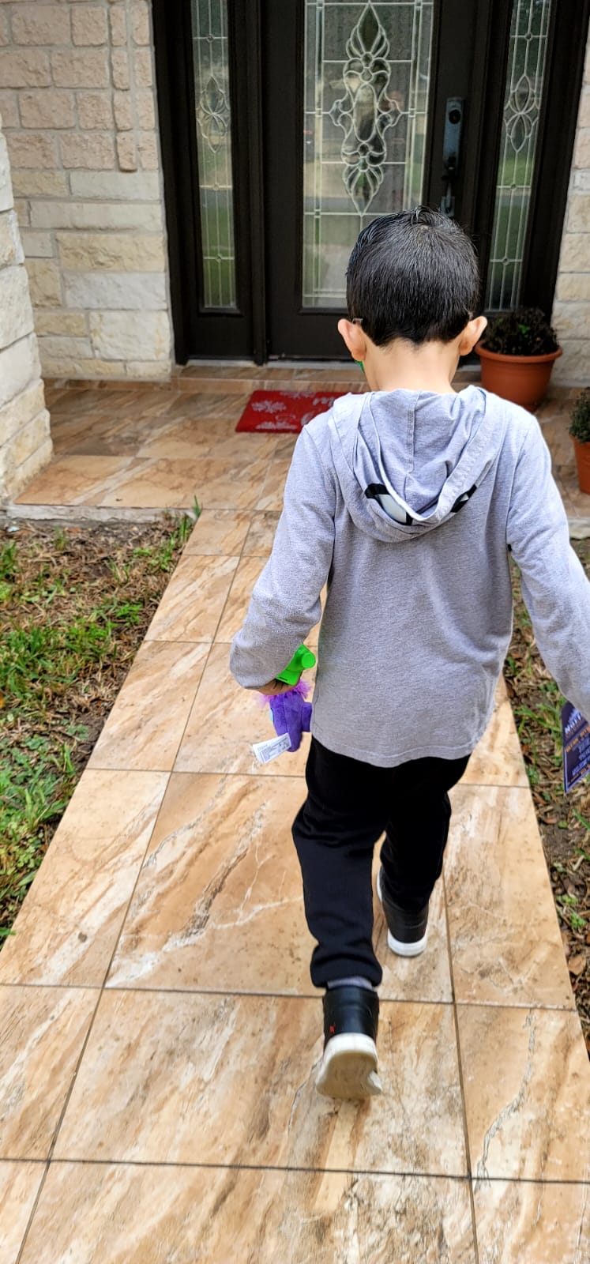
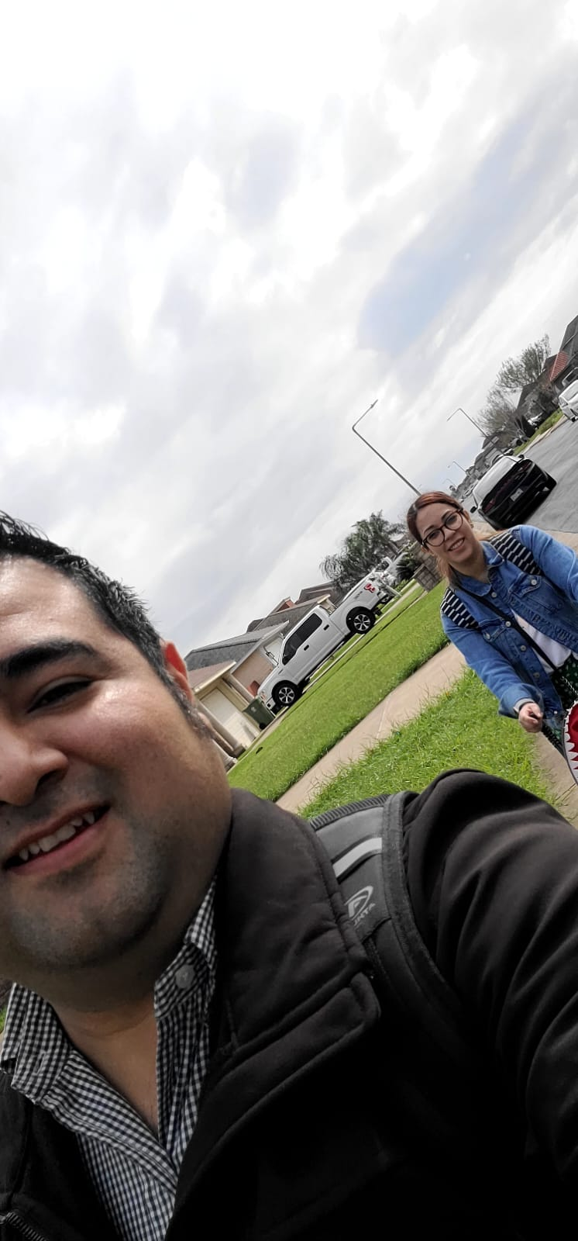
Door knocking
Door knocking is something which esually is made by the students as part of their training. It is wonderful to see our MSOP families do it for our Lord and Savior Jesus Christ

Slide 12
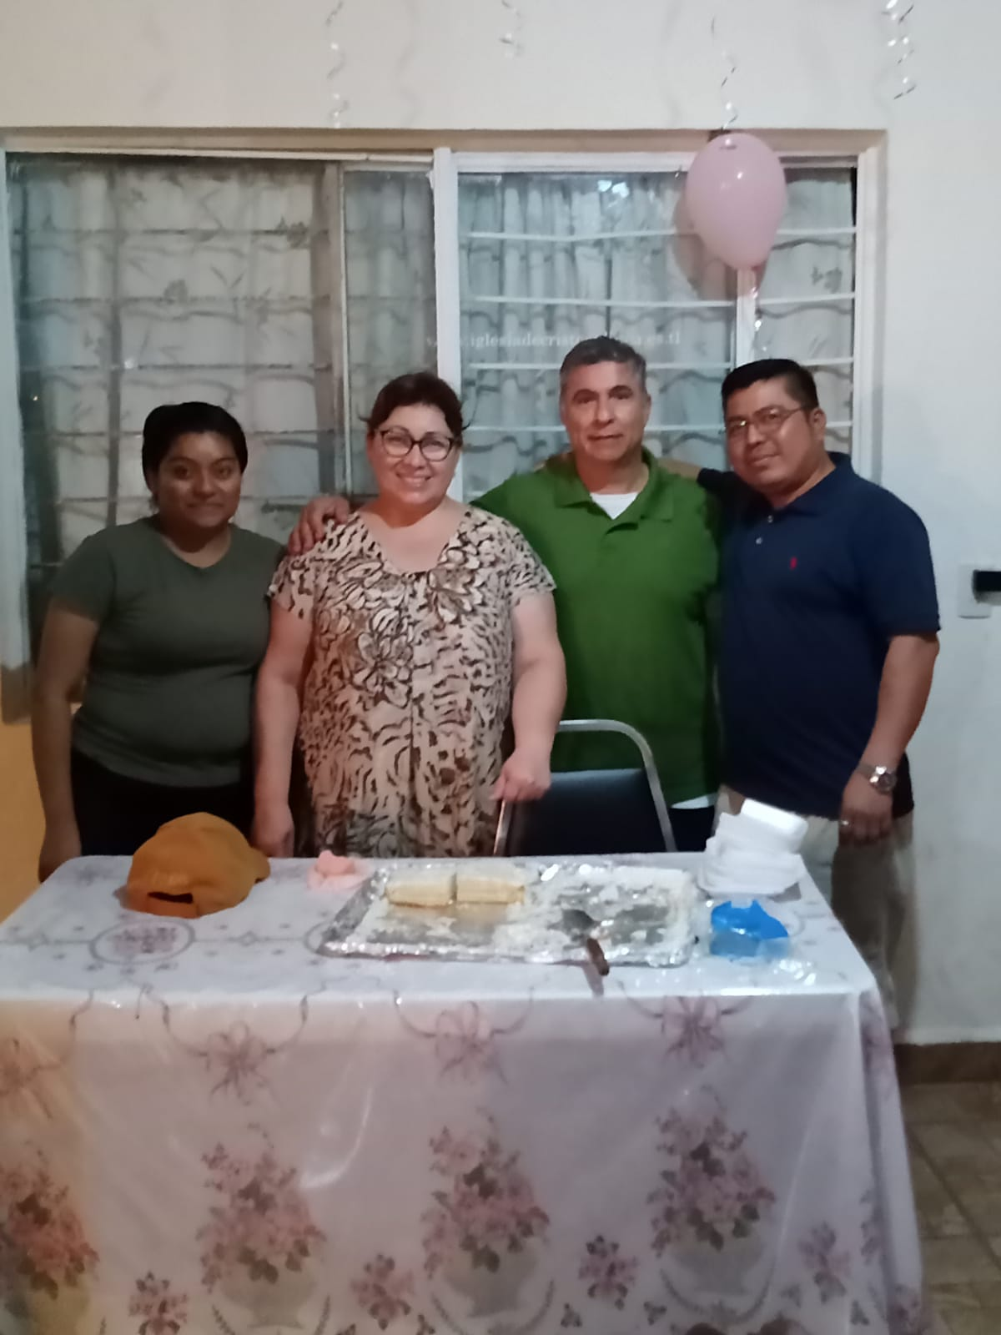
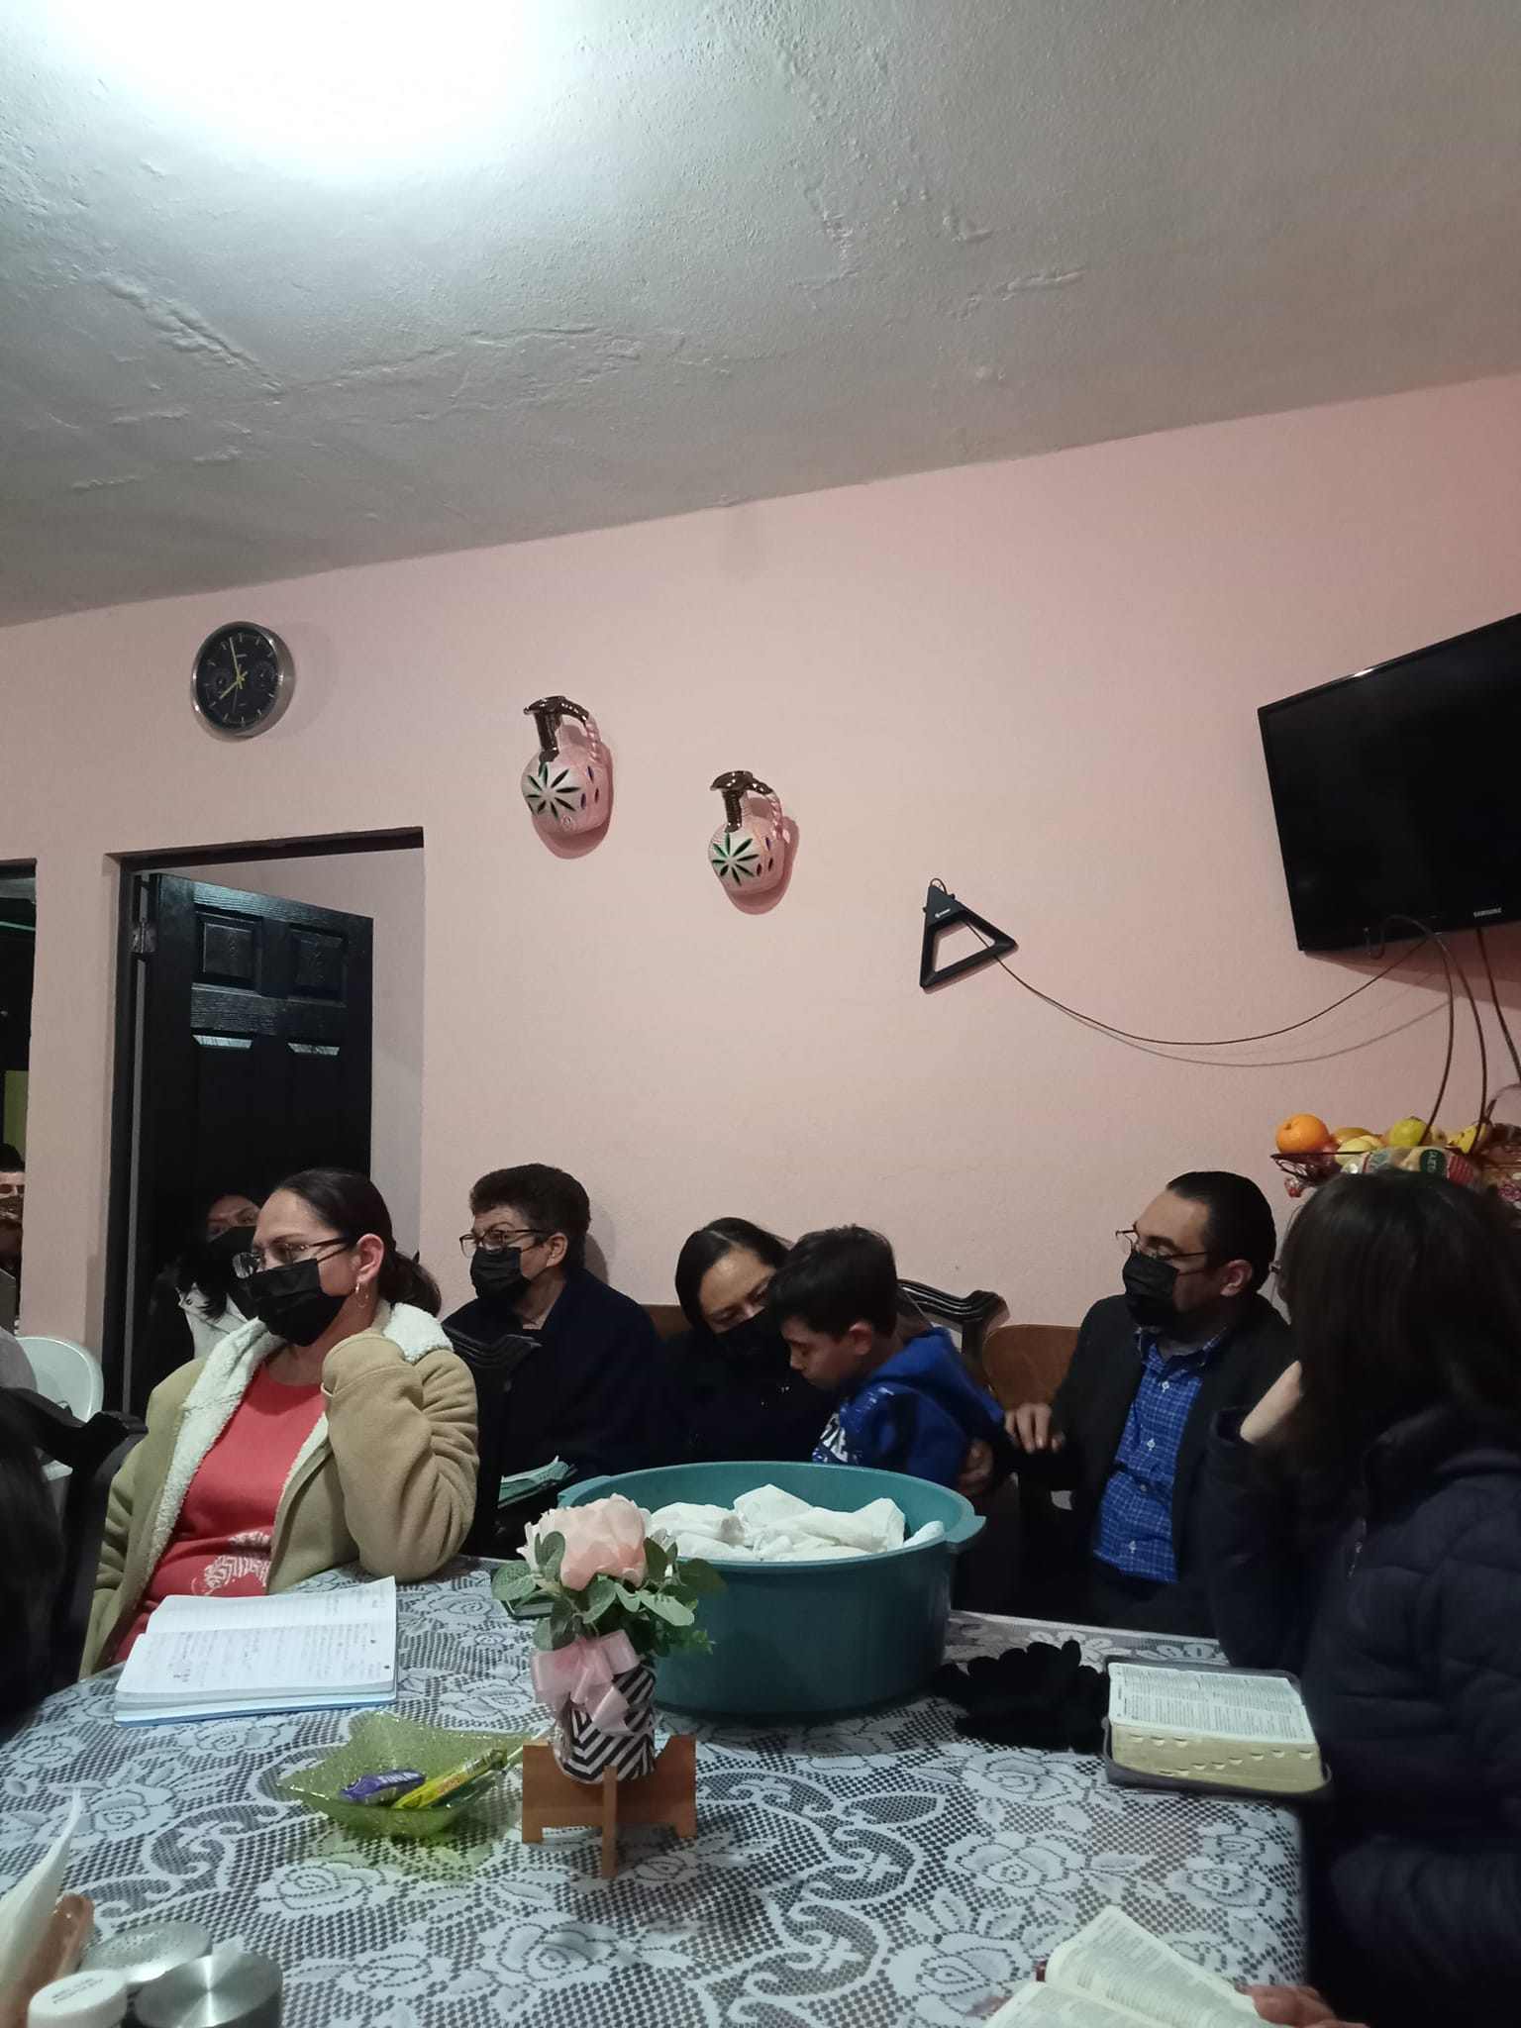
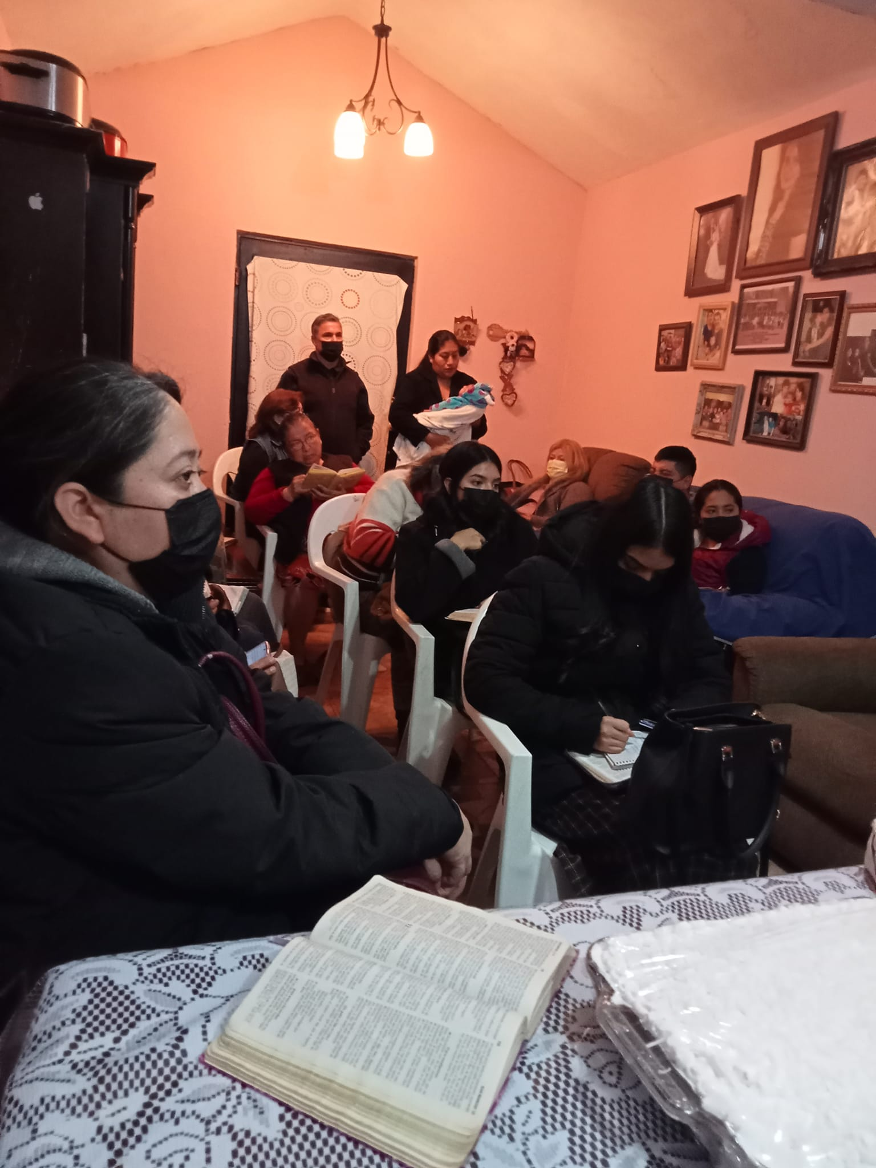
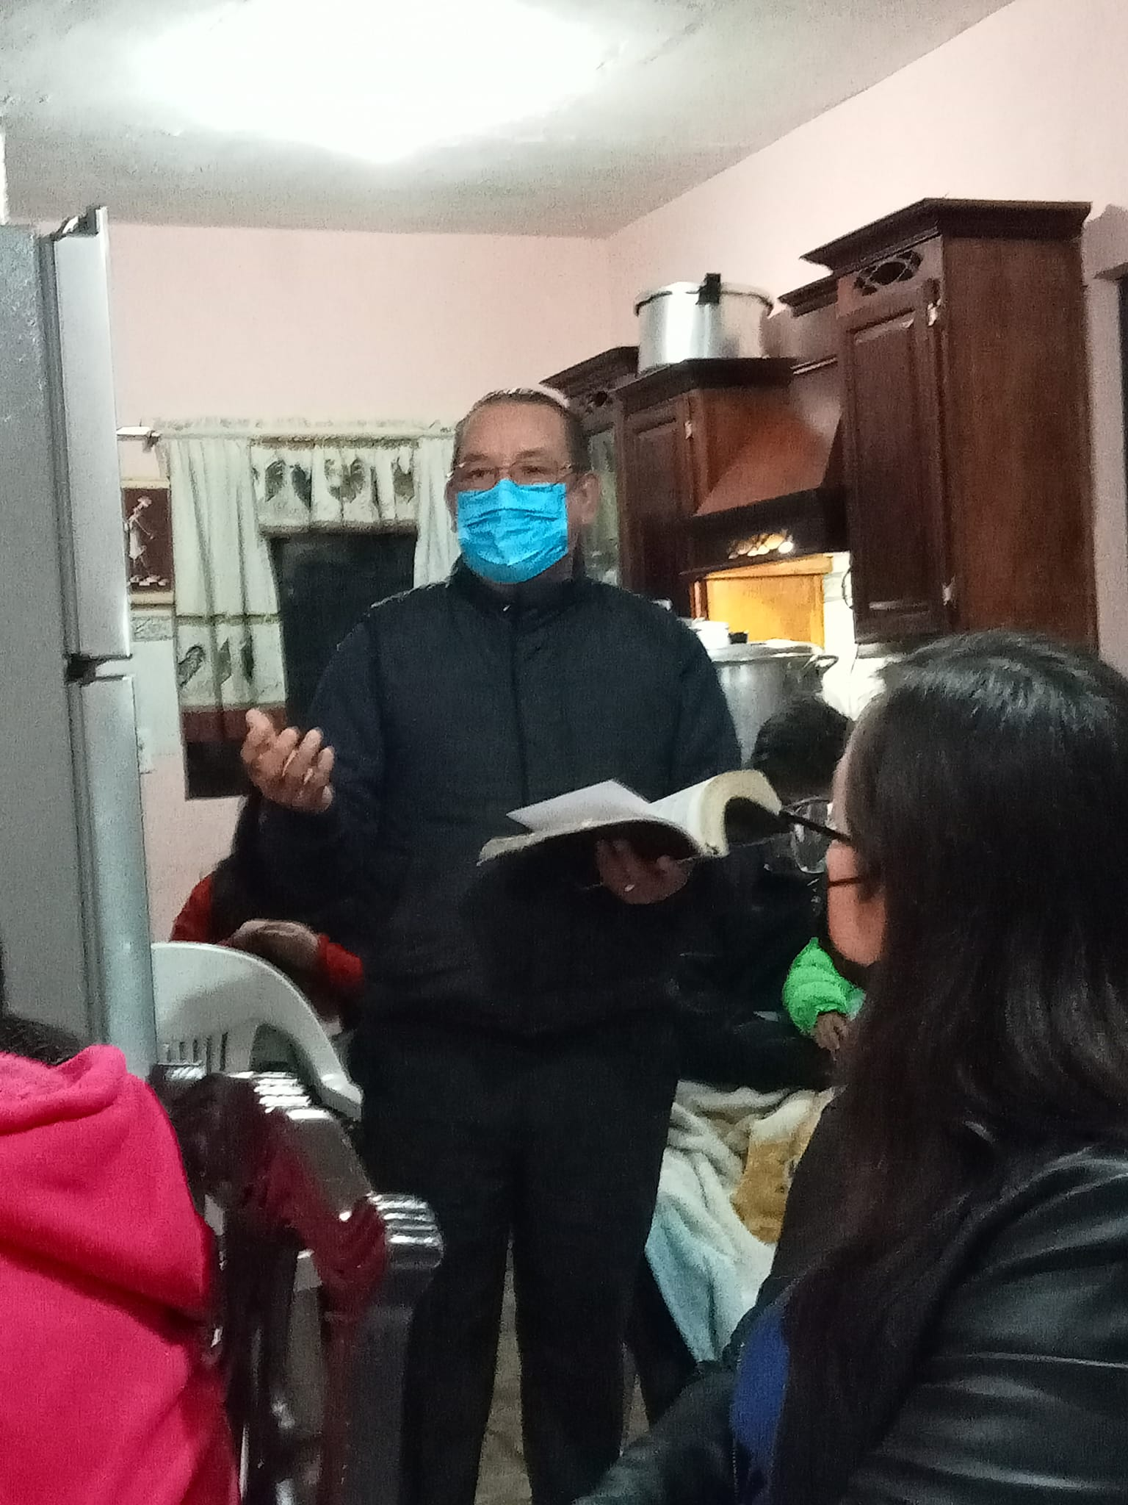
Fellowship with sierra ventana brotherhood
Sierra Ventana has been by the years a very friendly and lovely congregation. Usually they are taking care of the students and their families when they are in need. But also, they continualy are share with them fellowshoip meals in their homes.

Slide 13
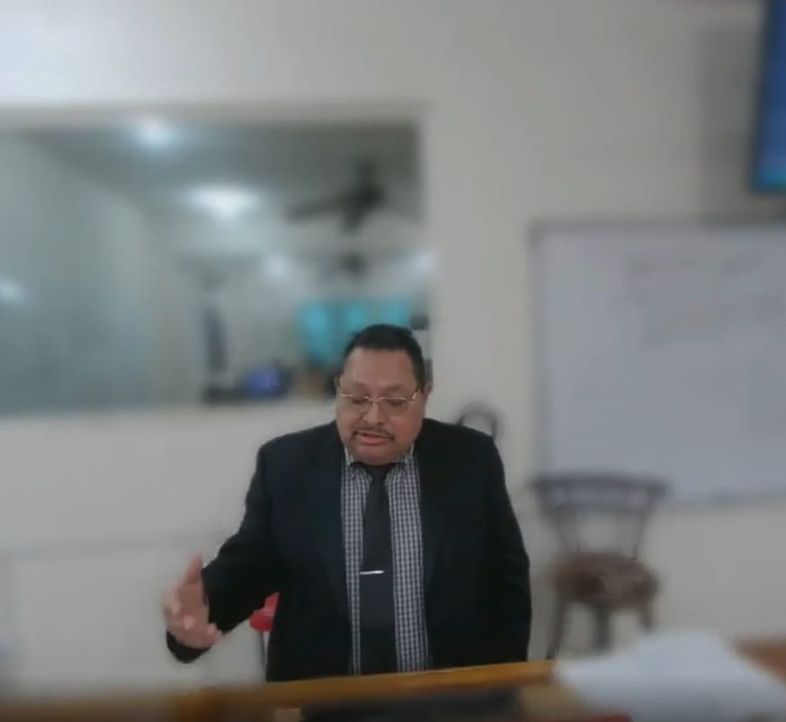
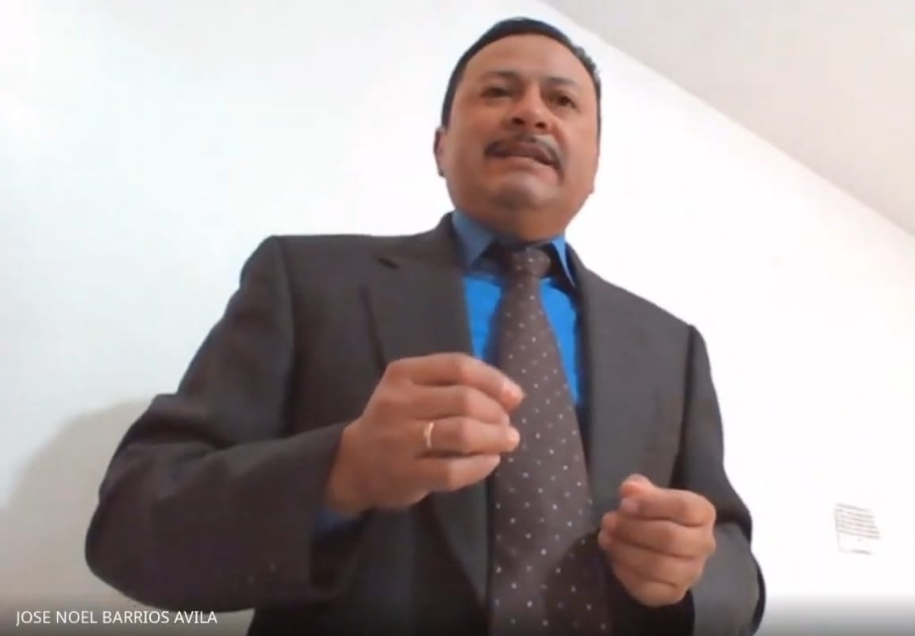
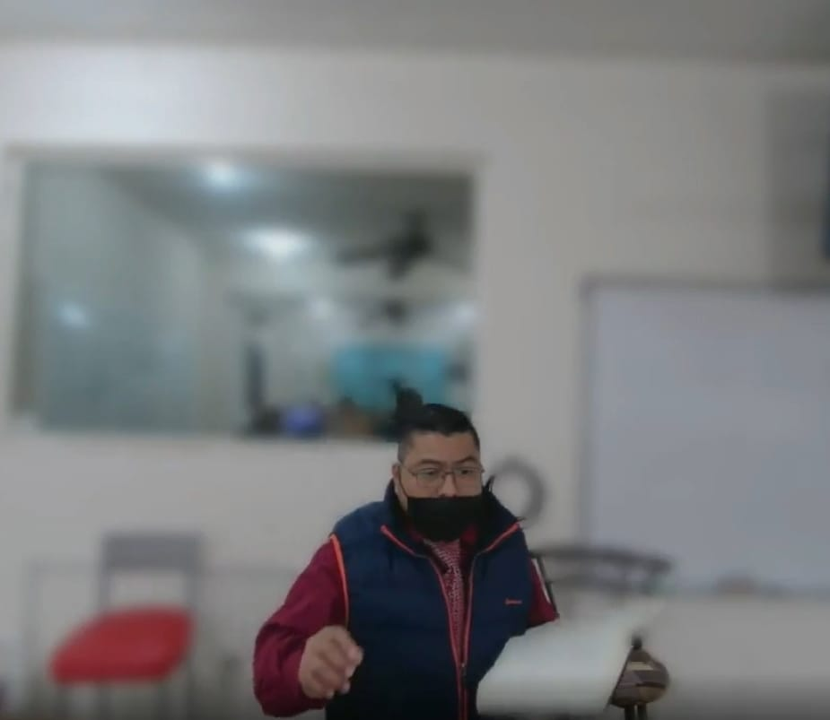
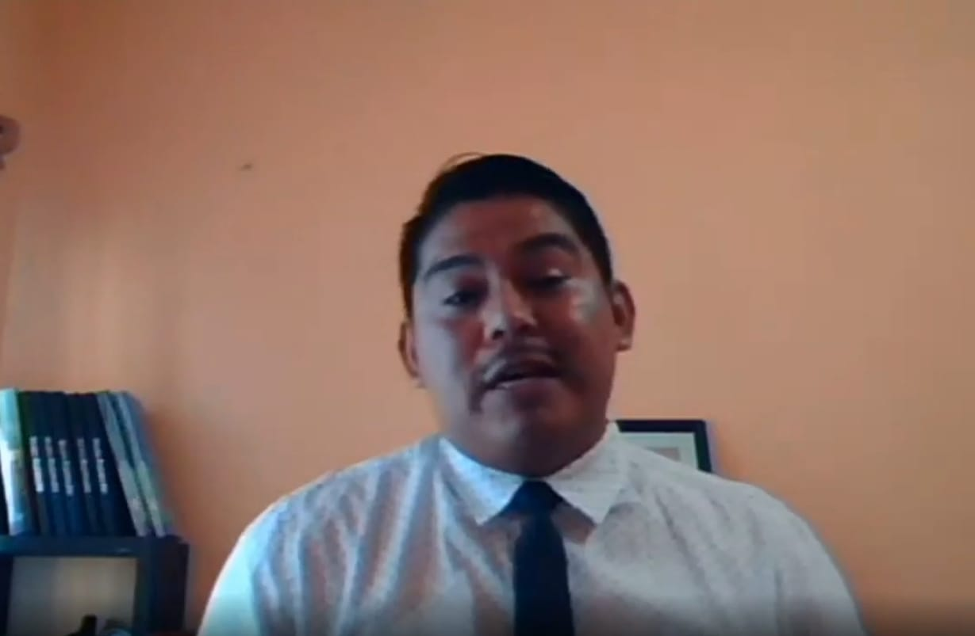
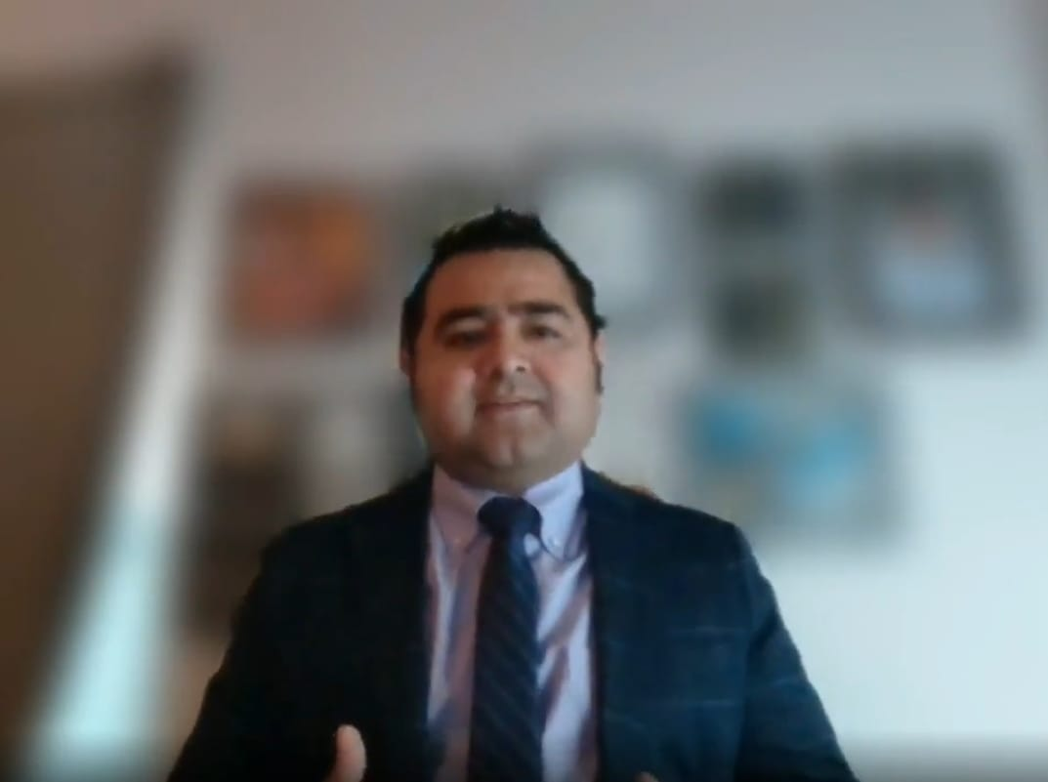
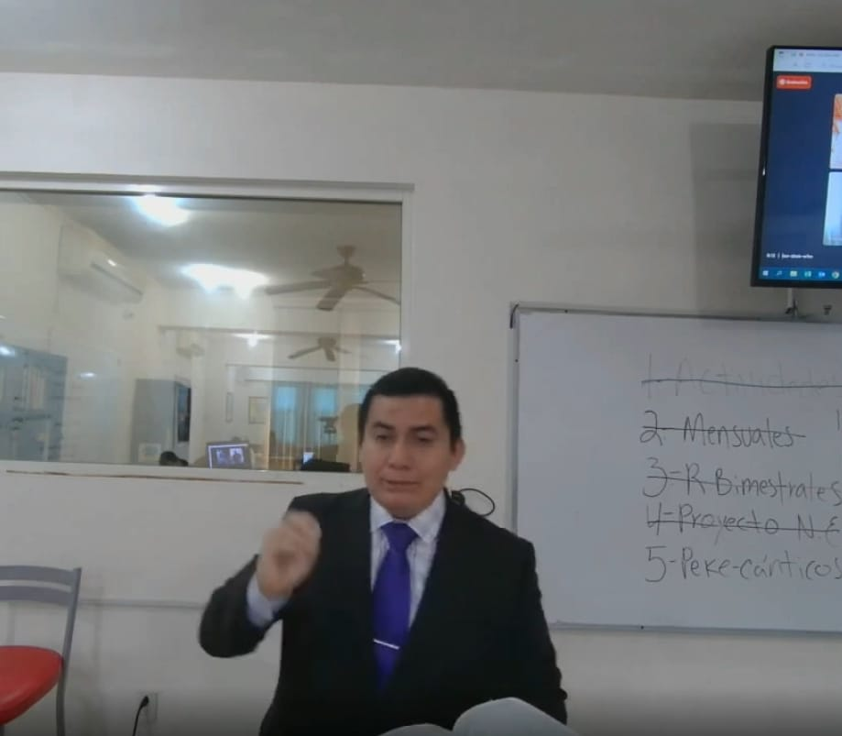
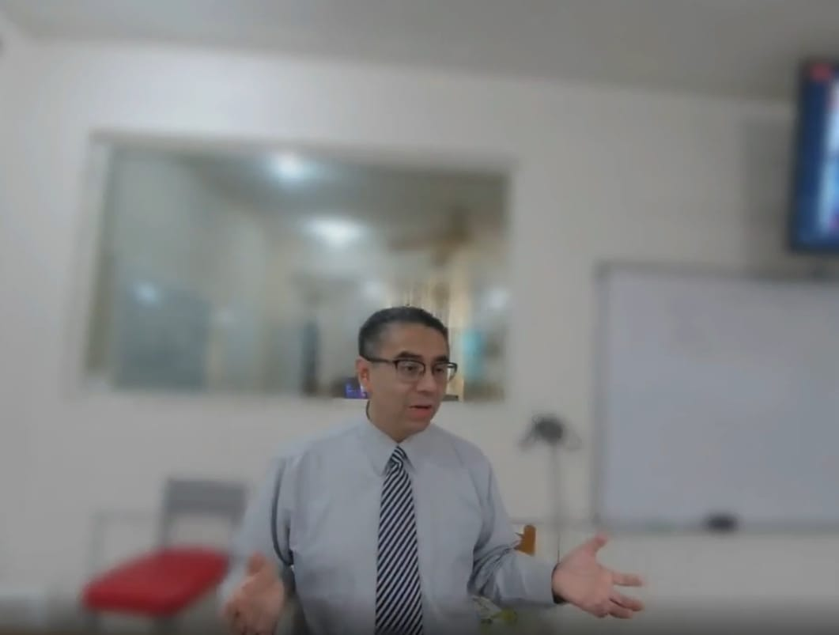
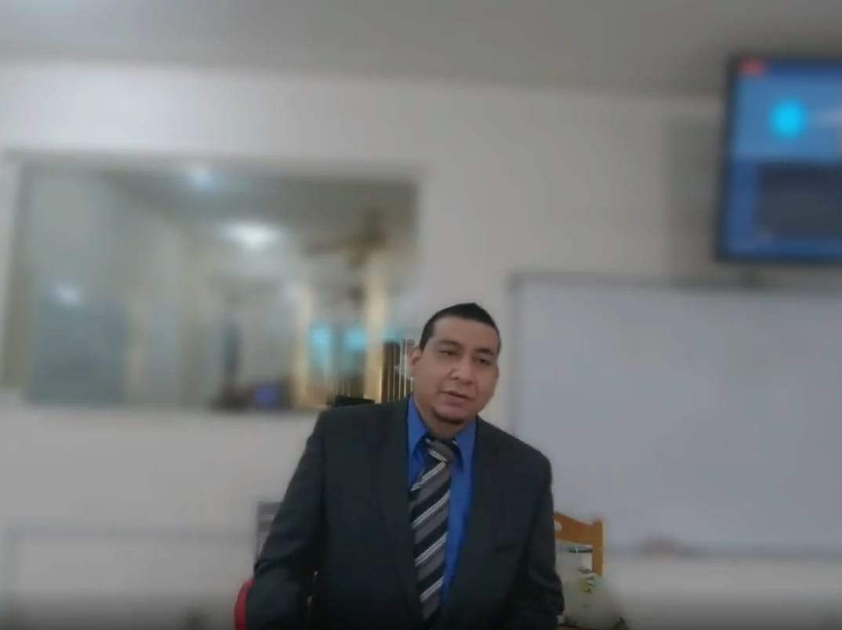
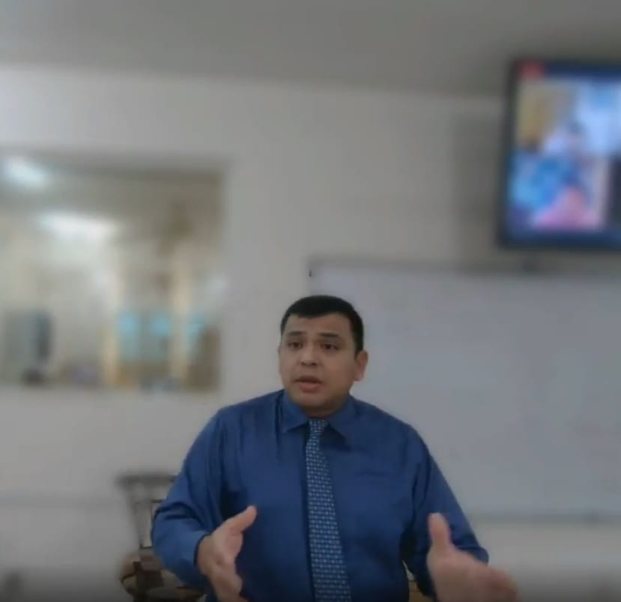
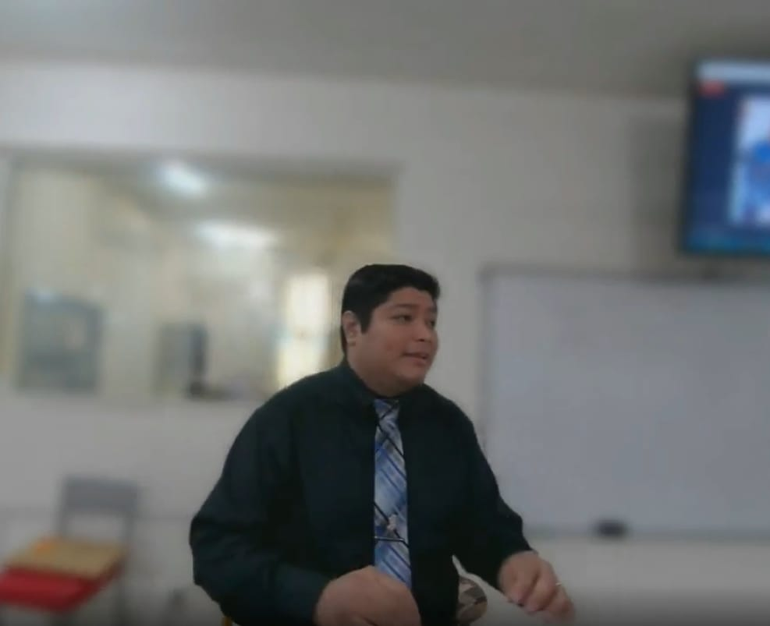
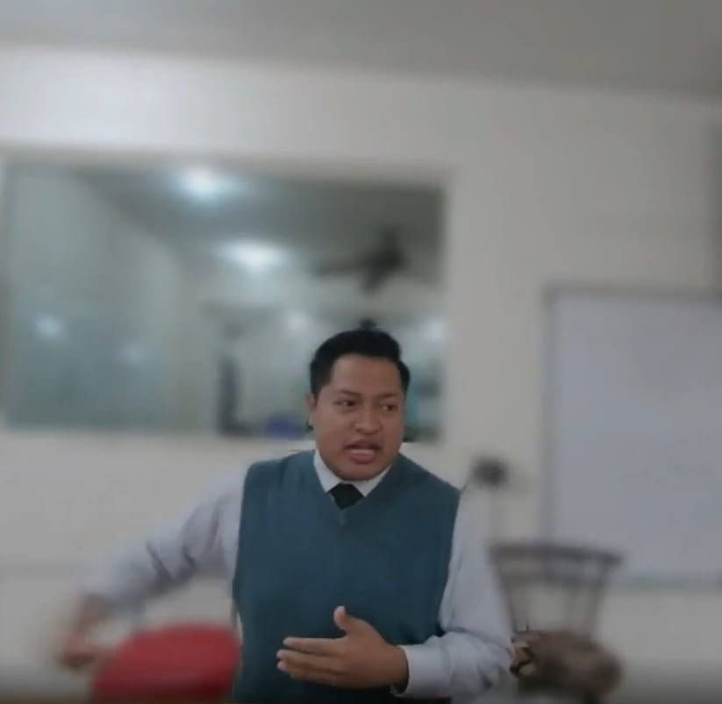
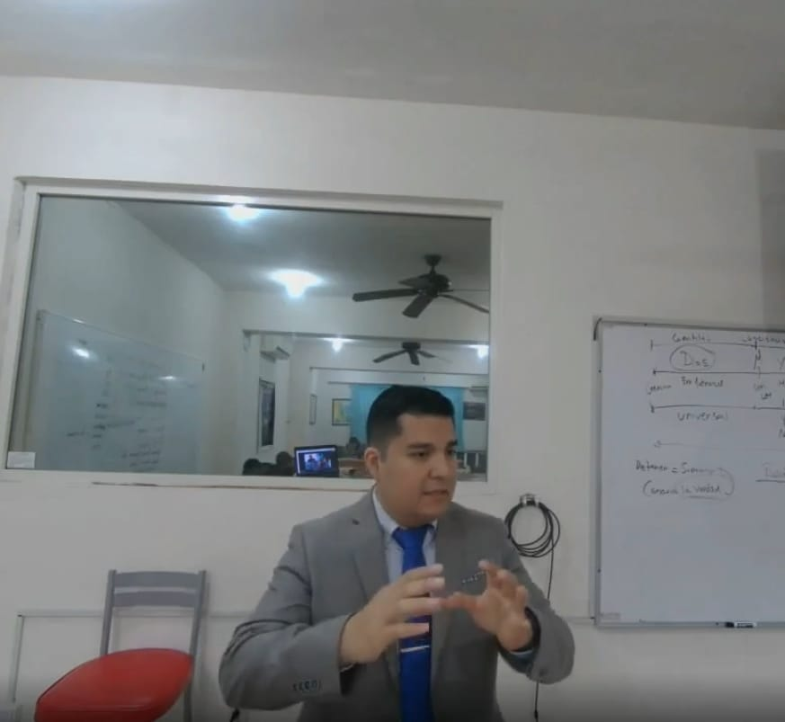
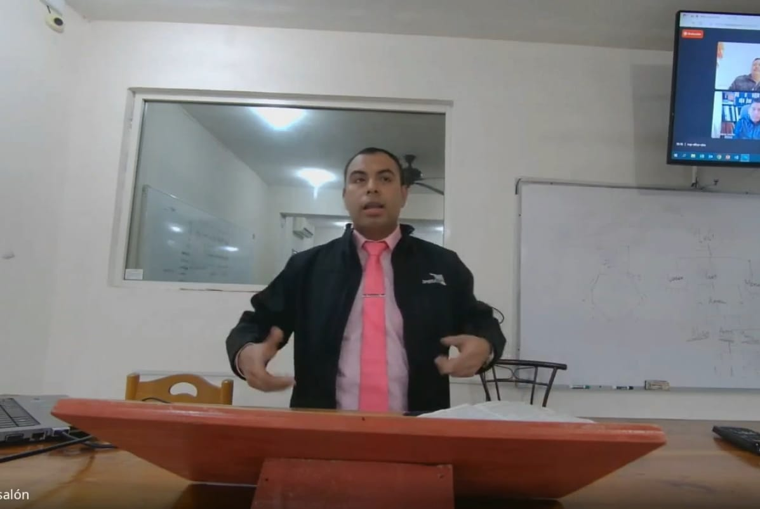
Daily Devotional at classroom
Daily Devotionals at classroom have two main purouses: 1) it lets to the student develop his preaching skills snd 2) it lets to the coplete class start the day worshiping God. During this time, instructors give counsels about the speech given by the student

Slide 14
Baptisms where msop is involved
Because of students and instructors are constantly involved in Gospel teaching, some people come to Christ and be baptized for the remission of their sins

Slide 15
Wives and their preparation

Slide 16
Lectureships
On October 2022, We had the opportunity to be at “Plateros” church of Christ in Querétaro to share God´s Word. This is the anual lectureships which this congregation are doing. Brother Luis Alonso Rodríguez y Brother Jesús Conrado Jiménez, were some of the Speakers

Slide 17
Fellowship among studentes
Students take advance of every situation to spend time together and increase their fellowship. Some times it is for eat together but also to take a study time.

Slide 18
Devotionals at Apartments

Slide 19
OUR GRATEFULNESS
We want to show you our appreciation and thankfulness for the work and support that you have given to Monterrey School of Preaching every year.
We know that without your spiritual and economic support any of this would be possible to do. We keep you all in our prayers that God may prosper you and your families forever.
We pray that God let you all to continue doing the same work for His glory an honor.
Sincerely
Jesus Conrado & Carmen Jimenez
Director

